Slide 1
RTOWG Update to TSC/WG, 1/27/21
Weekly coordination calls with Ramboll
Modeling schedule update – see next slide
Formulation of glide slope adjustments
RTOWG meeting – 12/16/20
  Columbia University GEOS-Chem results for haze on IWDW - western U.S. focus – Arlene Fiore, George Milly, others
  Verification effort for IWDW and 2014v2 results – Marco Rodriguez, Ramboll
  Updated projections write-up and FFS spec sheet – Ralph Morris, Ramboll
  Discuss schedule for delivery of results for RepBase2 and 2028OTBa2, emissions/modeling results, updated and new projections loaded on TSS, URP Adjustments – Tom and all

Slide 2
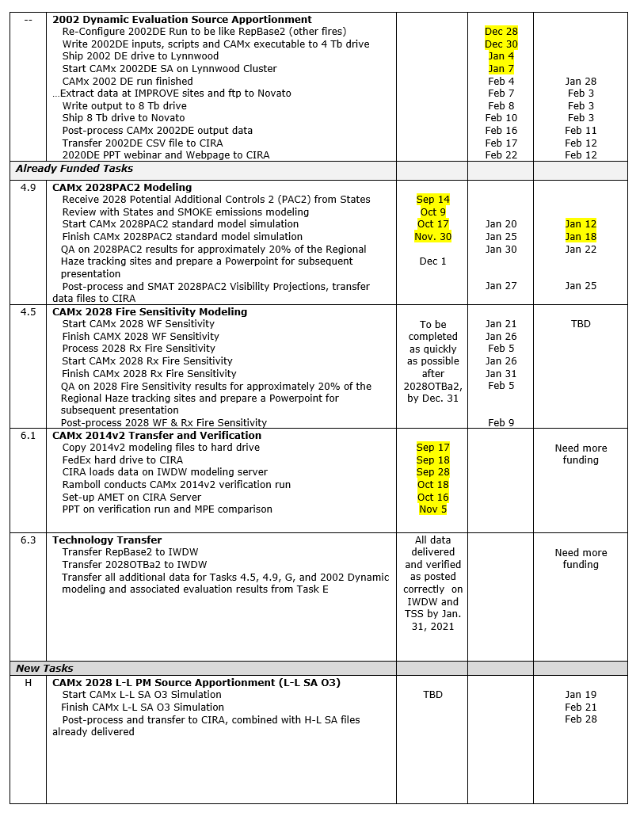
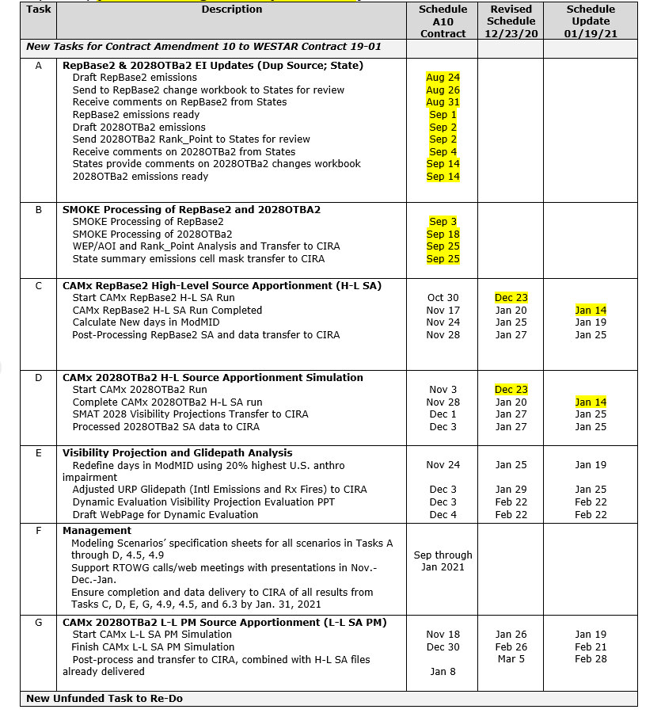
WESTAR Contract 19-01 Schedule Goals status for new Tasks A through G as well as other revised, existing Tasks in the WRAP-WAQS Regional Haze Modeling Study (Updated Jan 19, 2021; yellow shading for competed tasks).

Slide 3
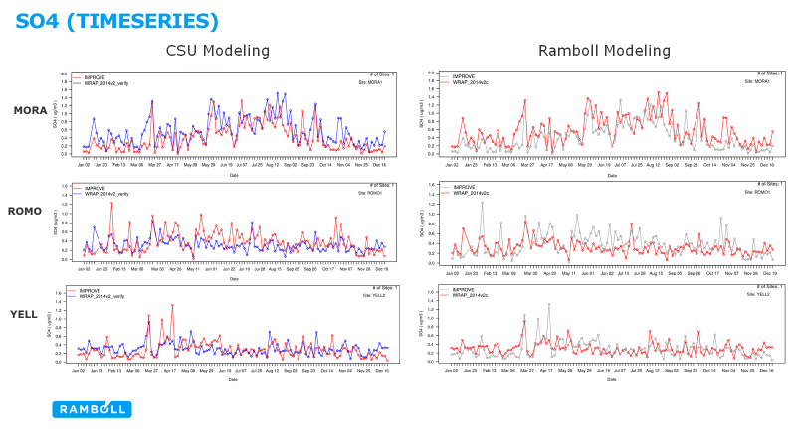
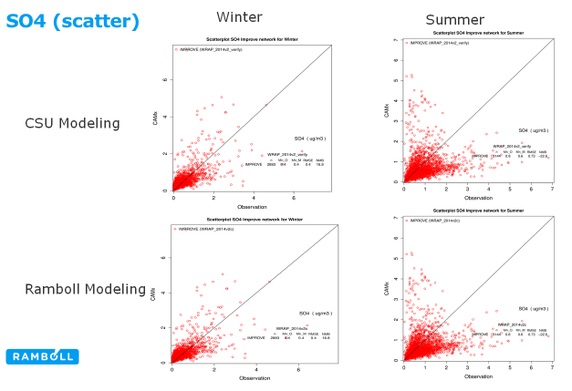
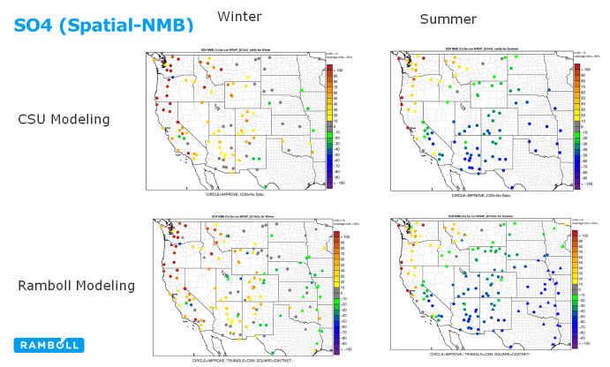
Verifying reproducibility of modeling platform
After model and inputs are installed at new site, it’s important to confirm that original simulation can be replicated
Compilers, compiler options, parallelization, hardware, file corruption, etc, can affect results
CAMx 2014v2 at Ramboll (CA) and CIRA (CO)

Slide 4

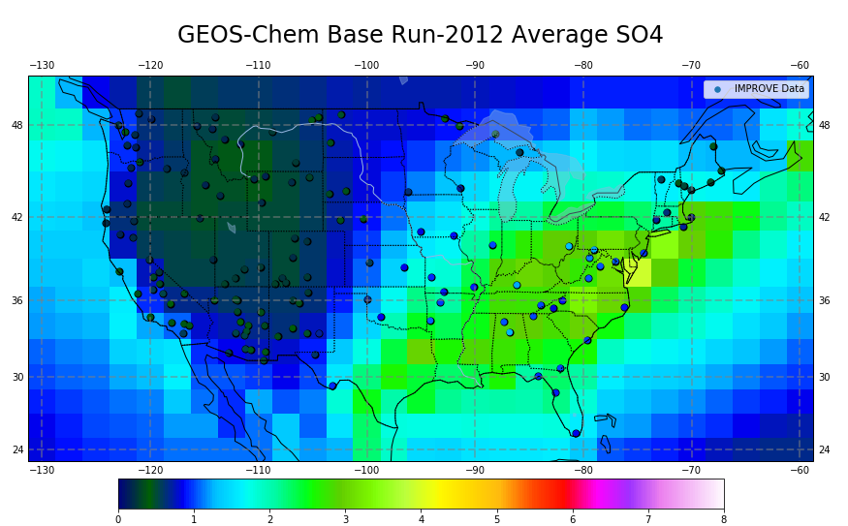
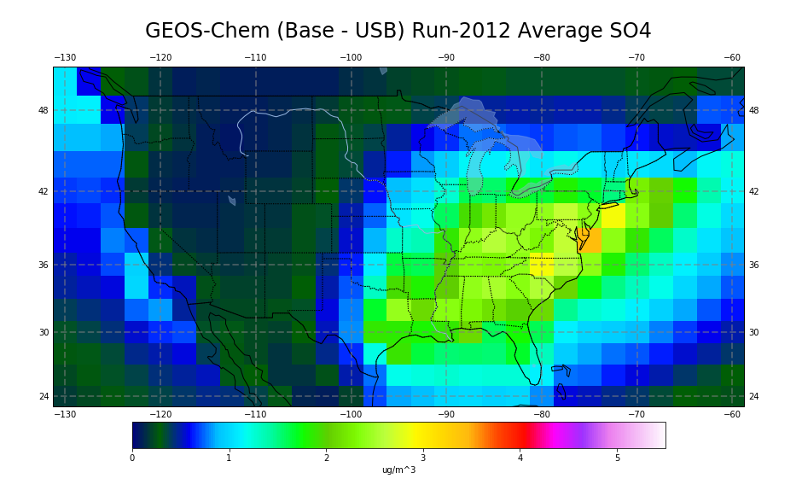
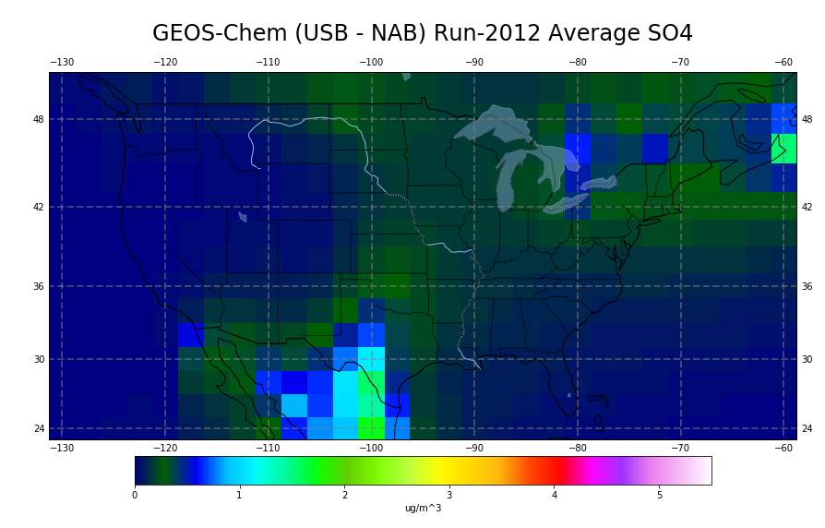
Estimating U.S. Anthrop & Canada+Mexico
influence on haze (SULFATE) with sensitivity simulations
BASE SIMULATION (2012)
U.S. ANTHROPOGENIC INFLUENCE
From Arlene Fiore’s 12/16/20
presentation to the WRAP RTOWG
CANADA + MEXICO INFLUENCE
0 1 2 3 4 5 6 7 8 μg m⁻³
sulfate
Model indicates U.S. anthropogenic emissions are dominant sulfate influence except near Mexican border with TX in the model
0 1 2 3 4 5 μg m⁻³
sulfate
*We have these plots for PM_{2.5} and components 2004-2012 (GCv9.02)
Erik Helstom LDEO; Simulations from Guo et al., ACP 2018

Slide 5
TSC Update on Ramboll modeling results
2028OTBa2 and 2028PAC2 projections
RepBase2 and 2028OTBa2 source apportionment
Adjustments to 2064 endpoints to Uniform Rate of Progress Glidepath

Slide 6
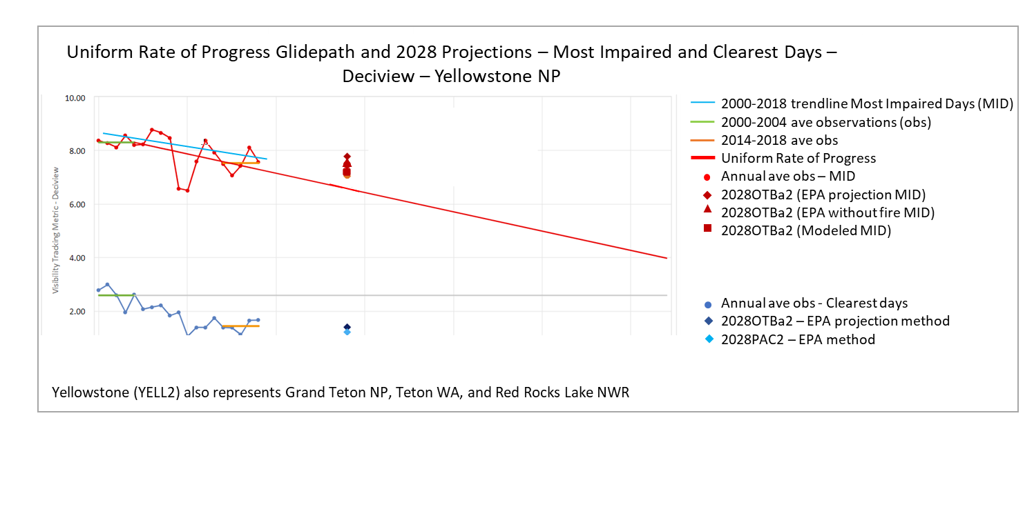
2028OTBa2 Projections delivery: EPA default projection method
TSS Modeling Express Chart 4
7.1
1.2

Slide 7
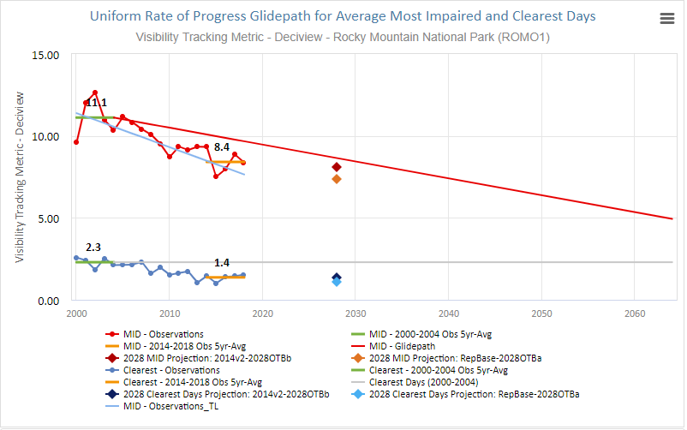
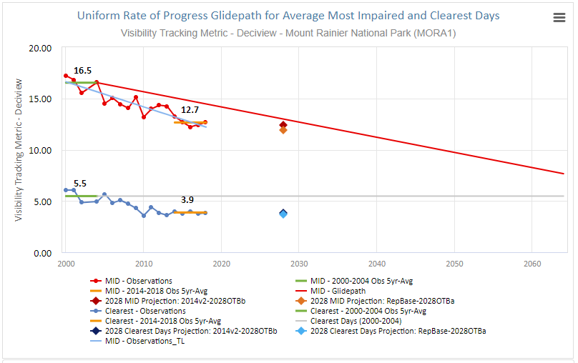
2028OTBa2 Projections: EPA default projection method
Rocky Mountain NP
Sites influenced by urban areas
7.6
Mount Rainier NP
1.2
12.0
3.7

Slide 8
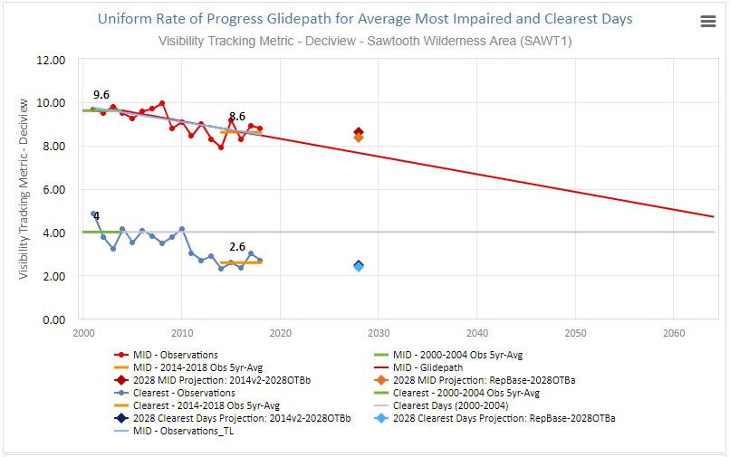
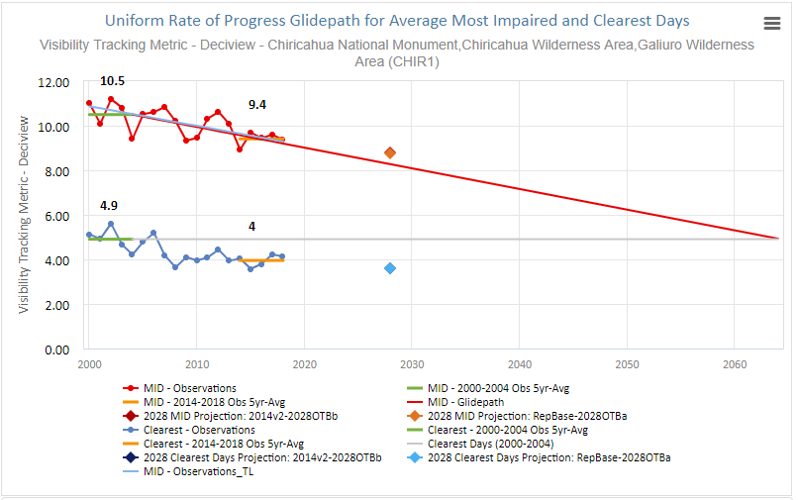
2028OTBa2 Projections: EPA default projection method
Sawtooth NF
8.4
2.4
Chiricahua NM
8.9
8.9
Contributions from fires or international sources
complicate demonstration of progress from
reducing US anthropogenic emissions
3.6
3.6

Slide 9
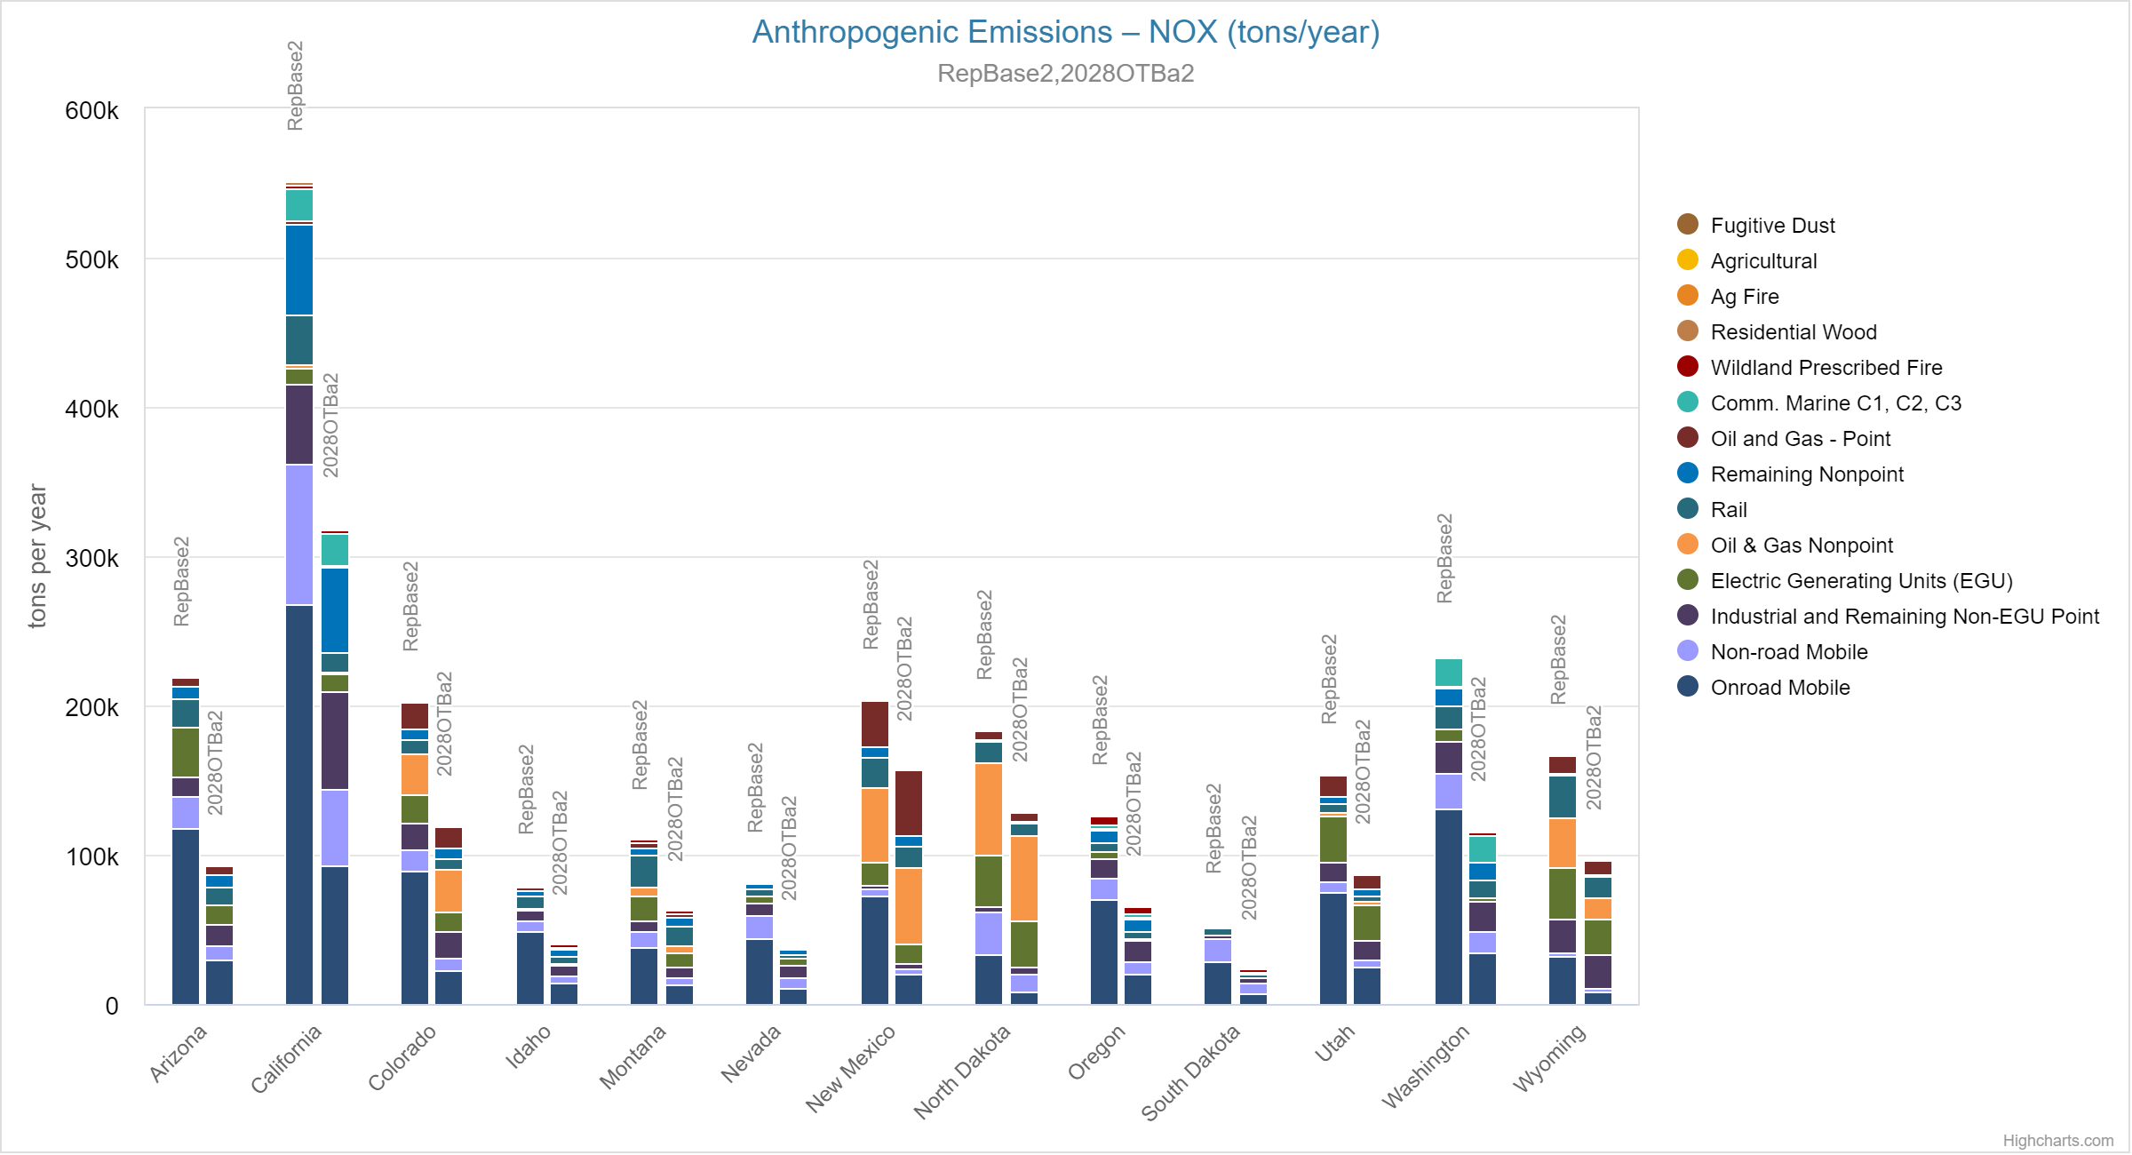
WRAP Anthropogenic NOx Emissions RepBase2 to 2028OTBa2
TSS Emissions Express Chart 1

Slide 10
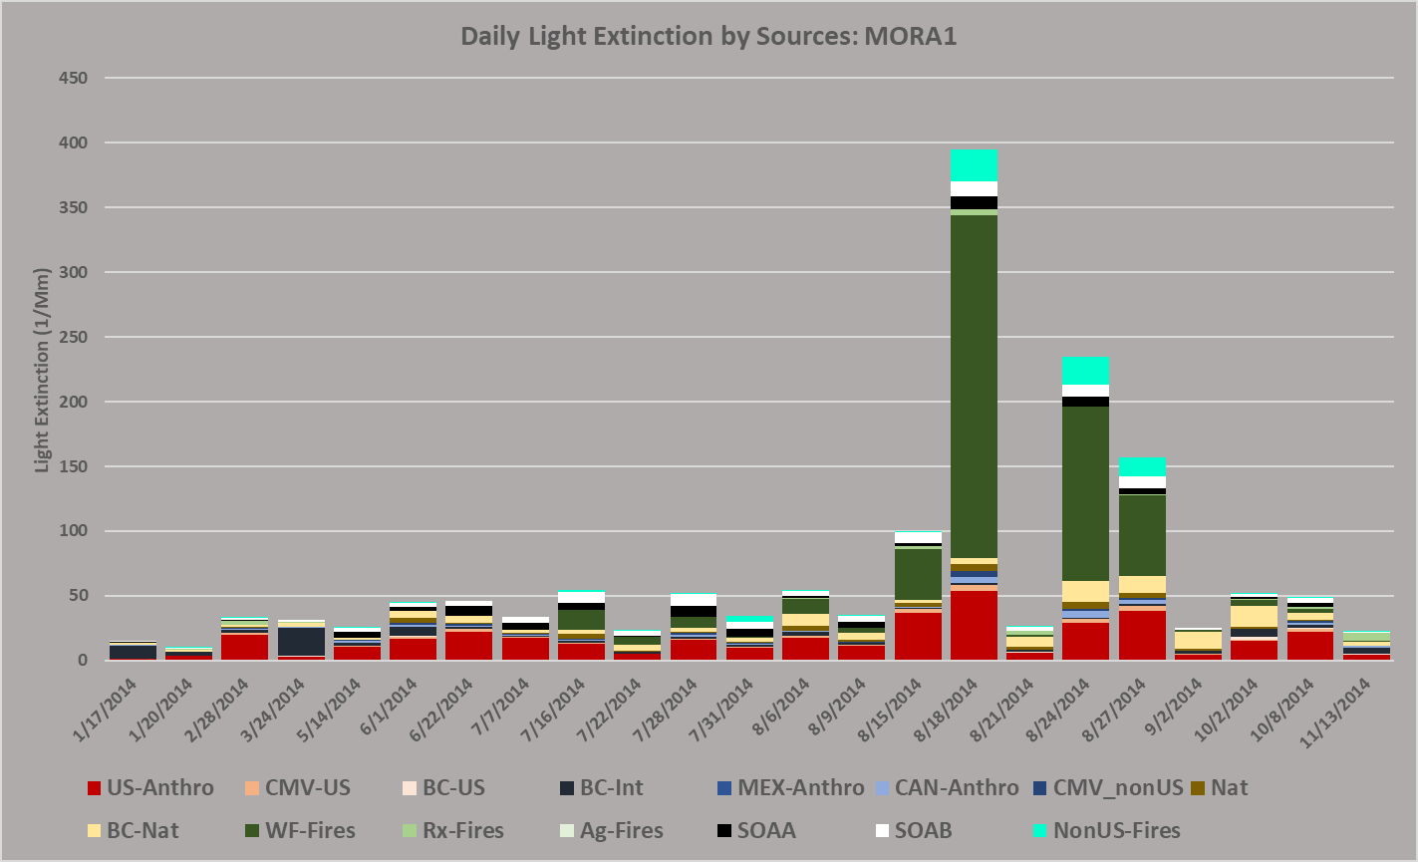
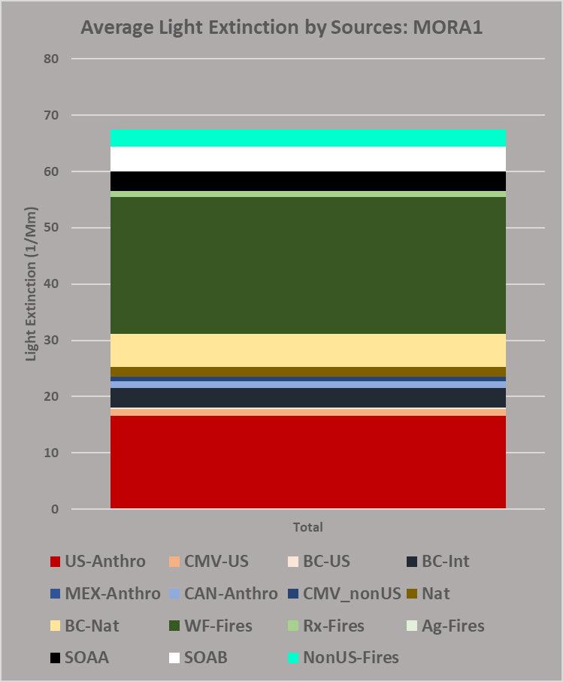
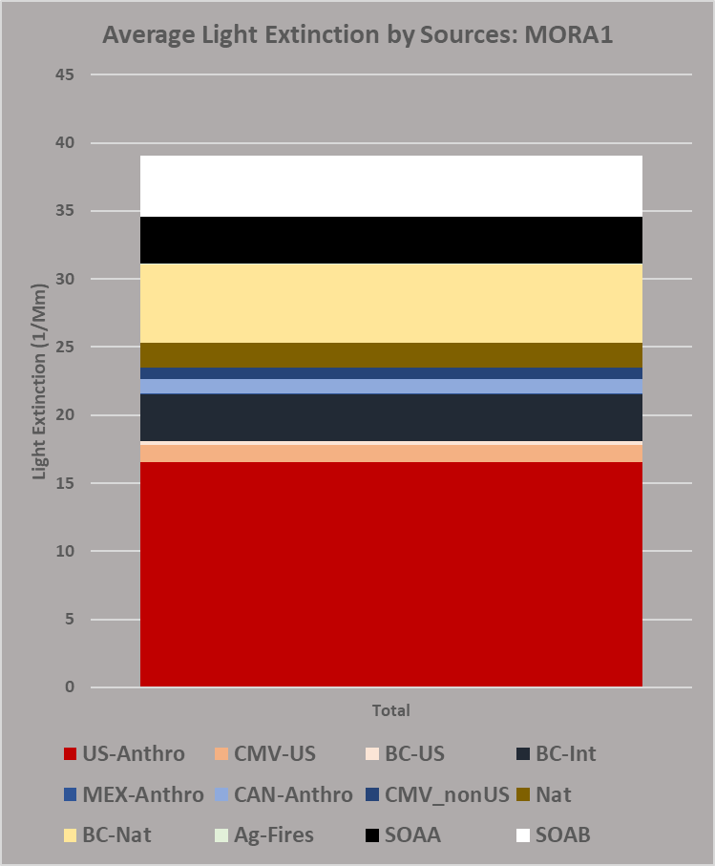
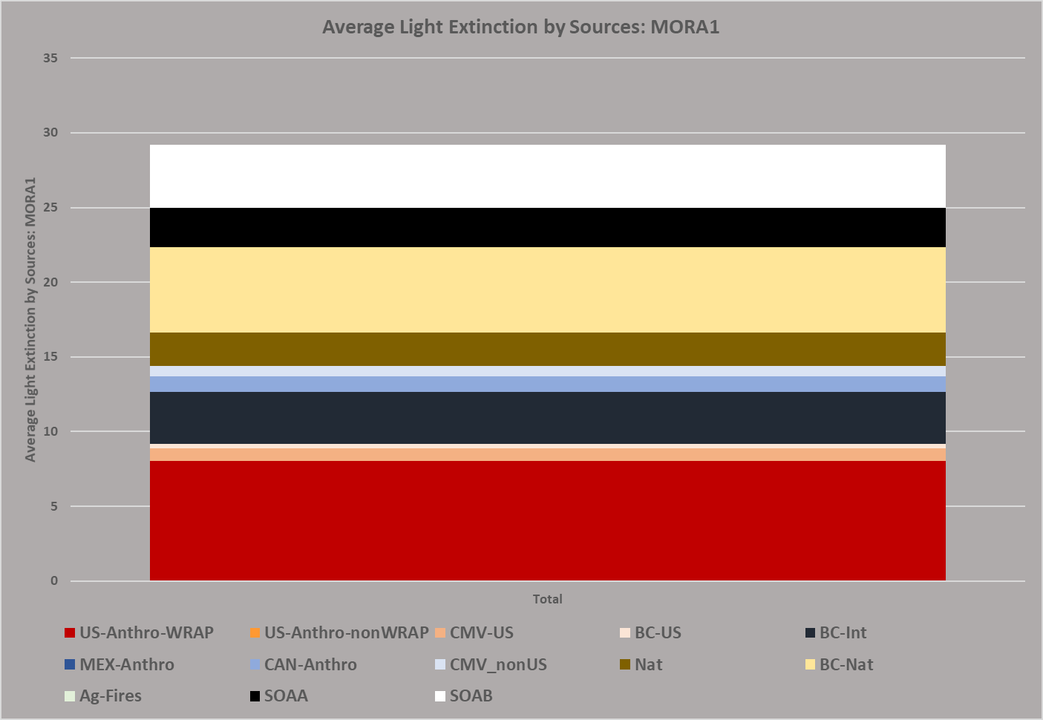
Source Apportionment: RepBase2 and 2028OTBa2
Source apportionment identifies contributions:
U.S. Anthropogenic
International Anthropogenic
Natural
U.S. wildfire + wildland prescribed fire +non-U.S fire
RepBase2 source apportionment informs alternative 2028 projection method: “EPA without fire”
Mount Rainier NP – EPA most impaired days – RepBase2
RepBase2
“EPA without fire” projection method
removes RepBase2 fire contributions
2028OTBa2 source apportionment:
only U.S. anthro emissions change
RepBase2
__ 30 Mm⁻¹__
__ 30 Mm⁻¹__
2028OTBa2
US Anthro = 18.1 Mm⁻¹
= 27% total
US Anthro = 18.1 Mm⁻¹
= 46% total
US Anthro = 9.2 Mm⁻¹
Relative response factors for each aerosol species are applied to 2014-2018 IMPROVE data to project 2028OTBa2 results compared to Uniform Rate of Progress glicepath.

Slide 11
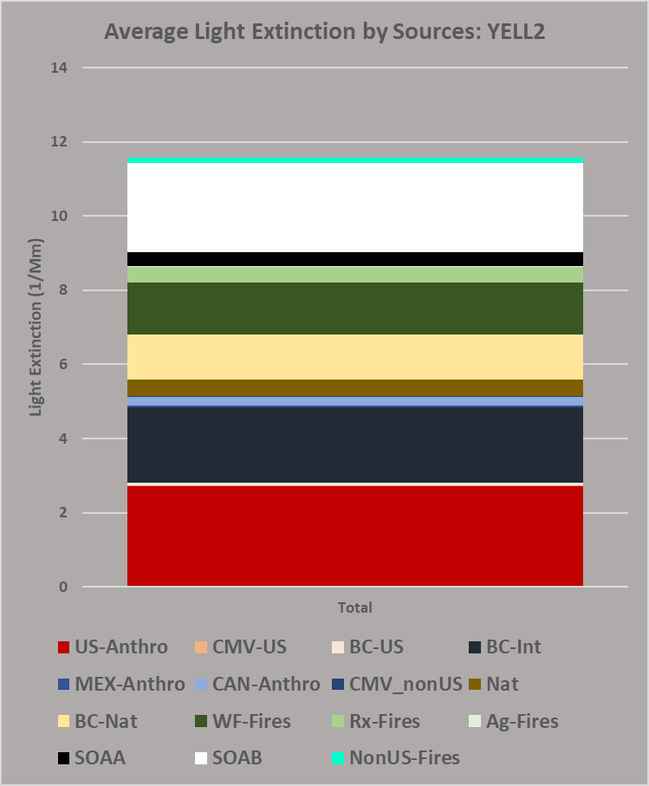
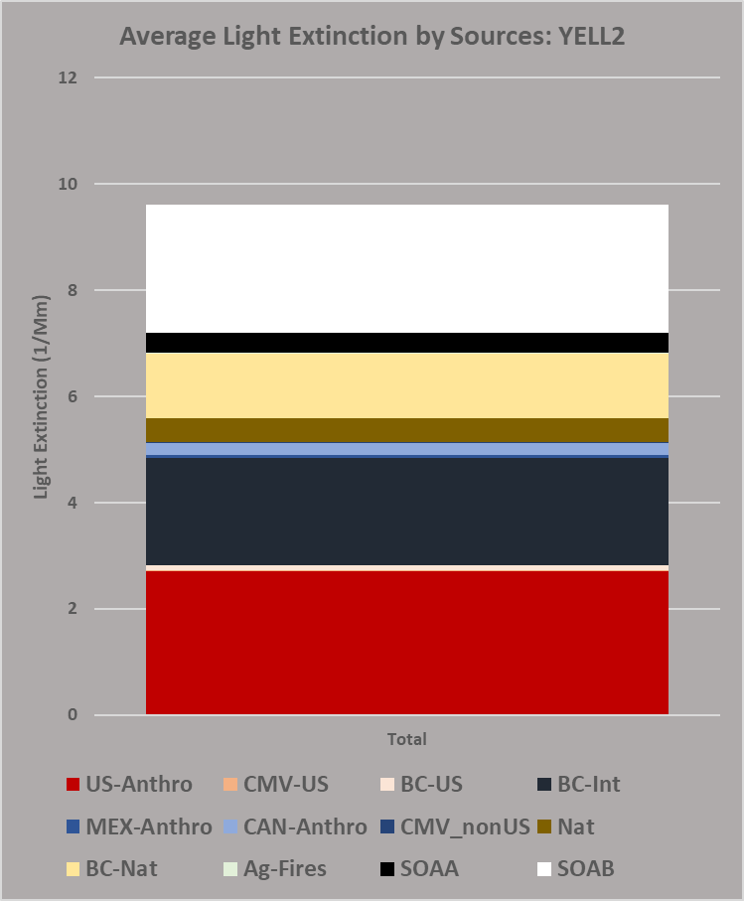
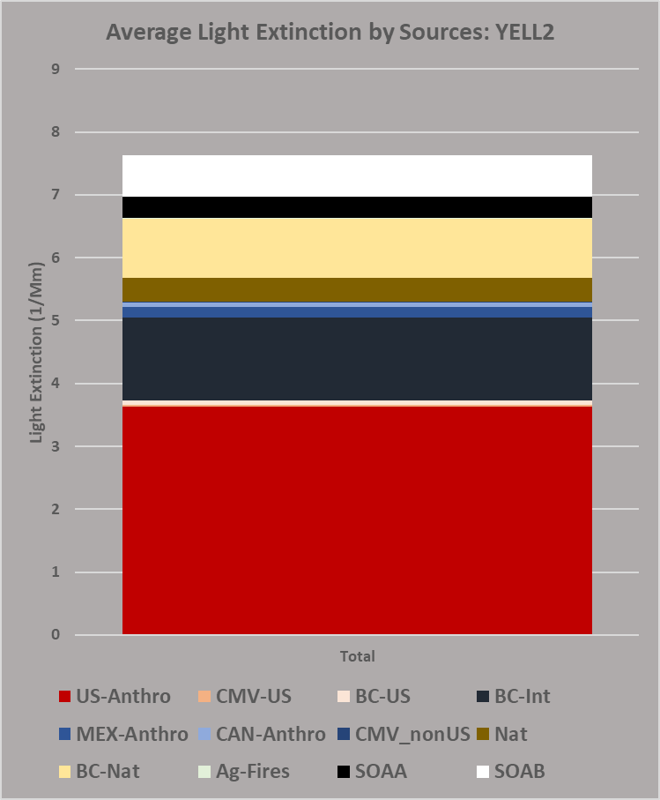
Alternative projection methods based on RepBase2 source apportionment: focus on U.S. anthropogenic contributions to haze
“EPA without fire” projection method retains EPA Most Impaired Days and removes contributions from U.S. wildfire, U.S. wildland prescribed fire, and non-U.S. fires (from RepBase2 source apportionment.)
“Modeled MID” projection method selects days with highest modeled US anthropogenic impairment
EPA MID (Most Impaired Days)
Yellowstone NP
EPA MID without fire
Yellowstone NP
ModMID (Modeled U.S. MID are
different days than EPA MID, no fire)
Yellowstone NP
RepBase2
RepBase2
__ 8 Mm⁻¹__
__ 8 Mm⁻¹__
RepBase2
US Anthro = 24%
US Anthro = 29%
US Anthro = 49%

Slide 12
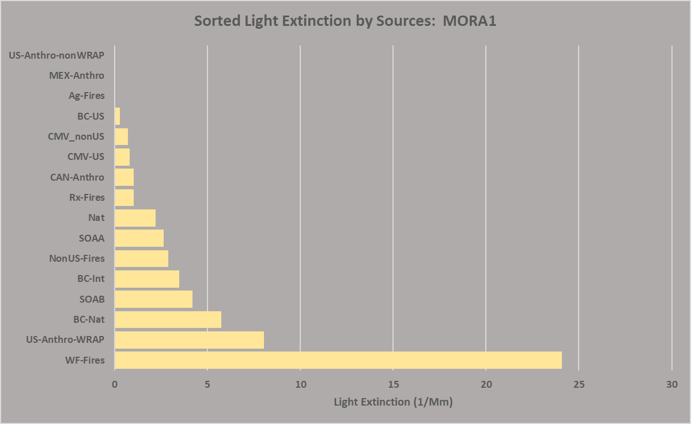
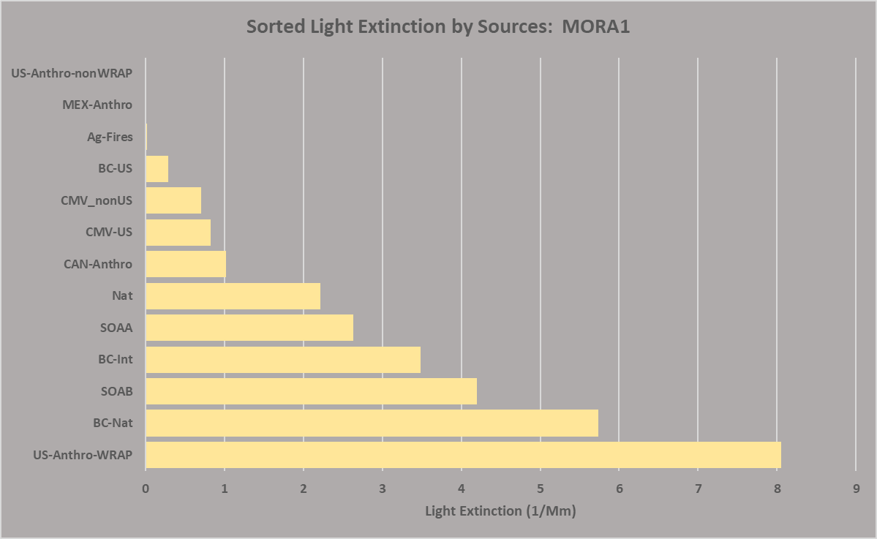
2028OTBa2 Source Apportionment: rank source contributions
Mount Rainier NP – EPA most impaired days
Mount Rainier NP – EPA most impaired days without fire
Low level source apportionment to be delivered in Feb 2021 will include state and sector contributions

Slide 13
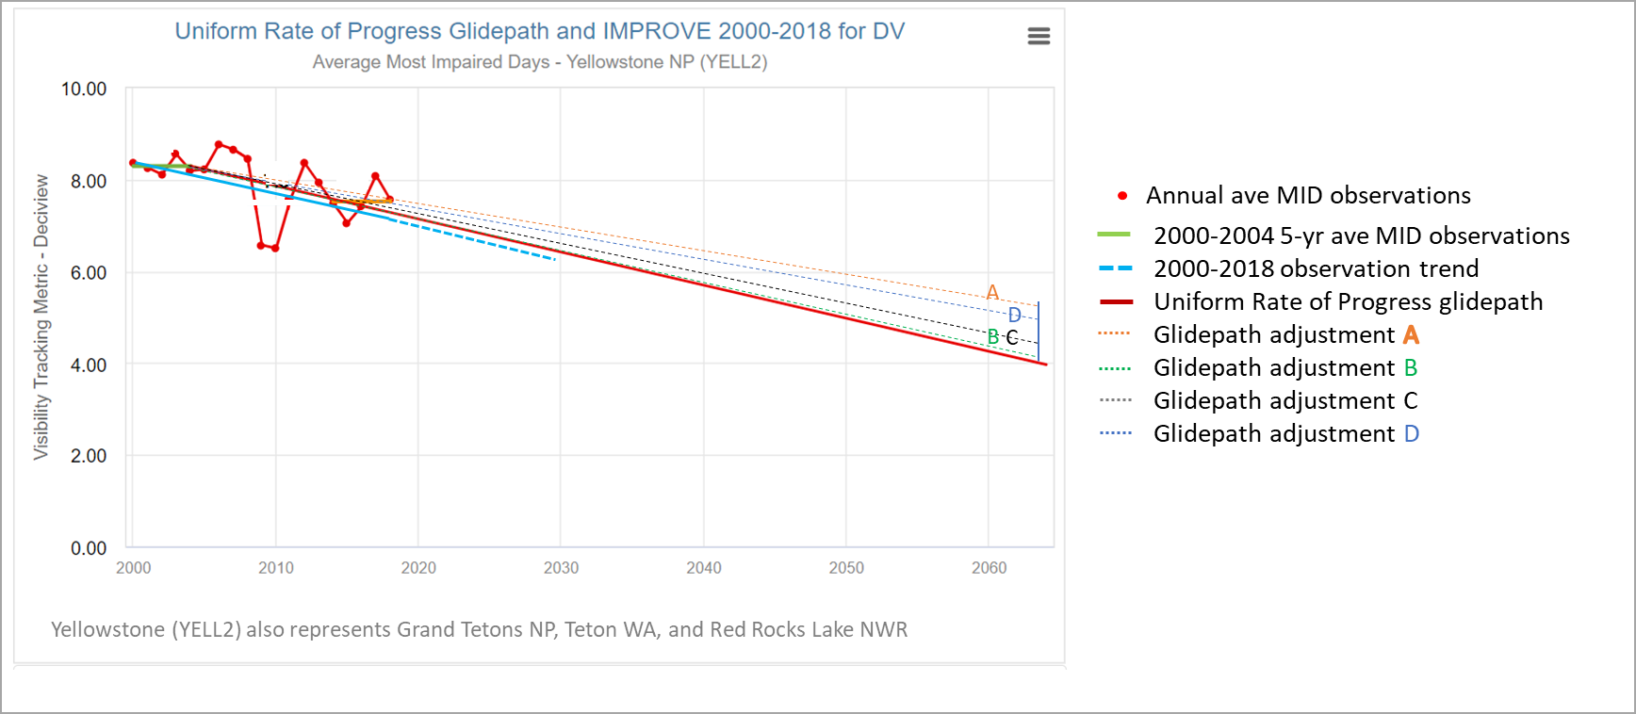
Under review: Adjustments to 2064 endpoints
to account for international and wildland prescribed fire contributions
Adjustments to Uniform Rate of Progress Glidepath and 2028 Projections – Most Impaired Days – Deciview – Yellowstone NP

