Slide 1
Update on specifying boundary conditions for regional-scale air quality models
  Mike Barna, NPS-ARD
  RTOWG call
  9/10/19

Slide 2
Evolution of specifying boundary conditions
Regional air quality models need to have concentrations specified at the model’s boundary
Initially we used static BCs (ca. pre-2000)
  Typically “clean” values for remote maritime or rural environments
  Small impact on results
  Did not change spatially or temporally
Global chemical models provided first dynamic BCs (ca. 2000 - now)
  GEOS-Chem, MOZART, GOCART, etc.
  Coarse spatial resolution (2.5-10 deg)
  Requires interpolation to harmonize global scale v. regional scale domains
  Not all chemical species are represented within the global model
  Significant uncertainty with international emission inventories
  One-way nesting (no feedback between global and regional model)

Slide 3
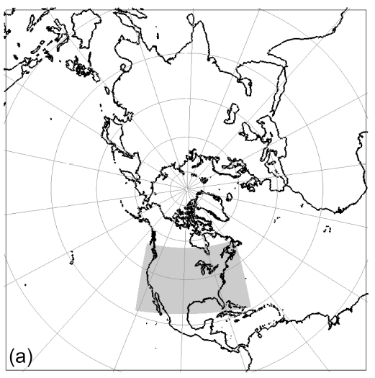
Evolution of specifying boundary conditions (cont’d)
Extension of air quality models from regional to hemispheric scale
  H-CMAQ
  Model is internally consistent
    Same meteorology
    No interpolation
    Same chemical species and mechanism
  Still have problem with uncertain emission inventories, e.g., China, India
Saharan dust transport
12km nested domain within 108km domain
Mathur et al., 2017, Atmos Chem Phys

Slide 4
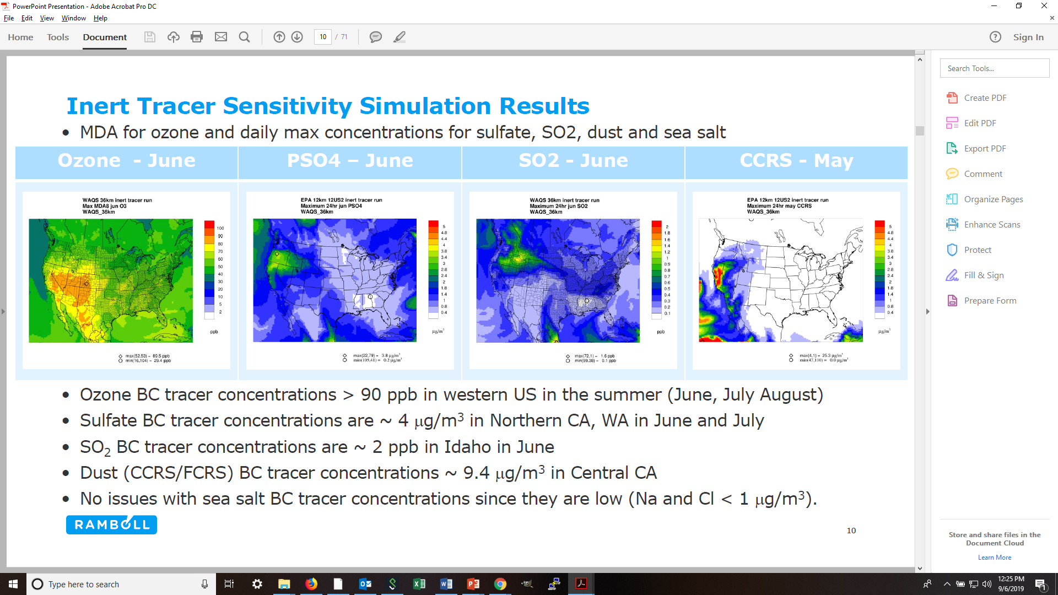
Current challenges associated with BC’s
Regional modelers often don’t know the lineage of what they’re getting in terms of inputs, configuration, or model version
The model performance evaluation may not be very rigorous, or available for review
  Often too expensive for the regional modeler to perform MPE on global model
  Weirdness in the global model manifests itself in the regional model
    Forgetting to turn off volcanoes results in high S
    Over-vigorous mixing of upper level O3
Ideally, regional modelers would like global model results that have been thoroughly evaluated and vetted by the global modelers
Ramboll, 2019, RTOWG / IWDW-WAQS 2014v1 Shakeout Modeling Platform Results meeting

Slide 5
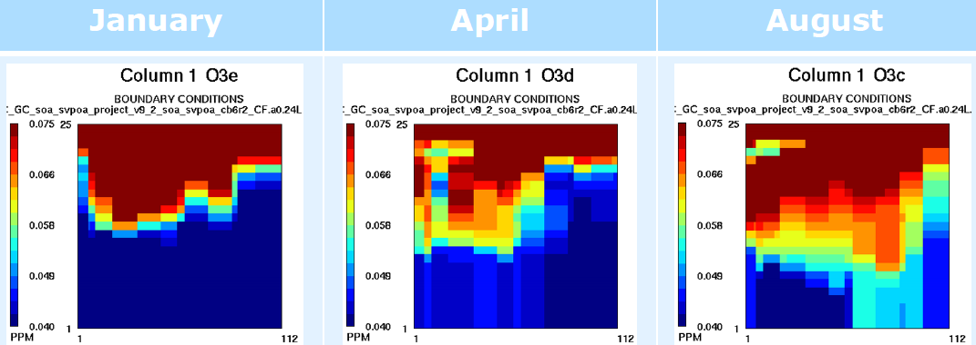
The western US is particularly sensitive to BCs
Pollutant concentration is typically lower than eastern US
  Fewer emission sources
Relative contribution from distant “background” sources is higher
  Asia, Canada, Mexico
High ozone concentrations from GEOS-Chem BCs
Ozone at western boundary
Ramboll, 2019, RTOWG / IWDW-WAQS 2014v1 Shakeout Modeling Platform Results meeting

Slide 6
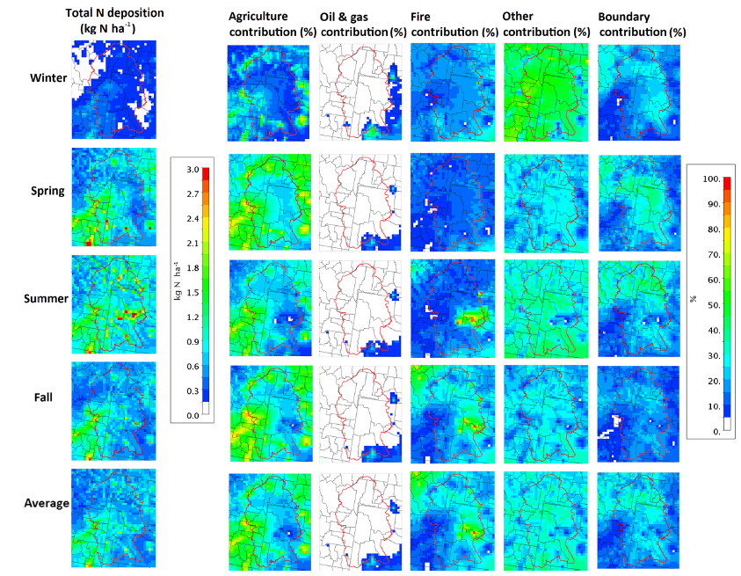
Example: Nitrogen deposition at Yellowstone
The Greater Yellowstone Area (GYA) ecosystem is sensitive to additional nitrogen deposition
CAMx PSAT was used to quantify source sectors and regions
Nitrogen species from the BCs can make a large contribution
  Mostly NH4+ and NO3-
Zhang et al., 2018, Atmos Chem Phys

Slide 7
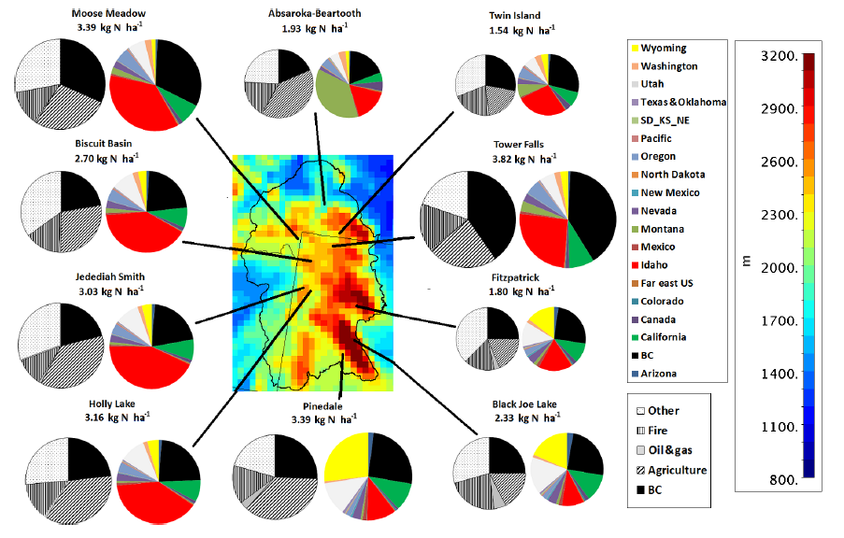
Example: Nitrogen deposition at Yellowstone (cont’d)
Zhang et al., 2018, Atmos Chem Phys

