Slide 1
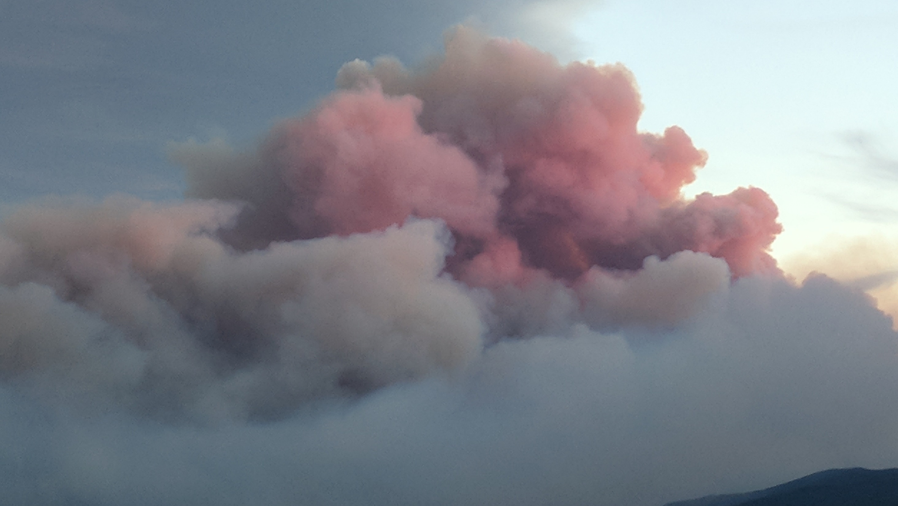

Wildland Fire Emission
Factor Development
Western States Air Resources Council Western Regional Air Partnership
Fire and Smoke Workgroup
February 28, 2022
Shawn Urbanski
USDA Forest Service, Rocky Mountain Research Station
Missoula Fire Science Laboratory

Slide 2
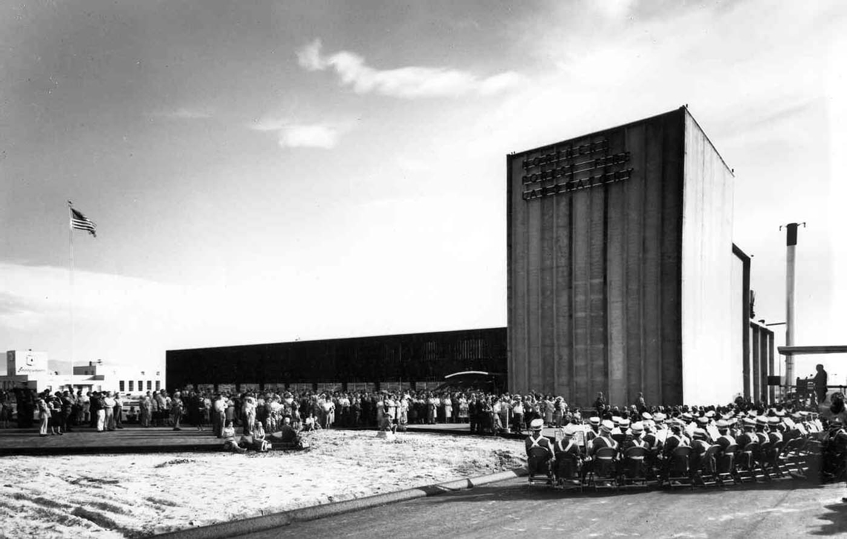
Missoula Fire Sciences Laboratory
Established by US Forest Service 1960 to find scientific solutions:
Better managing the nation’s wildland resources
Improve forest fire prevention and suppression
Currently the Missoula Fire Lab is part of the US Forest Service Rocky Mountain Research Station

Slide 3
Fire, Fuel, and Smoke Science Program
One of Seven Science Programs in the Rocky Mountain Research Station
Headquartered at the Missoula Fire Sciences Laboratory
Focus Areas:
Physical fire processes
Fuel dynamics
Smoke emissions and dispersion
Fire ecology
Fire and fuel management strategies
Science delivery

Slide 4
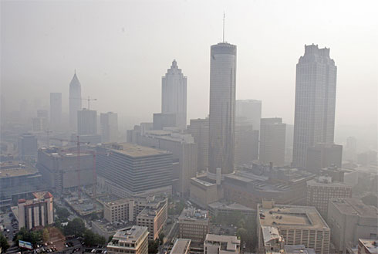
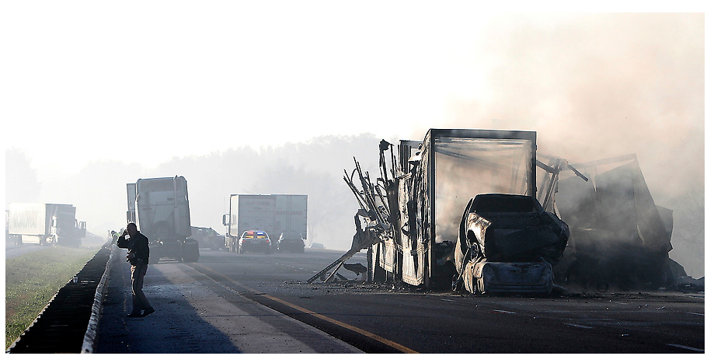
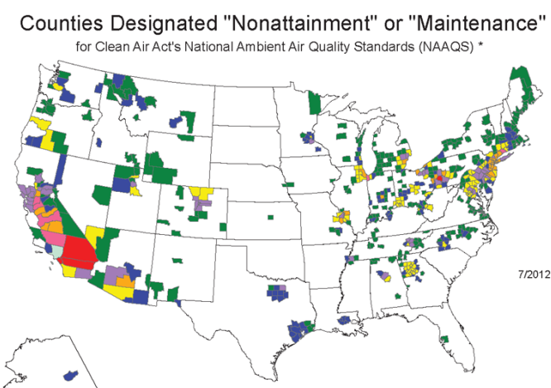



Societal Impacts Driving Smoke Research
Smoke is a major source of air pollution
Fine particulate matter (PM_{2.5}) is primary pollutant
But smoke also contains 100s of gases
Public Health
Safety
Scenic Integrity
Regulatory
Nuisance
Climate
Notes:
1. WHY SMOKE RESEARCH IS IMPORTANT

Slide 5
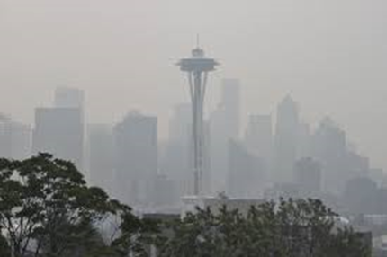
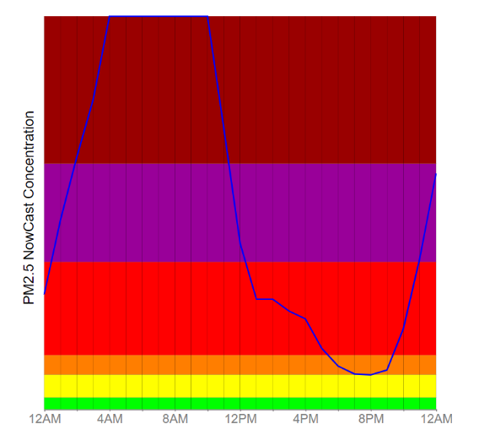
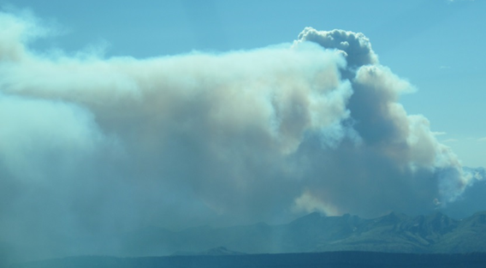
From Fire to Smoke Impacts
COMPOSITION
PM_{2.5}
CH₃OH
NO₂
IMPACTS
ATMOSPHERIC MODELS
NH₃
C₁₀H₁₆
C₆H₆
C₃H₄O
CH₂O
NO
HCN
Bruce Sounder/Flickr CC
EMISSIONS MODELS
Transport
Chemical & physical transformations
Surface deposition
Notes:
3. COMPOSITION -> EMISSIONS -> TRANSPORT -> IMPACTS (TIE’EM ALL TOGETHER). Image SEA from High Country News (hcn.org, https://www.hcn.org/issues/50.17/latest-wildfire-smoke-deaths-could-double-by-centurys-end original source Bruce Sounder/Flickr CC). Seely Lake Aug 22, 2017 (MT DEQ)

Slide 6
Smoke Research at the Missoula Fire Sciences Laboratory
Composition – Relative abundance of pollutants in smoke
How does composition vary with fire behavior, fuel properties, and environmental conditions?
Emissions – Amounts of pollutants (smoke) produced
Where, when, & how much of various pollutants are produced?
Transport – Atmospheric transport of smoke local to regional scales
Where does the smoke go? What are impacts on atmospheric composition?
Monitoring – Impacts of smoke on ambient air quality
Notes:
2. WHAT SMOKE RESEARCH IS AT THE FIRE LAB

Slide 7
Emissions
Emissions
Where, when, & how much of various pollutants are produced?
Emission of air pollutant X (mass/area/time) estimated as:
area
burned
fuel
loading
combustion
completeness
emission
factor
Emissions of X
=
×
×
×
Fuel consumption model
Satellite remote sensing:
fire energetics
burn severity
Satellite remote sensing:
burn scars
active fire detections
Infrared flight fire perimeter
Mapped fuel
classification system
EF_{X}
field & laboratory studies

Slide 8
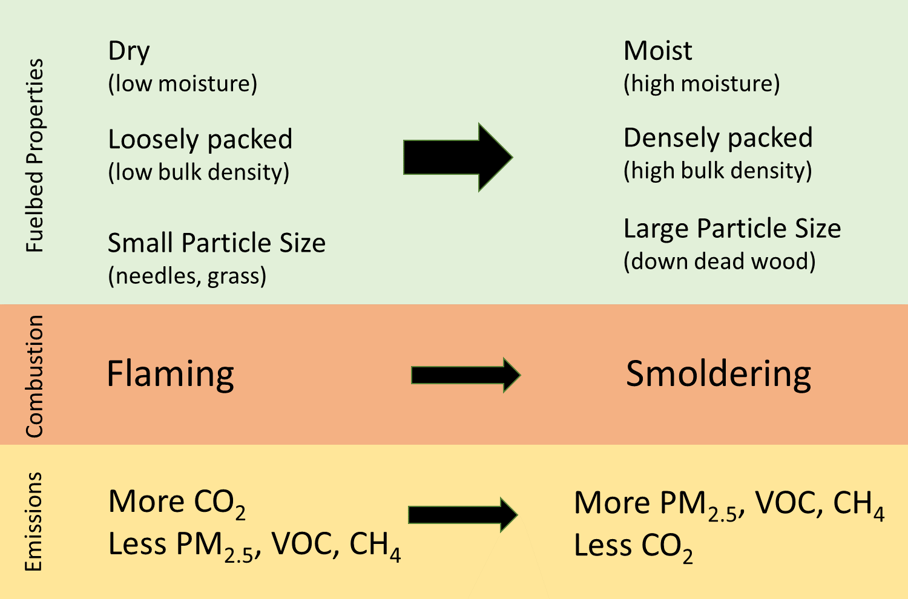
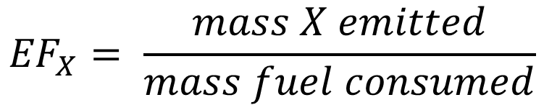
Smoke Composition – What’s in the Smoke
Fresh smoke contains 100’s of pollutants
Composition is quantified with
Emission Factors (EF)
$${EF}_{X}= \frac{mass X emitted}{mass fuel consumed}$$
EF_{X} vary considerably
Understand how the interaction of fuel properties, fire behavior, and environmental conditions control smoke composition
Notes:
4. SMOKE COMPOSITION: WHAT’S IN SMOKE & HOW/WHY COMPOSITION VARIES

Slide 9
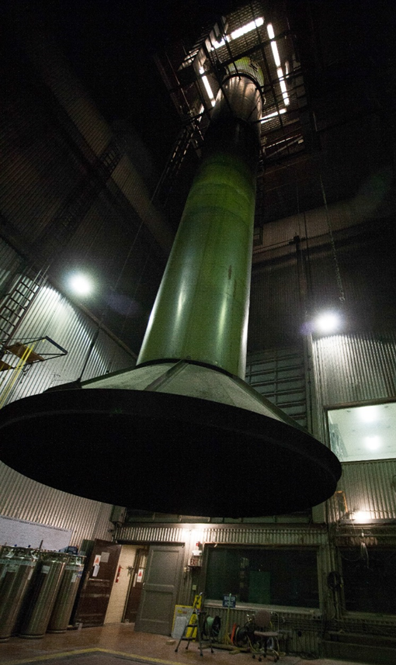
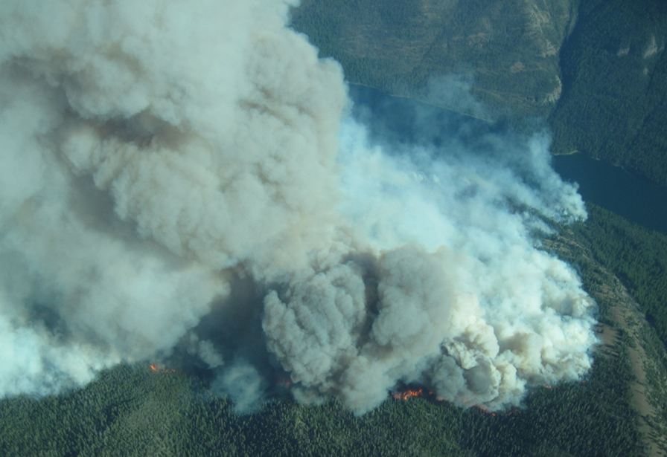
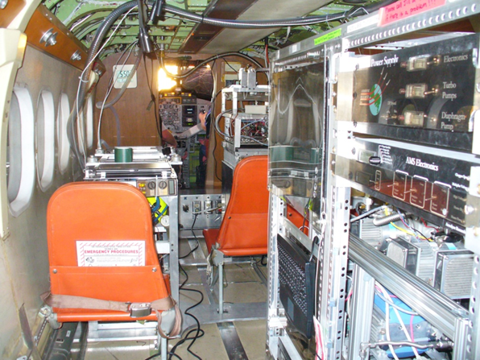
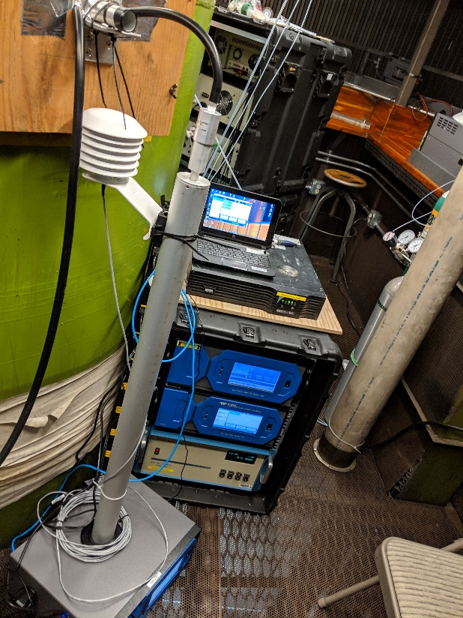
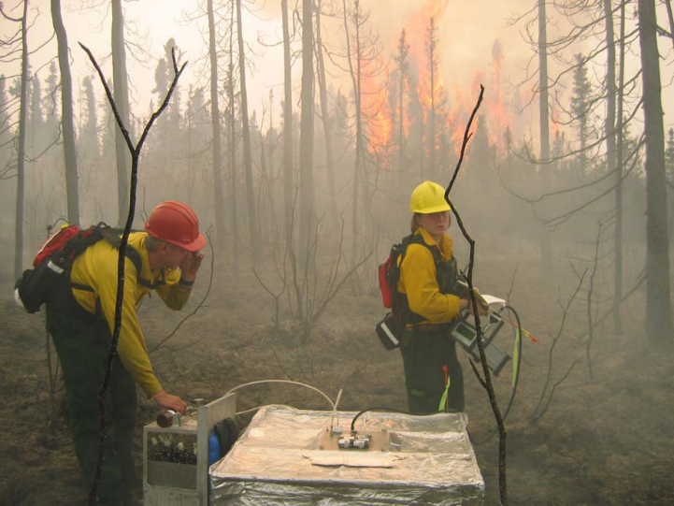
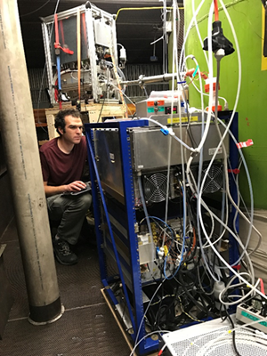
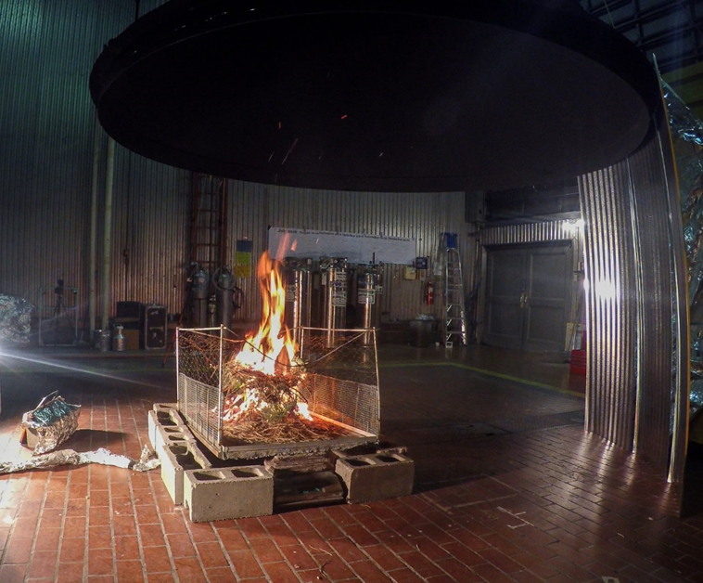
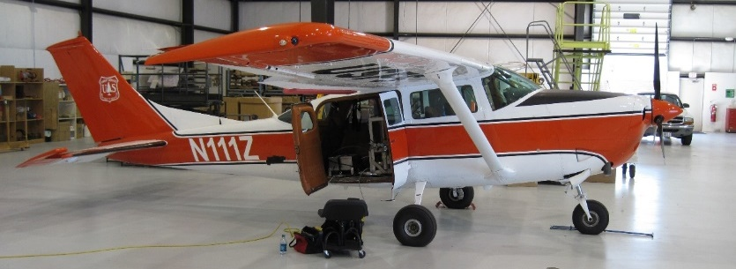
Smoke Composition – Laboratory and Field Studies

Slide 10
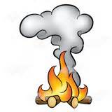












Measurement of Emission Factors - Carbon Mass Balance Method
Smoke Composition – Measuring Emission Factors (EF)
All the volatilized carbon species are measured
Smoke includes
100’s of VOC
Nitrogen compounds
PM diverse in size & composition
Relative abundances vary
Fuel properties
Fire behavior
Environmental conditions
$$_{CO2}^{ smoke}$$
Emissions are well mixed
$$_{CO}^{ smoke}$$
smoke sample
well mixed
smoke plume
Emission of species i is:
$$_{CH4}^{ smoke}$$
$$_{i}^{ emitted}= ∆_{i}=_{i}^{ smoke}−_{i}^{ bkgd}$$
$$_{VOC}^{ smoke}$$
$$_{PM2.5}^{ smoke}$$
$$_{CO2}^{ bkgd}$$
$$_{CO}^{ bkgd}$$
background
air
background
air
$$_{CH4}^{ bkgd}$$
Sum of volatilized carbon
Fuel carbon fraction
$$_{VOC}^{ bkgd}$$
$$_{PM2.5}^{ bkgd}$$
Notes:
This slide illustrates the different combustion processes. Describe the difference between pre-ignition, flaming, and smoldering processes.

Slide 11
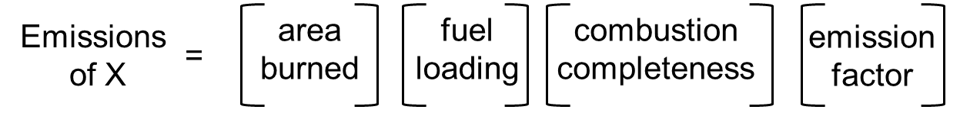
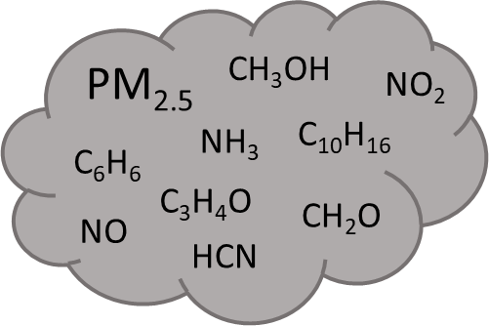

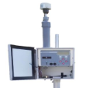
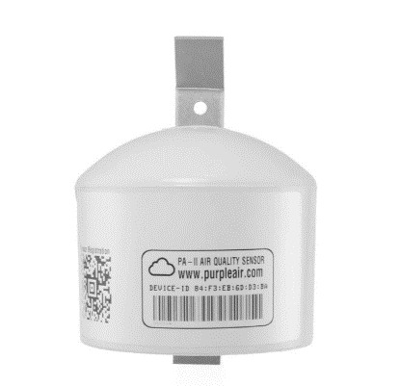
Emission Factors: Just one piece needed for smoke impacts
COMPOSITION
IMPACTS
ΔH
ATMOSPHERIC
MODELS
Bruce Sounder/Flickr CC
Plume Rise
ΔH
Transport
Chemistry
Removal

Slide 12
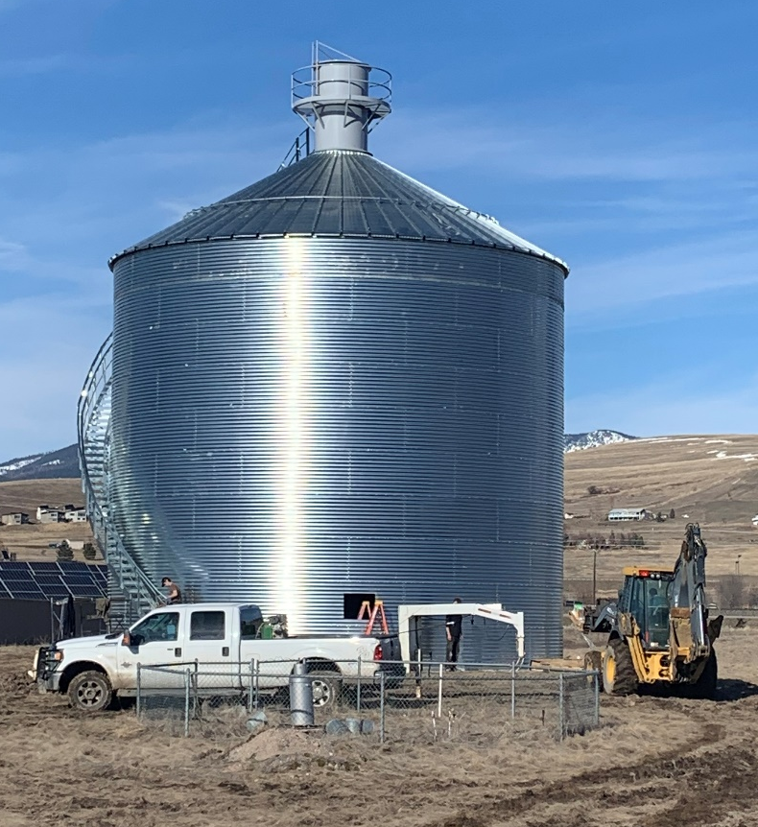

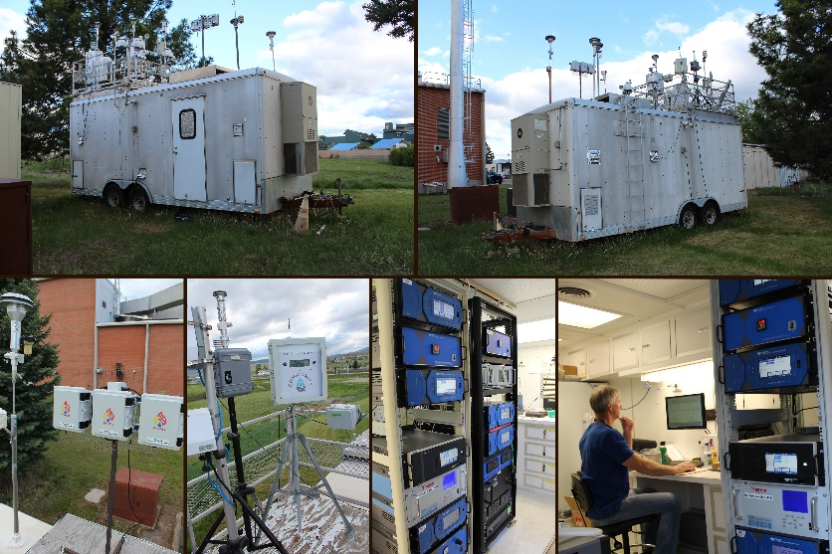
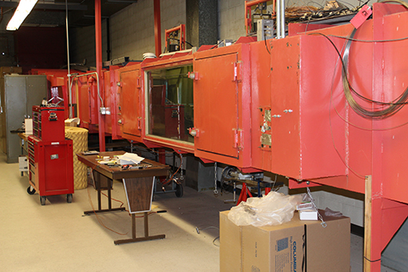
THANK YOU !
Invitation
Tour of Missoula Fire Sciences Laboratory
September 8, 2022
New
Combustion
Facility
Combustion
Lab
Wind Tunnel
USFS – EPA
Smoke Monitor Evaluation
QUESTIONS?

Slide 13
PM_{2.5} Emission Factors
Smoke production models assume fixed flaming-to-smoldering ratios for litter fuels
Hypotheses Smoldering and EFPM_{2.5} increase with:
Increasing conifer litter bulk density (BD)
Burn Ponderosa Pine needle fuelbeds in laboratory and measure emissions for varied bulk density
Measure modified combustion efficiency (MCE) to quantify smoldering combustion and EFPM_{2.5}
FOFEM and CONSUME: Models for planning prescribed burns and managing smoke impacts

Slide 14
PM_{2.5} Emission Factors
Smoke production models∗ assume fixed flaming-to-smoldering ratios for litter fuels
Hypotheses Smoldering and EFPM_{2.5} increase with conifer litter bulk density (BD)
Test Burn Ponderosa Pine needle fuelbeds in laboratory and measure emissions for varied bulk density
Bulk density, BD
(kg m⁻³)
Bulk density – 4 groups:
Very low, 13 kg m⁻³
Low, 25 kg m⁻³
Moderate, 51 kg m⁻³
High, 76 kg m⁻³
25
50
85
Fir / Spruce
Ponderosa Pine
Jack / Red Pine
Loblolly Pine
∗FOFEM and CONSUME: Models for planning prescribed burns and managing smoke impacts

Slide 15
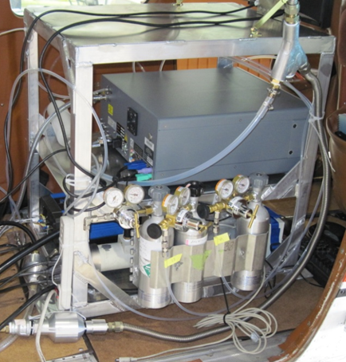
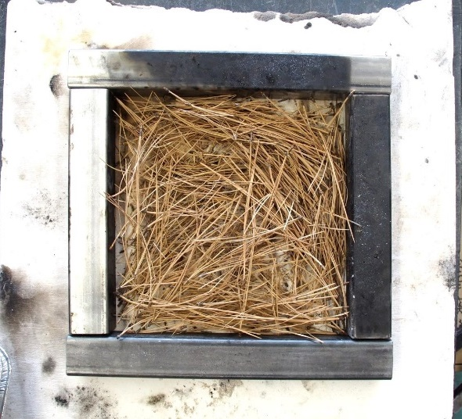
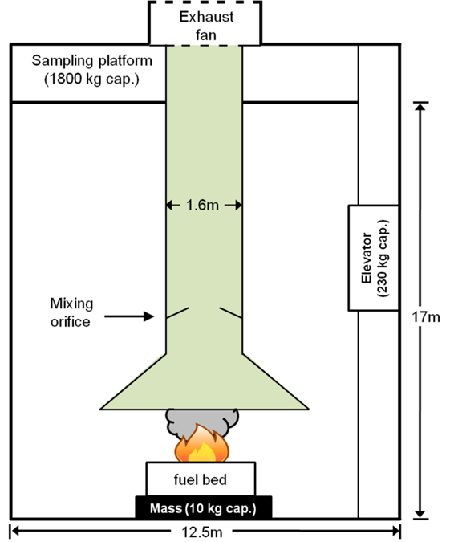
PM_{2.5} Emission Factors
Burn Ponderosa Pine fuelbeds (fixed dimensions)
Measure emissions: MCE and EF for CO₂, CO, PM_{2.5}, CH₄
Missoula Combustion
Facility
Fuelbed
12 in x 12 in x 1 in
Cavity ring-down spectroscopy
PM_{2.5} filter samples

Slide 16
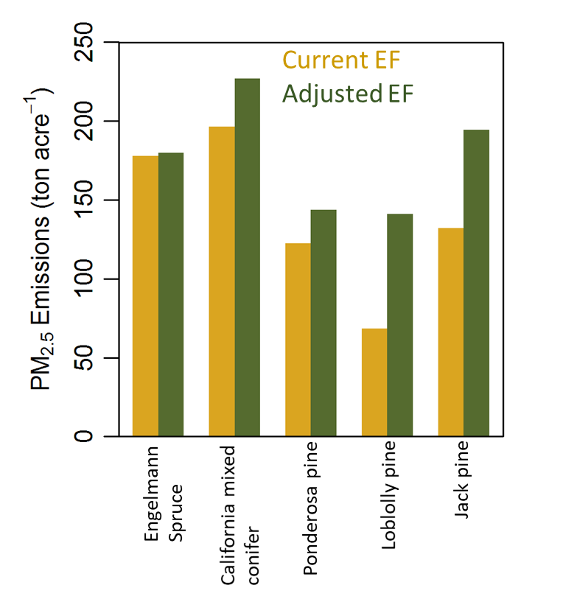
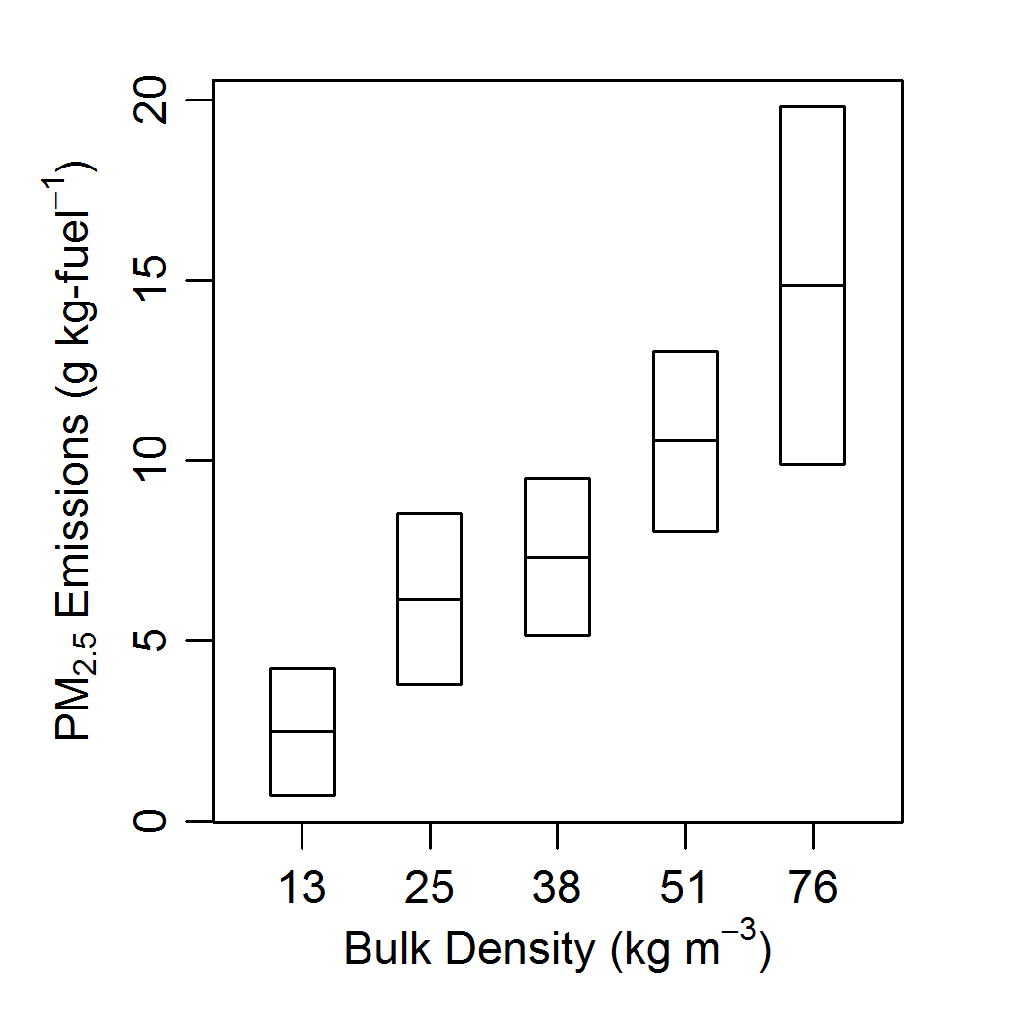
PM_{2.5} Emission Factors
Results
Implications
EFPM_{2.5} increases with fuelbed litter bulk density
Current smoke management tools predict less pollutant emissions
PM_{2.5} emissions likely underestimated for prescribed fires with significant needle litter component

Slide 17
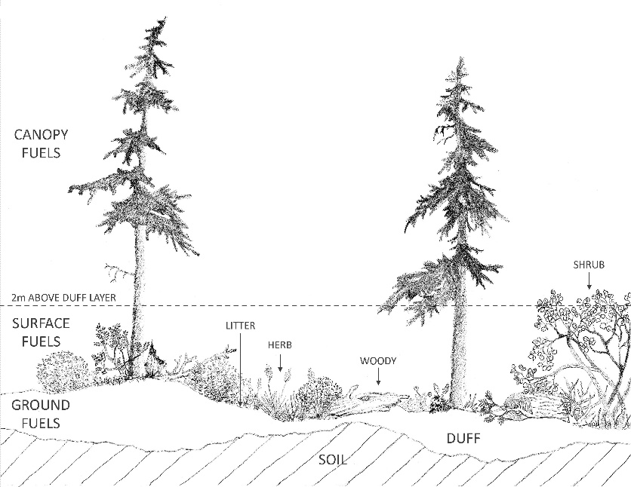
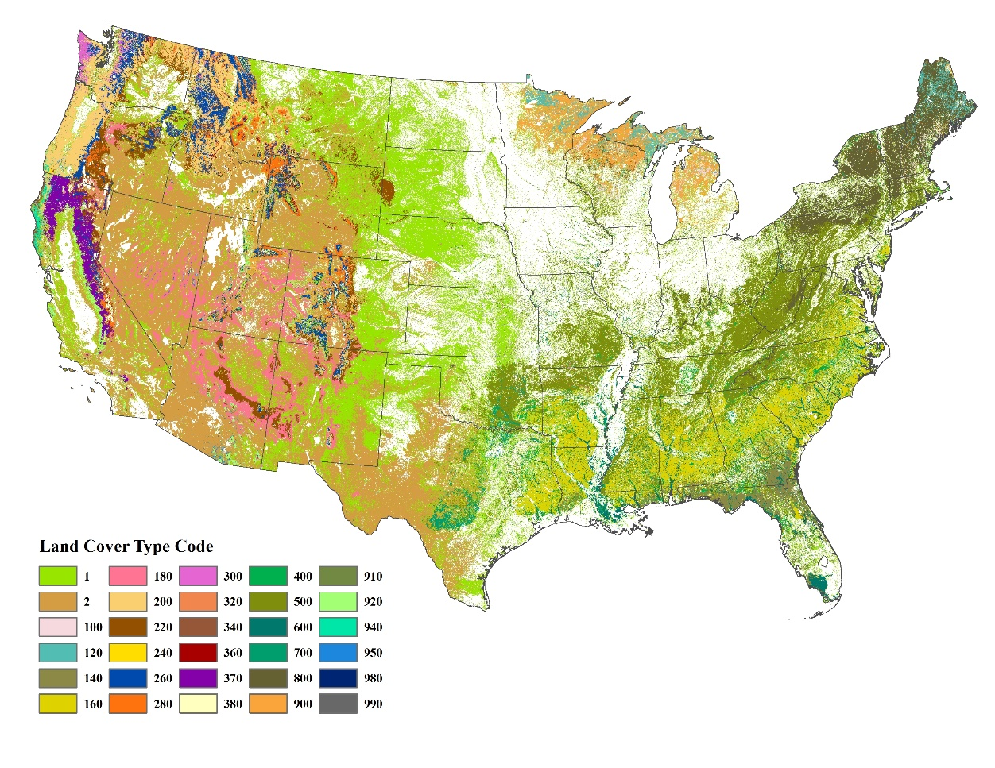
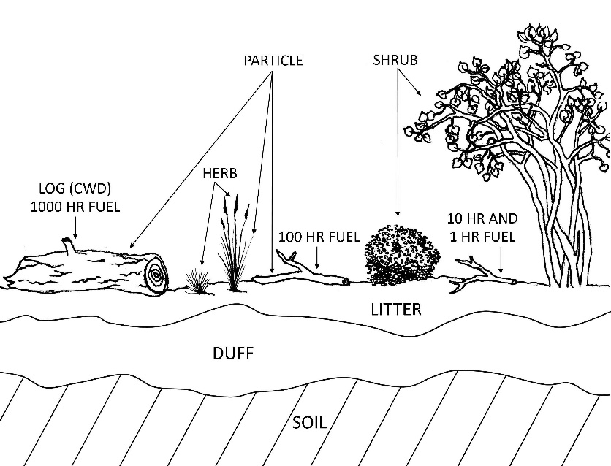
Fuel Classification System
Assign fuel class to map pixels
Estimate loading of
fuel components
Urbanski, S. et al. 2018. Contiguous United States wildland fire emission estimates during 2003-2015. Earth System Science Data. 10: 2241-2274.
Keane, Robert E. 2015. Wildland fuel fundamentals and applications. Springer. 191 p.

Slide 18
Missoula Fire Lab Emission Inventory (MFLEI)
Retrospective wildland fire emission inventory for CONUS
designed to
Quantify impacts of wildfires on air quality and public health in the US at local, regional, and national scales
Evaluate & improve smoke forecasting techniques
Support the development of effective and efficient emission control strategies
Better understand consequences of fire/land management, individual decisions and overall policy on air resources

Slide 19
Missoula Fire Lab Emission Inventory (MFLEI)
MFLEI advantages over real-time and retrospective global fire emission inventories
Detailed fuels available only for CONUS
Post-fire burned area & burn severity from satellite borne sensors and fire management perimeters from airborne IR imagery
Fuel consumption models developed for fires in CONUS ecosystems
Emission factors measured for fires in CONUS ecosystems
Provides daily burned area, fuel consumption, and pollutant emissions at a 500 m x 500 m resolution

Slide 20
Missoula Fire Lab Emission Inventory (MFLEI)
Fire burned area & date:
Multiple data sources
Fuel classification system:
Forest Fuel Type Groups
Fuel classification system map:
USDA Forest Service Forest Type Group Map
Fuel consumption:
First Order Fire Effects Model (FOFEM) for litter and duff
CONSUME for down dead wood, herb, and shrub
Miller and Yool (2002) for forest canopy
Pollutant Emission Factors:
Synthesis of published field and laboratory studies

Slide 21

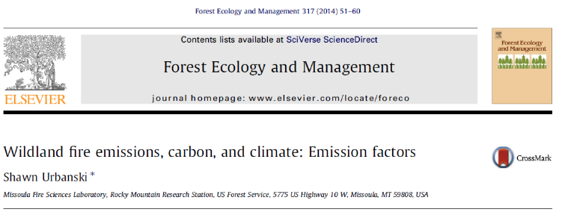
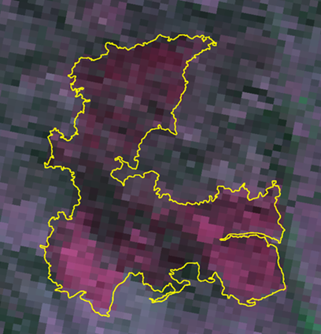
Missoula Fire Lab Emission Inventory (MFLEI)
area
burned
fuel
loading
combustion
completeness
emission factor
(EF_{X})
Emission_{X}
=
×
×
×
Airborne IR fire perimeters
Satellite remote sensing
  Burned area
  Burn severity
  Active fire detections
Mapped fuel
classification system
Fuel consumption models
(FOFEM and CONSUME)
Published field & lab measurements
Forest fuels based on >29,000 USFS Forest Inventory & Analysis Program plots
EF_{X} – EF for emissions of species X (CO, PM_{2.5}, CH₄,….)
Parsons et al. (2010) RMRS-GTR-243

Slide 22
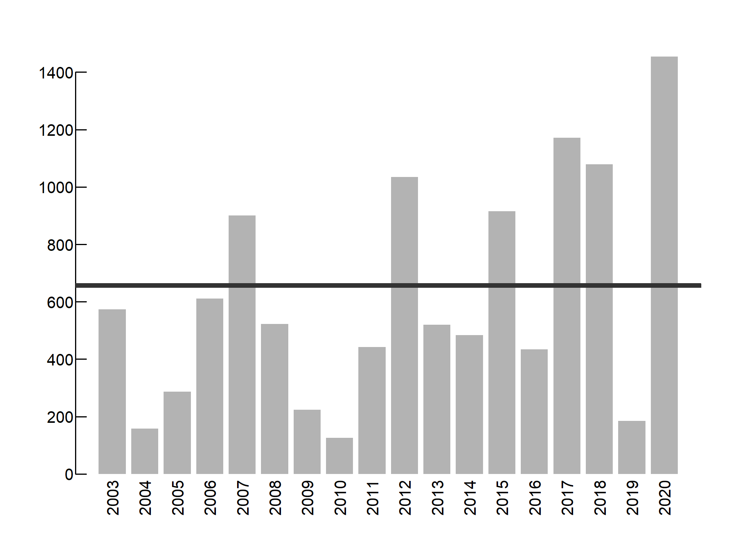
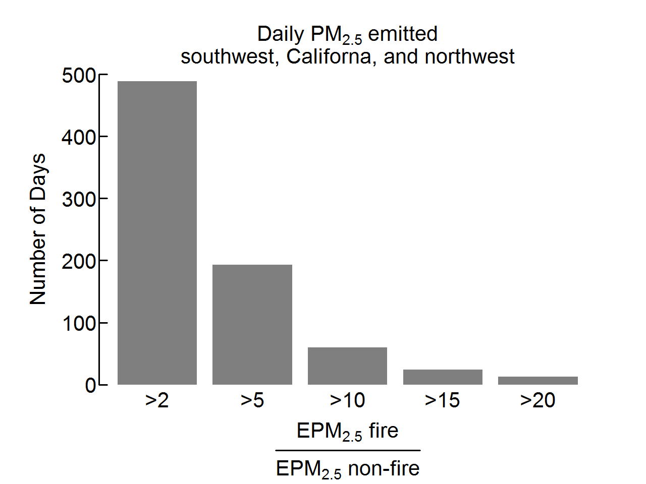
Wildfires: major source of PM pollution in western U.S.
2% of wildfire days account for ∼ 50% of emissions
On these days:
Annual PM_{2.5} emitted by wildfires in western US
Anthropogenic emissions
2014 EPA NEI
Wildfire
PM_{2.5}
Anthropogenic
PM_{2.5}
≥ 10 x
PM_{2.5} emitted (Gg y⁻¹)
Daily wildfire PM_{2.5} emitted
2003-2015
PM_{2.5} Emitted (Gg/y)
Urbanski et al. (2018)

Slide 23
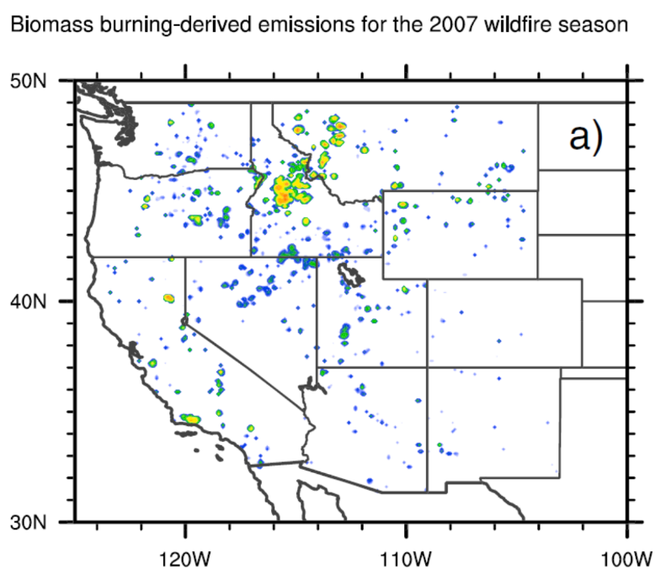
Quantifying impacts of wildfires on urban air quality
Salt Lake City 2007 Wildfire Season
Wildfire contributions towards air pollution (CO) at Salt Lake City
Atmospheric transport model
MFLEI emissions
Idaho
52%
Utah
15%
CA & NV
28%
Mallia, D. V., J. C. Lin, S. Urbanski, J. Ehleringer, and T. Nehrkorn (2015),
Impacts of upwind wildfire emissions on CO, CO2, and PM2.5 concentrations in Salt Lake City, Utah, J. Geophys. Res.Atmos., 120, 147–166, doi:10.1002/2014JD022472

Slide 24
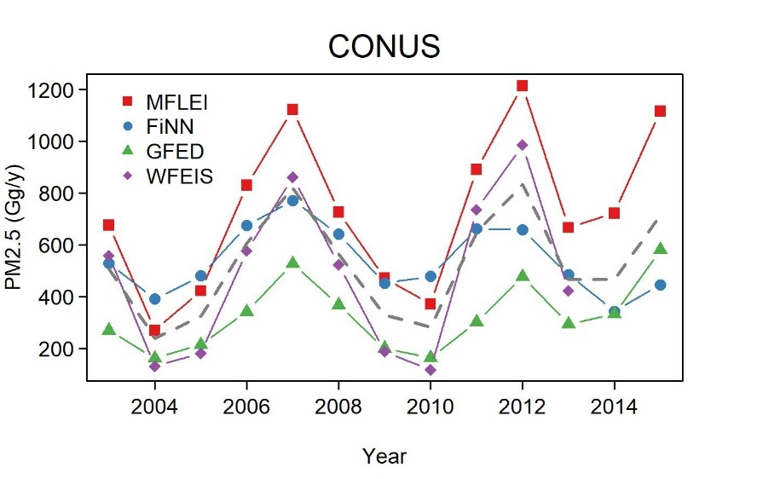
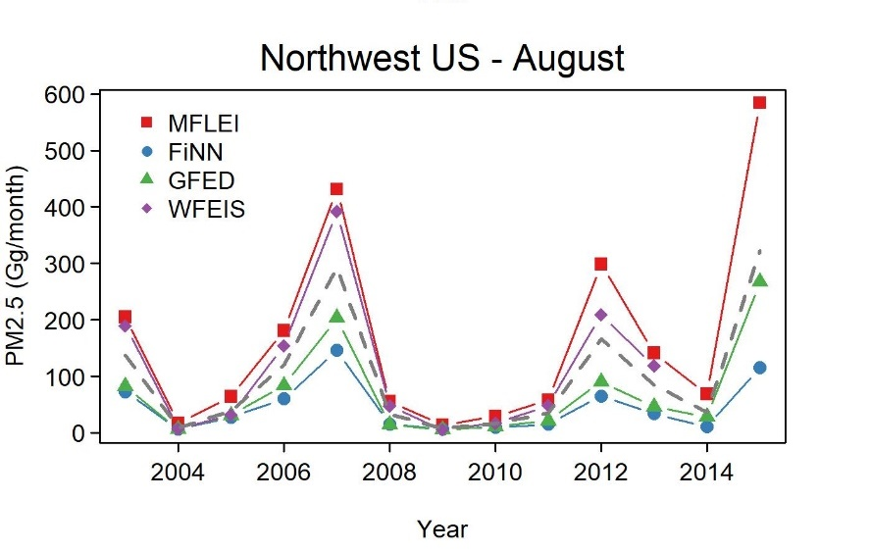
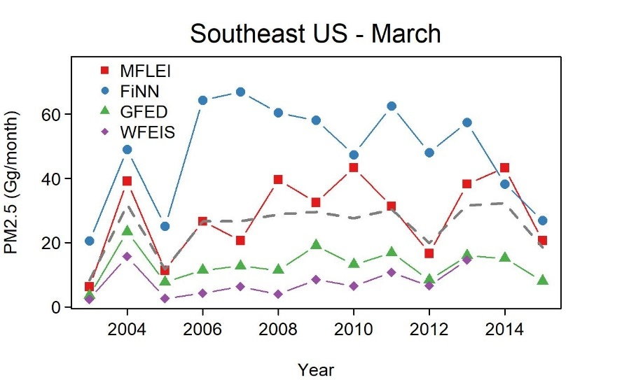
Large discrepancies exist between emission inventories
Rigorous evaluation of inventories is needed across time & spatial scales relevant to air quality impacts.
Δt: 1 – 30 days
Δx: fire event, air shed, regional
MFLEI: Missoula Fire Lab Emission Inventory
FiNN: Fire INventory from NCAR
GFED: Global Fire Emission Database
WFEIS: Wildland Fire Emissions Information System

