Slide 1
WRAP Oil and Gas Work Group
WRAP Regional Haze Planning Webinar
June 20, 2019

Slide 2
Oil and Gas Work Group (OGWG) - Background
Co-chairs: Darla Potter (WY), Amanda Brimmer (CO), and Mark Jones (NM)
Membership
States, FLMS, EPA, Tribes
Work documented on WRAP website: https://www.wrapair2.org/OGWG.aspx
OGWG has interacted/collaborated with Tribal Data work group, Control Measures work group, and other WRAP work groups
Notes:
My Co-chairs in the work group are:
Darla Potter from Wyoming Department of Environmental Quality and
Amanda Brimmer from (Denver northern front range regional air quality council ) in CO
Membership of our work group includes most of the WRAP states, FLMs, EPA, and tribes. We have had Several advisors and guest presentations
and ongoing coordination with other WRAP workgroups.
Most recently we had the Control measures work group chair attend and present at our bimonthly meeting. Where we think there will be some important joint work that may need to be done on developing and forecasting the effects of potential future control scenarios.
All our work and meeting notes have been methodically documented on our website

Slide 3
Responsibilities and Deliverables
The Oil and Gas Work Group is:
Responsible for addressing the data and analysis elements, topics, and issues under the Oil and Gas section of the WRAP Workplan (Section I.D.1)
Responsible for providing oversight and coordinating efforts with projects and activities across the WRAP and with other groups related to Oil and Gas
The Oil and Gas Work Group will:
Prepare a detailed Workplan for the TSC as inputs to update the WRAP annual Workplan for achieving these Oil and Gas analysis and planning elements. These will include:
Schedule for work product completion
Budget estimates of outside funding support needed
Timing of progress reports
Milestones to support timely and necessary Oil and Gas analysis activities
Provide Work Group meeting notes and progress reports
Notes:
Here is some background of the charge and tasks for our work group.
It’s important to note that there are only two distinct source group work groups – the oil and gas and the fire work groups dedicated to those sources only.
Oil and Gas source analysis is very complicated. In that it is a rapidly changing industry with sub-regional issues.
In this update we are mostly trying to orient you to what info is available and some of our work products over the last two years

Slide 4
Work Products
WRAP OGWG 2017 Workplan (Consensus on January 10, 2017)
WRAP OGWG Oil and Gas Emission Sources (Consensus on October 17, 2017)
WRAP OGWG Road Map Scope of Work (Consensus on October 10, 2017)
Identification and Review of Oil & Gas Specific Projection Methodologies and Work Products
Base Year and Future Year Oil & Gas Emissions Inventories
Identification and Review of Member Agency Oil & Gas Programs and Emissions Management
OGWG Road Map: Phase I Report (Consensus on April 16, 2018) – Appendix A (On-the-Books Regulations Tables)
Work Products: OGWG Emissions Survey for State Air Agencies and O&G Operators
Complete survey (January 2019)
Fleet turnover and controls-focused survey (January 2019)
Notes:
Slide 4 shows many of the planning documents and work products we have developed
The work group has contracted Ramboll for several assignments.
A major process was carefuly developing a road map to achieve our goals and required deliverables for regional haze planning including a base and future year emissions inventory.
Also important was developing a survey instrument completed in January 2019 with the input of state agencies to outreach to the oil and gas industry to learn more about current state of production and controls.
A major part of the survey design was to learn more about not just current conditions but how things are changing and what we should consider for the future.
These Work products being developed are for one of the only emissions sectors where emissions are high and development are increasing in many places that is actually contains controllable emissions, unlike most all the other sectors

Slide 5
Most Recent Work Product
“Baseline 2014-2016 Oil and Gas Emission Inventory for the WESTAR-WRAP Region” prepared for WRAP OGWG by Ramboll
Base year 2014 emissions were compiled from existing emission inventory sources
Additional survey efforts enhanced the emissions inventory making the inventory applicable to the 2014-2016 baseline period
presentation, report, and detailed emission inventory spreadsheet) in the WRAP OGWG OneDrive folder (June 2019)
Review and comments due by next Tuesday, June 25th
Notes:
The most current work product is the Baseline 2014-2016 O&G inventory which is really a cumulative product of the work we have done to date over the past 2 years.
To develop the baseline 2014-2016 WESTAR-WRAP region emission inventory base year 2014 emissions were compiled from existing emission inventory sources (detailed in the report described in Section 2.1). Subsequent to compilation of the base year 2014 emission inventory, outreach was conducted to gather additional data from regulatory agencies and upstream O&G operators to enhance the emissions inventory and, to the extent that data was provided, make the inventory applicable to the 2014-2016 baseline period (described in Section 2.2).
Work with representatives on OGWG to submit comments. Co-chairs.

Slide 6
Baseline Inventory - Basis
Started from WRAP OGWG v1, integrated survey data to develop WRAP OGWG v2
Several rounds of previous outreach on inventory inputs
8/14/2018
2014 base case (v1) emission inventory spreadsheet
2014 oil and gas activity spreadsheet
10/9/2018
WRAP OGWG Survey Data Collection Synthesis Memo, Ramboll
5/22/2018
Survey results memorandum (via email)
Made inventory updates per agency and operator survey responses
Note: Tank controls capture efficiency: Currently status quo (100% capture efficiency except for certain Colorado sources)

Slide 7
Survey-Based Baseline Inventory NOx Changes

Slide 8
Survey-Based Baseline Inventory VOC Changes
Notes:
Less important
Changes in VOC emissions from the surveys were due to Higher tank control prevalence
Which led to a very dramatic decrease of estimated VOC emissions from Williston, ND and also several other basins including the Permian Basin in NM.
The total percent change in VOC for the inventory was 22% reduction
VOC do significance RH.

Slide 9
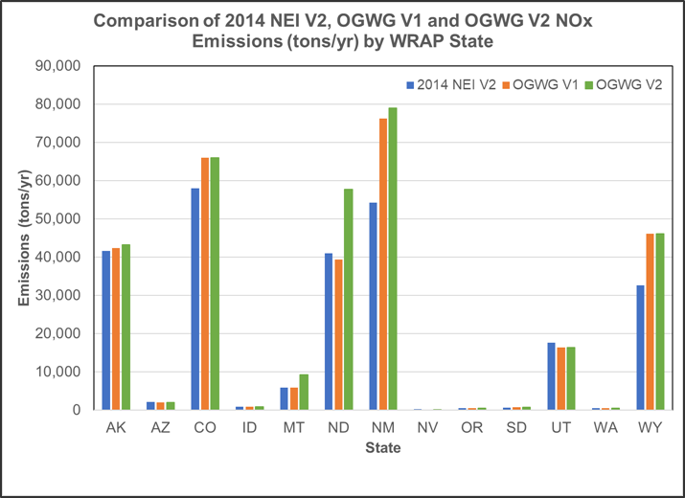
Baseline Inventory - Results
Regional Modeling Scenarios
2014 NEIv2 in Shakeout v1 run
OGWG v1 in Shakeout v2 run
OGWG v2 in Current/Representative Baseline run
Notes:
This graph represents the changes in NOx emissions by state comparing the 2014 NEI to the OGWG inventory V1 from last year to the most current OGWG version 2 that is presented in the current baseline inventory report (out for review).
Most of the changes going from OGWG version 1 to 2 are from the emissions changes made that we just discussed in the previous two slides
The greatest change was in ND due to the aforementioned drill rig and artificial lift engine factor increases

Slide 10
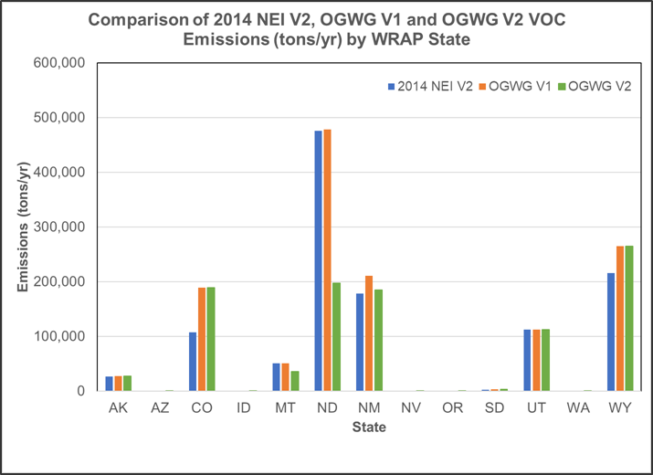
Baseline Inventory - Results
Regional Modeling Scenarios
2014 NEIv2 in Shakeout v1 run
OGWG v1 in Shakeout v2 run
OGWG v2 in Current/Representative Baseline run

Slide 11
Baseline Inventory – EPA Updates
WRAP co-chairs communicated to EPA the availability of the baseline 2014-2016 inventory for use in EPA’s 2016 Modeling Platform
2017 NEI should include and account for inventory improvements
Path forward being discussed currently with EPA.
Impact would vary from state to state.
Notes:
Two representatives from EPA were on our last oil and gas work group call and WRAP oG wg members have also been participating in EPA’s development of a 2016 emissions inventory for modeling
Currently oil and gas states and EPA are scheduled to have a call to see how we might best use this updated info in the EPA platform and also to help some of the states carry over WRAP O&G emissions inventory info into EPA’s 2017 NEI, especially in the area source categories.

Slide 12
Forecast Scenarios (OTB & OTW)
Develop low, medium and high scenario emission inventories
Medium scenario for regional haze modeling
Low and high scenarios for planning purposes
Medium scenario being finalized based on previous agency input
Developing low and high scenario methodology
Agency involvement: review of inventory and related products later this summer
Notes:
Now that he basecase inventory has been drafted and putting the finishing touches on it to go into modeling. It should be noted that this will only be a snap shot of what the industry looks like.
Current work of the Oil and Gas group includes continuing developing O&G inventory future forecast emissions.
Since there is uncertainty to projections the idea is to prepare multiple scenarios for future year based on different energy outlooks
If you are an agency that has an oil and gas component and not already involved please reach out to cochairs to get plugged in.

Slide 13
Forecast Scenarios (Additional Reasonable Controls)
Develop single scenario (likely medium OTB & OTW scenario) future year emission inventory
Determining source categories that will be the focus of additional reasonable controls analysis
Compiling survey results applicable to future year control scenarios
Agency involvement: review of survey results related to controls and focus source categories memo
Notes:
Then we will look at applying certain control scenarios for the 2028 future year inventory
Not belabor details
Additional reasonable controls analysis
Additional survey results obtained on controls –
basecase inventory a lot information really important when we look at future year control strategies

Slide 14
Status, Schedule & Looking Ahead
Notes:
Task 1: Base Year Inventory
Complete: Baseline (version 2) inventory
In-progress: Agency review of baseline inventory and report, Ramboll compilation of representative gas compositions and controls from survey
Next steps: Finalize emission inventory based on comments in mid- to late-June, memo on gas compositions and controls from survey in early-July
Task 2: Forecast 2028 Inventory (On-the-books controls)
Completed: Draft medium scenarios, agency comment
In-progress: Low and high scenario forecast methods
Next steps: Develop low and high scenario forecast methods
Task 3: Forecast 2028 Inventory (Additional reasonable controls)
In-progress: Identification of sources to focus on for additional controls
Next steps: Memorandum on sources to focus on for additional controls, memo on surveys responses related to controls in early-July
Not yet started
Task 4: O&G Program and Emission Management Review
Schedule of what we have been talking about
Reiterate a lot of work, really tight timeframe,
Engagement throughout the process in OG work group rather than just review of work product at the end.
Engagement
Careful and meticulous, methodical,
Ability to change rapidly growing and evolving emissions sector
Just trtying to give the best information we have
A lot to process and consider beyong oil and gas work group.

Slide 15
Questions?
Notes:
For more information on any of the topics today you can explore our WRAP oil and Gas work group webpage
Or contact any of the co-chairs.

