Slide 1
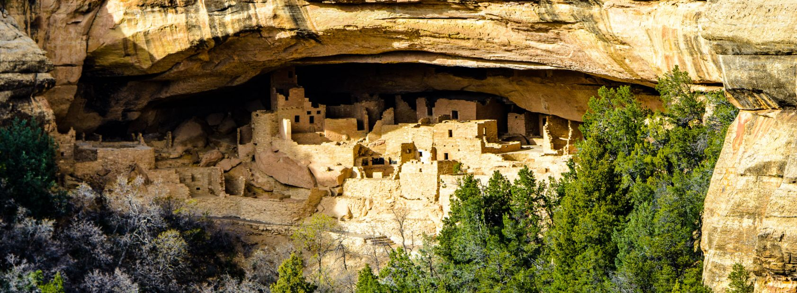
WRAP Regional Haze Modeling
2028 Visibility Projections and First Round of Potential Additional Controls (PAC1)
RTOWG Webinar
July 15, 2020

Slide 2
Introduction
MELA1
2028 Visibility Projections
Two sets of 2028 visibility projections made so far using EPA default visibility projection approach and CAMx modeling results:
RepBase/2028OTBa w/ RepBase fires
2014v2/2028OTBb w/ 2014v2 actual fires
Developed two alternative 2028 visibility projection approaches:
EPAwoF: Like EPA default using RRFs based on modeling results for days from 2014 IMPROVE MID only without using modeled contributions from fires that are eliminated using source apportionment
ModMID: Use modeled most U.S. anthropogenic emissions impaired days from 2014 IMPROVE sample days with contributions of fires eliminated using source apportionment
MEVE1
GUMO1

Slide 3
EPA Default Future Year Visibility Projection Method
EPA recommended visibility projection method using RepBase and 2028OTBa CAMx modeling results that used 2014 base year meteorology but 2014-2018 base year emissions:
Species-specific RRF based on ratio of 2028OTBa to RepBase CAMx modeling results averaged across observed IMPROVE 2014 MID
RRF = ∑ CAMx 2014 MID₂₀₂₈ / ∑ CAMx 2014 MID_{RepBase}
Apply RRF to IMPROVE 2014-2018 MIFD to obtained 2028 visibility projection
Visibility MID₂₀₂₀₈ = IMPROVE MID₂₀₁₄₋₂₀₁₈ x RRF
Issue: Modeled fire impacts on IMPROVE 2014 MID can make RRF stiff and unresponsive

Slide 4
Alternative 2028 Visibility Projection Approaches
Alternative 2028 projection methods to EPA default approach (EPAwoF and ModMID) do not produce very different visibility projections.
Largest differences with EPA default is for ModMID approach as it not only eliminates fire contributions in the RRFs but also using different days.
One reason alternative approaches don’t make huge differences is biggest impact of fires is on Organic Matter Carbon (OMC) whose RRF is already very stiff (close to 1.0) even without fires.
Example for Bext_{OMC} below for Yellowstone and RepBase source apportionment across 2014 IMPROVE MID
YELL Bext_{OMC} Extinction
SOAB
Wildfire

Slide 5
Potential Additional Controls
Some WRAP states provided a first round of Potential Additional Controls (PAC1) in 2028 that are used to make 2028 PAC1 visibility projections
Initial 2028 PAC1 visibility projections were made using EPA default projection approach
Issues found in 2028 emission inventories with double counted O&G sources mainly in New Mexico so doing minimal analysis of PAC1 results while fixing inventory
Expected state emissions reductions
Actual emission reductions were different for some states

Slide 6
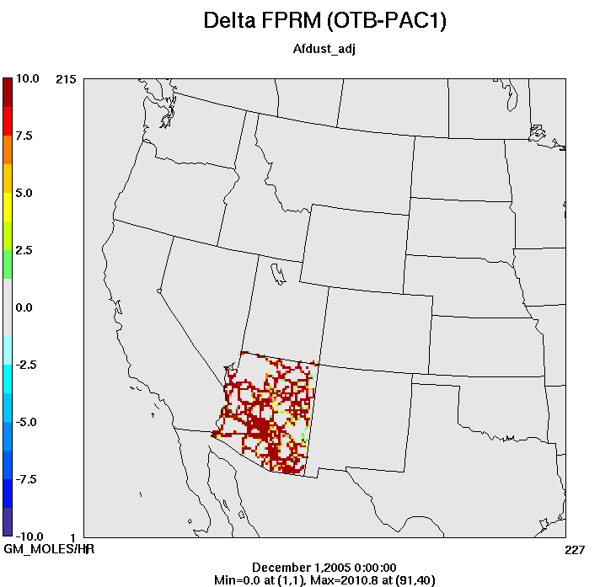
Actual PAC1 Total Emission Reductions by State
 | NOx | SO2 | PM25 | Comment
AZ | 1,651 | 2,092 | -61 | Primarily EGUs + PM2.5 from fugitive dust
CO | 314 | 0 | -1 | O&G Non-Point
ID | 675 | 1,335 | -65 | Non-EGU Point
MT | 55 | 458 | 1 | O&G Point
ND | 4,118 | 18,655 | 0 | EGU Point
NM | 28,937 | 7,704 | 6 | O&G Non-Point and Point
NV | 1,006 | 885 | 126 | Mainly EGU, some Non-EGU
OR | 2,832 | 440 | 1,101 | Non-EGU Point
SD | 1 | 0 | 0
UT | -1 | 0 | 0
WA | 0 | 0 | 0
WY | -2,272 | 3,467 | 1,406 | EGU and Non-EGU
AZ Fugitive Dust

Slide 7
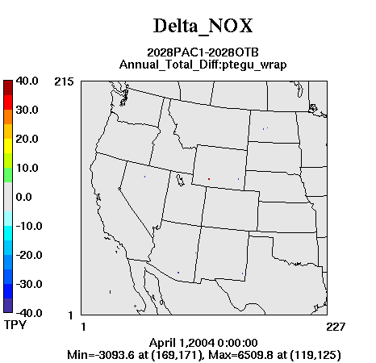
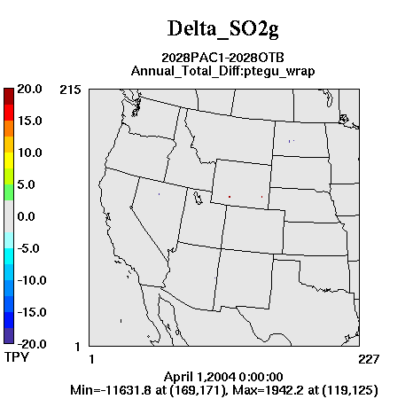
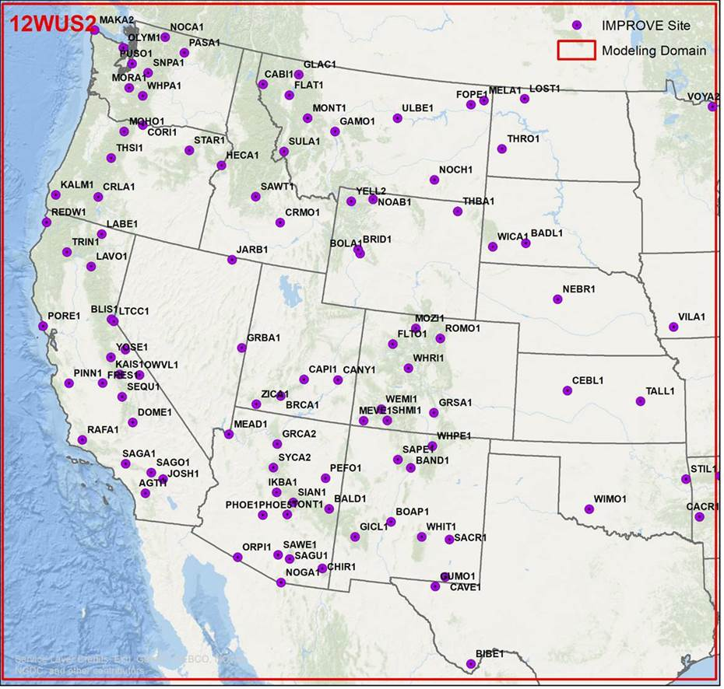
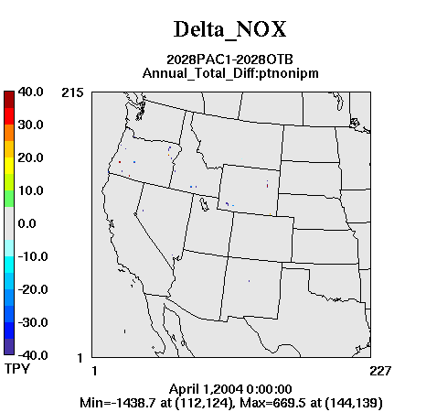
-0.2%
EGU and Non-EGU Point Sources
Changes (TPY)
Percent Change in 2028 Visibility
(lower deciview value, better projected visibility in 2028)
-4,000
-18,000
+4,000
+2,000
-0.7%
-600
-800
-0.2%
-0.6%
-0.5%
-1,000
-400
-2,000
-0.2%
-0.3%
-0.2%
-0.6%
-0.3%
-0.1%
-0.3%
-2,800
-700
-2,000
-400
-1,300
-4,500
-400
-50
-1.4%
-400
-200
-0.5%

Slide 8
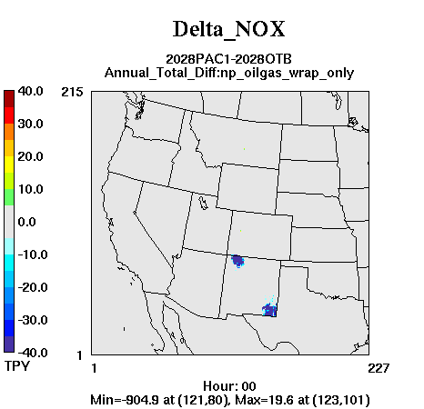
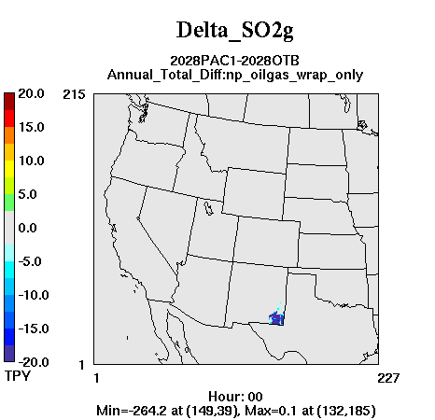
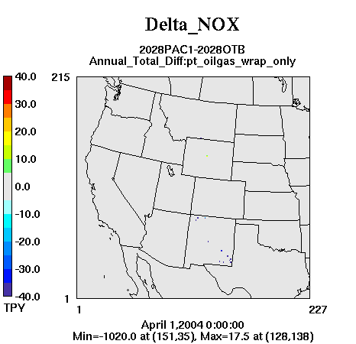
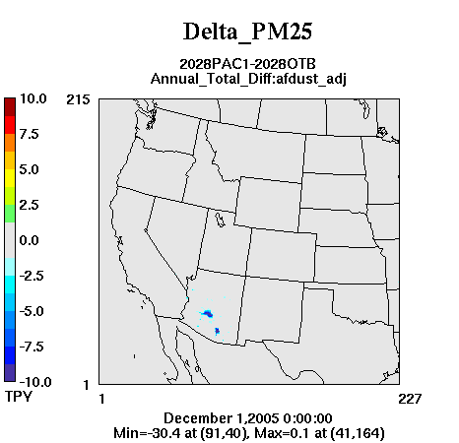
Oil and Gas and Fugitive Dust PM2.5
Changes (TPY)
Percent Change in 2028 Visibility
(lower deciview value, better projected visibility in 2028)
-25,000
-25,000
-0.6%
-0.3%
-0.8%
-0.3%
-0.6%
-500
-3,000
-700
-0.2%

Slide 9
2028 OTBa vs PAC1 MID Projections
 |  | 2028 (dv) |  | Difference
Site | State | OTBa | PAC1 | (%) | (dv)
SAGU1 | AZ | 10.13 | 9.99 | -1.4% | -0.14
SACR1 | NM | 14.71 | 14.55 | -1.1% | -0.16
BADL1 | SD | 11.84 | 11.74 | -0.9% | -0.10
SAPE1 | NM | 5.91 | 5.86 | -0.8% | -0.05
MEVE1 | CO | 6.19 | 6.15 | -0.8% | -0.05
WHPE1 | NM | 5.55 | 5.50 | -0.8% | -0.04
WHRI1 | CO | 4.48 | 4.44 | -0.7% | -0.03
LOST1 | ND | 16.25 | 16.14 | -0.7% | -0.11
WHIT1 | NM | 9.73 | 9.67 | -0.6% | -0.06
PEFO1 | AZ | 7.44 | 7.39 | -0.6% | -0.05
MOZI1 | CO | 4.88 | 4.85 | -0.6% | -0.03
BAND1 | NM | 8.02 | 7.97 | -0.6% | -0.05
WEMI1 | CO | 6.08 | 6.05 | -0.6% | -0.04
MOHO1 | OR | 8.35 | 8.30 | -0.6% | -0.05
THRO1 | ND | 13.95 | 13.86 | -0.6% | -0.08
BRID1 | WY | 6.33 | 6.29 | -0.6% | -0.04
TONT1 | AZ | 9.64 | 9.58 | -0.6% | -0.05
HECA1 | OR | 11.52 | 11.46 | -0.5% | -0.06
GRSA1 | CO | 7.54 | 7.50 | -0.5% | -0.04
CHIR1 | AZ | 8.73 | 8.69 | -0.5% | -0.04
GICL1 | NM | 7.18 | 7.15 | -0.5% | -0.03
SYCA2 | AZ | 10.99 | 10.94 | -0.5% | -0.05
GRCA2 | AZ | 6.37 | 6.34 | -0.4% | -0.03
BALD1 | AZ | 6.67 | 6.64 | -0.4% | -0.03
IKBA1 | AZ | 8.61 | 8.58 | -0.4% | -0.04
BOAP1 | NM | 10.04 | 10.00 | -0.4% | -0.04
CANY1 | UT | 6.15 | 6.12 | -0.4% | -0.02
MELA1 | MT | 15.44 | 15.38 | -0.3% | -0.05
CRMO1 | ID | 7.51 | 7.49 | -0.3% | -0.02
WICA1 | SD | 9.89 | 9.86 | -0.3% | -0.03
ROMO1 | CO | 7.46 | 7.44 | -0.3% | -0.02
THSI1 | OR | 10.78 | 10.75 | -0.3% | -0.03
SIAN1 | AZ | 8.50 | 8.48 | -0.3% | -0.02
BRCA1 | UT | 6.02 | 6.01 | -0.3% | -0.02
STAR1 | OR | 10.20 | 10.17 | -0.2% | -0.02
YELL2 | WY | 7.05 | 7.03 | -0.2% | -0.02
JARB1 | NV | 7.77 | 7.75 | -0.2% | -0.02
CAPI1 | UT | 6.67 | 6.65 | -0.2% | -0.02
VOYA2 | MN | 13.37 | 13.34 | -0.2% | -0.03
GUMO1 | TX | 12.27 | 12.24 | -0.2% | -0.03
KALM1 | OR | 11.54 | 11.51 | -0.2% | -0.02
Very small reductions in 2028 projected visibility due to PAC1 controls
Max = -1.4% (-0.14 dv) @ SAGU, AZ
2nd High = -1.1% (-0.16 dv) @ SACR, NM
Mostly hundredths of dv
73% of sites reductions of at least -0.01 dv
Sites with no change away from emission reductions (e.g., CA)

Slide 10
Conclusions 2028 PAC1
As expected, very small changes in projected 2028 MID dv
Mostly hundredths of dv changes
Largest changes in or near states with emissions reductions (e.g., NM, AZ, ND)
Smallest changes away from such states (e.g., CA)
Round 2 of Potential Additional Controls (PAC2)
Need state emission changes to be tested by Sept. 10, 2020
Caveats:
2028OTB emissions include double counted O&G sources
In both 2028OTBa and 2028PAC1
Does not affect the reductions in 2028 MID due to PAC1 controls
Probably minimal affect on 2028 MID projections

