Slide 1
Tribes, WRAP and Regional Haze
Practices and processes for Tribes to address regional air quality

Slide 2
Regional Haze and the Regional Haze Rule
1977 Clean Air Act (CAA) Amendments set National Visibility Goals
These are important to the human experience of landscapes, including sacred spaces
1990 CAA Amendments: Regional Haze Rule
Goal to return “Class 1 areas” to their natural state before human-caused air pollution
1991: Grand Canyon Visibility Transport Commission
Notes:
The 1977 Clean Air Act (CAA) amendments set a National Visibility Goal “the prevention of any future, and the remedying of any existing, impairment of visibility in mandatory class I Federal areas which impairment results from manmade air pollution.”
Section 169A of the Clean Air Act
Further CAA amendments in 1990 provided emphasis on regional haze issues, and required the U.S. Environmental Protection Agency (the EPA) to establish the Grand Canyon Visibility Transport Commission (GCVTC) to study the causes of regional haze and provide recommendations on a regulatory approach to remedy the problem.

Slide 3
Tribal Class I Areas
Notes:
As of 2018 these five tribes have elected to protect their air quality through classification as “Class I”.

Slide 4
Federal Class I Areas
Notes:
These large National Parks and Wilderness Areas must become free of human–caused regional haze.

Slide 5
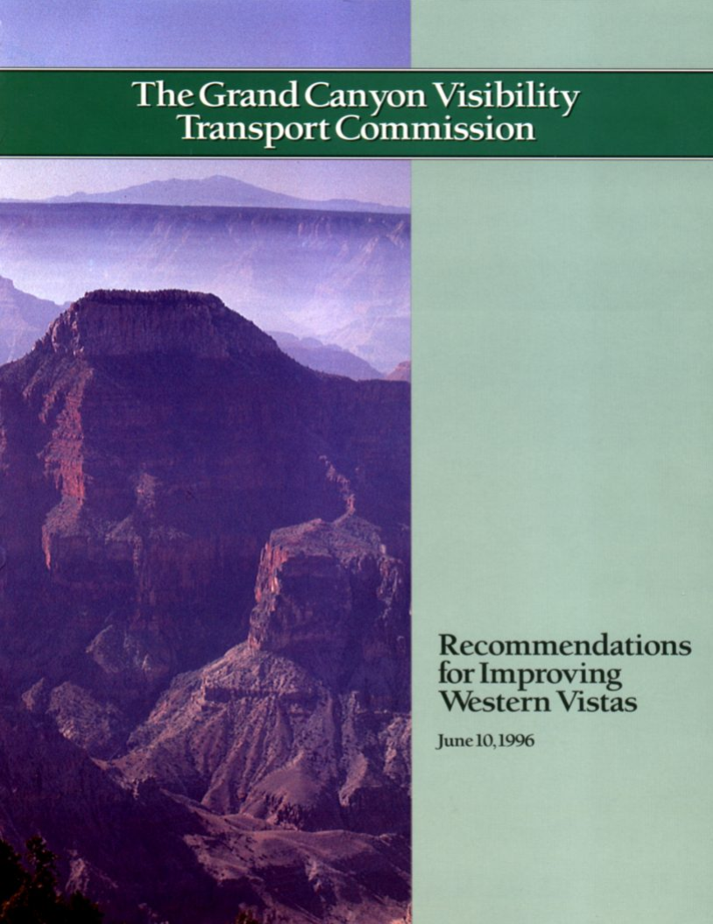
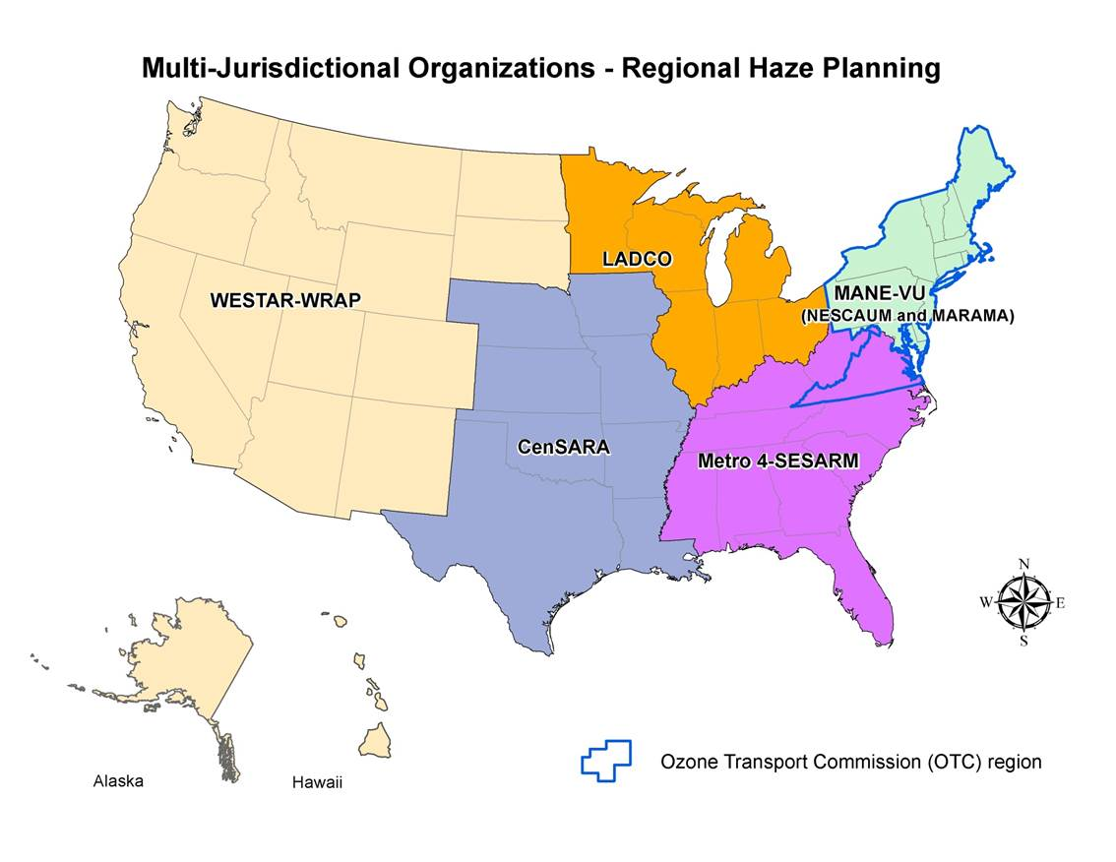
History: From Grand Canyon Visibility Transport Commission (GCVTC) to Western Regional Air Partnership (WRAP)
Notes:
The 1991 GCVTC became the WRAP in 1997 with new and broader air quality planning purposes.

Slide 6
GCVTC: Tribal engagement key from the start
Representatives of the Navajo Nation, Hopi Tribe, Hualapai Tribe, and Acoma Pueblo served on the GCVTC, along with many Tribal members on advisory, technical and communications committees.
Early and important example of Tribal engagement in air quality policy-making
Notes:
In 1991 the EPA announced the first meeting of the GCVTC in Grand Canyon National Park, with members including officials from the EPA, the Forest Service, the Bureau of Land Management, the Fish and Wildlife Service, the National Park Service, and the 8 Western governors.
Although other portions of the 1990 CAA amendments included the first explicit consideration of Tribes with respect to air quality regulations, there was no mention of Tribal participation in the requirement for the GCVTC, and the membership at the initial meeting reflected this.
The GCVTC immediately appointed a Public Advisory Committee (PAC) to obtain broad perspectives, and to develop policy options for its ultimate recommendations. This Public Advisory Committee included two Tribal leaders and was expanded to include others as the scope of the GCVTC grew beyond the Grand Canyon to include the "golden circle of parks"
The GCVTC, and development of regional haze mitigation policies, was an early and important example of Tribal engagement with federal and state agencies to develop federal policy.

Slide 7
For Western states & Tribes: Western Regional Air Partnership (WRAP)
Grew out of the committee assigned to study visibility in Grand Canyon National Park
Voluntary partnership of Tribes, states, local air agencies, federal land managers (FLM), and the EPA
Work together to:
address Regional Haze Rule planning & implementation
understand current and evolving regional air quality issues in addition to regional haze
provide input to EPA in modifications to existing regulations or development of new ones

Slide 8
WRAP history: the first ten years

Slide 9
WRAP purpose and implementation
Primarily coordinate Western implementation of Regional Haze Rule
Broader mission to provide a venue for cooperatively addressing air quality issues of regional concern
Tribes and Tribal perspectives fully recognized and included in the WRAP from the beginning, setting a precedent for ways Tribes, states and federal agencies can collaborate to develop regional environmental policies
All Tribes in West automatically members
WRAP Board of Directors includes equal number of members from Tribes and states, along with federal government representatives, and is co-chaired by one Tribal and one state representative
Notes:
Tribes are automatically members in the WRAP, but need to send an official letter to WRAP requesting active membership and designating two contact people in order to be active members.

Slide 10
Tribal Caucus of the WRAP
This important group expressed concerns beyond regional haze. In 2009 these concerns were incorporated into WRAP charter:
research on the health impacts of particulate matter in rural communities;
dust modeling to improve Tribal and state emissions inventories;
research and coordination on climate change impacts and mitigation;
inclusion of increased emissions from oil and gas production in analyses for Regional Haze Rule compliance;
monitoring the effects of atmospheric mercury deposition;
technical assistance with other aspects of CAA compliance; and
modeling increased ozone emissions in rural areas.

Slide 11
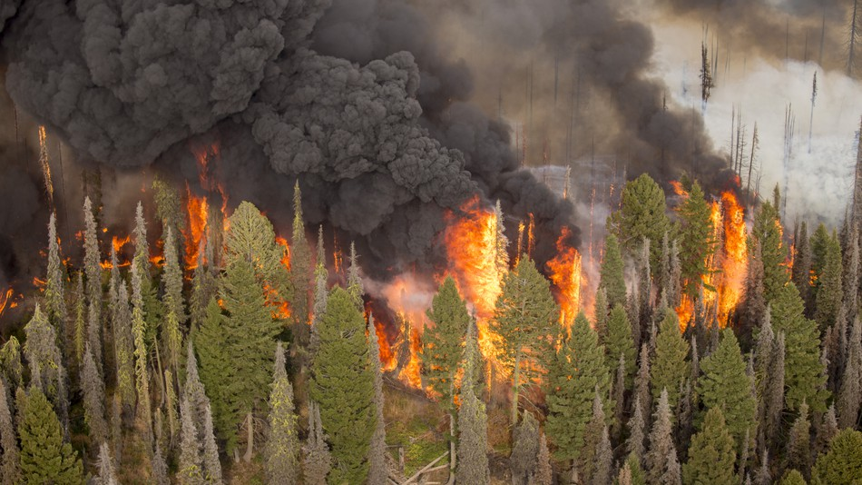
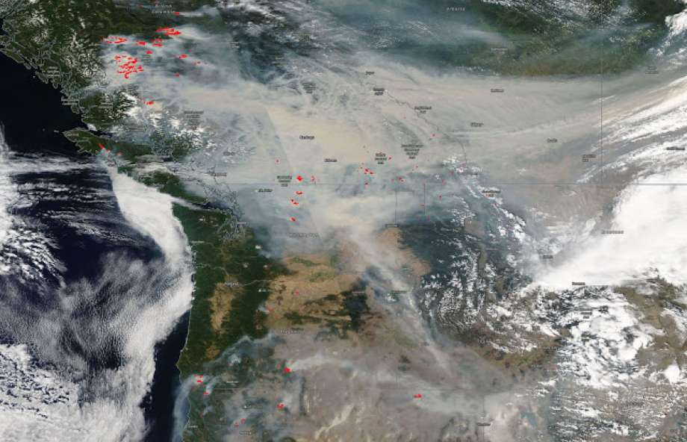
today

Slide 12
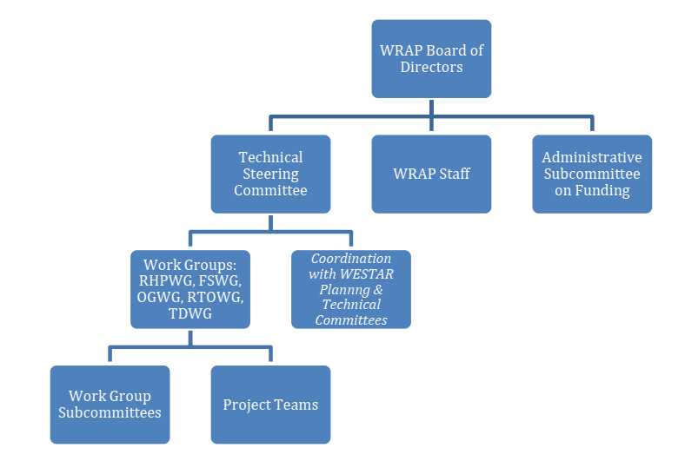
WRAP today
Continued voluntary partnership of Tribes, states, FLM, EPA
24 Tribes are active members of WRAP, participating in all WRAP sub-committees
In-person meetings
Decisions by consensus
BOD Co-chaired by Tribe
Equal Tribe and State BOD representation
Notes:
Tribes always have played an important role in WRAP governance. Needs and opportunities for more Tribal participation are growing.

Slide 13
Work groups focus effort on key challenges
Regional Haze Planning Work Group
Data collection, modeling, analysis
Fire & Smoke Work Group
Understanding fire’s role in air quality planning & improve coordination
Oil & Gas Work Group
Identify sites and improve data collection and research
Tribal Data Work Group
Training, funding opportunities, data collection support
Regional Technical Operations Work Group
Provides regional technical support for issues of common member interest
Notes:
These current WRAP’s sub-groups are of interest to different Tribes.

Slide 14
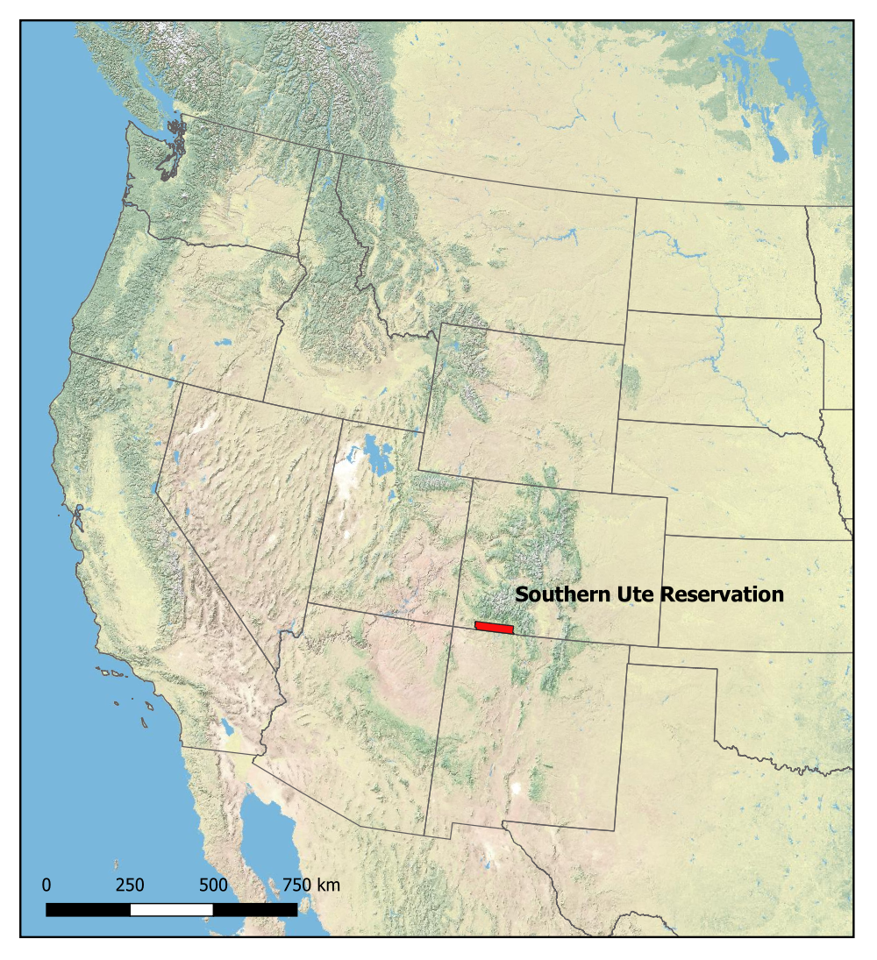
CASE STUDY Permitting In-house to Protect Public Health: Southern Ute Indian Tribe

Slide 15
Case Study: Southern Ute Indian Tribe
The Southern Ute Indian Tribe (SUIT) has significant oil & gas activity, both from SUIT-owned and non-Tribal companies.
Ozone concentrations on the Reservation have been close to non-attainment for ozone at one or more of its air monitoring stations for several years (e.g. 69ppb of 70ppb -- the national health-based standard).
SUIT’s Air Quality Program (AQP) manages some CAA implementation and enforcement, e.g. operating Title V permitting program.
SUIT currently under Federal Implementation Plan for Tribal Minor New Source Review (TMNSR) permitting for all oil & gas activity (over 6000 air pollution emissions sources on the Reservation)
Concern at AQP that the FIP and State of NM air quality regulations may not be adequate to prevent future non-attainment designation, due to volume of oil & gas activity, particularly if there is another boom.
AQP recommended assuming administrative responsibility for Federal TMNSR program and FIP – tasked to seek additional stakeholder input
Notes:
The SUIT AQP has worked to share emission inventory information with WRAP for their 2014 Greater San Juan Basin Emission Inventory and for their efforts in aiding the BLM in development of the Colorado Air Resource Management Modeling Study.
The Southern Ute Indian Reservation (SUIR) is a Reservation with significant natural gas production and the Southern Ute Indian Tribe (SUIT) owns and operates oil and gas production, processing and transmission companies on and off the Reservation. Ozone concentrations on the SUIR have been close to the 2015 Ozone standard of 70 ppb at one or more of its monitoring stations in one or more of the last several years. An Intergovernmental Agreement (IGA) is managed by the Southern Ute Indian Tribe and State of Colorado Environmental Commission (Commission), which serves as the policy-making and administrative review authority for the Reservation Air Program, and the IGA established the Tribe as the administrator of the Reservation Air Program. A main goal of the IGA was to create a single air quality program for all lands within the exterior Reservation boundaries. Under the IGA, the EPA retains authority to administer federal Clean Air Act programs on the Reservation that have not been adopted by the Commission. Since 2012, SUIT has been administering a Part 70 program delegation of the Title V Operating Permit program for the SUIR. This delegation provided the Tribe authority to perform permitting, compliance inspections, and civil enforcement. In 2018, 36 sources operated under SUIT-issued Title V permits.
According to the 2015 Southern Ute Indian Tribe Comprehensive Emission Inventory for Criteria Pollutants, Hazardous Air Pollutants, and Greenhouse Gases, oil and gas production and processing infrastructure account for the vast majority of stationary sources of air pollution on the Reservation. The Tribe manages two regulatory and one non-regulatory air quality monitoring stations on the SUIR. Pollutants monitored include ozone, oxides of nitrogen, carbon monoxide, particulate matter, sulfur dioxide, methane, and non-methane hydrocarbons. The Tribe also has an experimental mobile methane detection unit. Minor sources on the SUIR are currently regulated through the EPA’s administration of the federal TMNSR and FIP for all oil & gas activity (over 300 sources). There are approximately 2600 additional oil and gas sources on the SUIR with emissions below the de-minimus permitting thresholds of the TMNSR and FIP. There is concern at the Air Quality Program that the FIP and State of New Mexico air quality regulations may not be adequate to prevent a future non-attainment designation for Ozone in the San Juan Basin, due to the volume of oil & gas activity, particularly if there is another boom. The SUIT is considering either seeking administrative delegation for the TMNSR and FIP or submitting a TIP to replace the TMNSR and FIP in its entirety. The Air Quality Program recommended the Commission to consider authorizing the Tribe to seek administrative delegation of the federal TMNSR program and FIP at the Commission meeting on December 5, 2018. The Commission has tasked the Air Quality Program with seeking some additional stakeholder input prior to making a final decision on minor source regulation on the SUIR.

Slide 16
Tribal engagement in WRAP It’s Important

Slide 17
Tribal membership in WRAP
24 Tribes are active members today
All Tribes are automatically members; any Tribe in the region can take an active part in the WRAP
Membership commitments can include: regular meetings of sub-committees, participation in workshops, review of technical documents, and time spent working on ideas and solutions
For face-to-face meetings, some travel costs are covered and some are Tribal responsibility
Notes:
To become active members, Tribes need to contact WRAP in writing and request this, and designate two people as points of contact

Slide 18
Benefits of Tribal participation in WRAP
The WRAP tackles key regional policy decisions - Tribal participation forms/informs decision process now and for the future.
Tribal presence ensures a Tribal perspective in decisions now and in the future.
Whether or not Tribe develops a Tribal Implementation Plan (TIP), participation in WRAP provides opportunity to engage in collaborative management of regional air quality and public health.
Access to partnering States’ SIP planners and SIP components
Access to data, technical training, and technical expertise
Collaborate with federal, state, other land managers to shape policy
Shape policy development and consultation/collaboration processes
Shape appropriate responses to pending policy
Notes:
The WRAP tackles key regional policy decisions, and Tribal participation helps to form and inform the decision process now and for the future. This Tribal presence ensures a Tribal perspective in decisions now and ensures that a tribal voice is included in future WRAP undertakings and major policy issues.
Whether or not a Tribe has any interest in, or need for, developing its own Tribal Implementation Plans or TIPs for air quality management, participation in WRAP provides an opportunity to engage in collaborative management of regional air quality and public health.
This includes access to & familiarity with the partnering States’ State Implementation Plan (SIP) planners and SIP components.
WRAP provides Tribes with the opportunity to collaborate with federal, state and other land managers to shape policy, to shape the policy development and consultation/collaboration processes, and to shape the appropriate responses to policy.
Any Tribe in the region can join the WRAP. Membership commitments can include: regular meetings of sub-committees, participation in workshops, review of technical documents, and time spent working on ideas and solutions. For face-to-face meetings, some travel costs are covered and some are your responsibility.

Slide 19
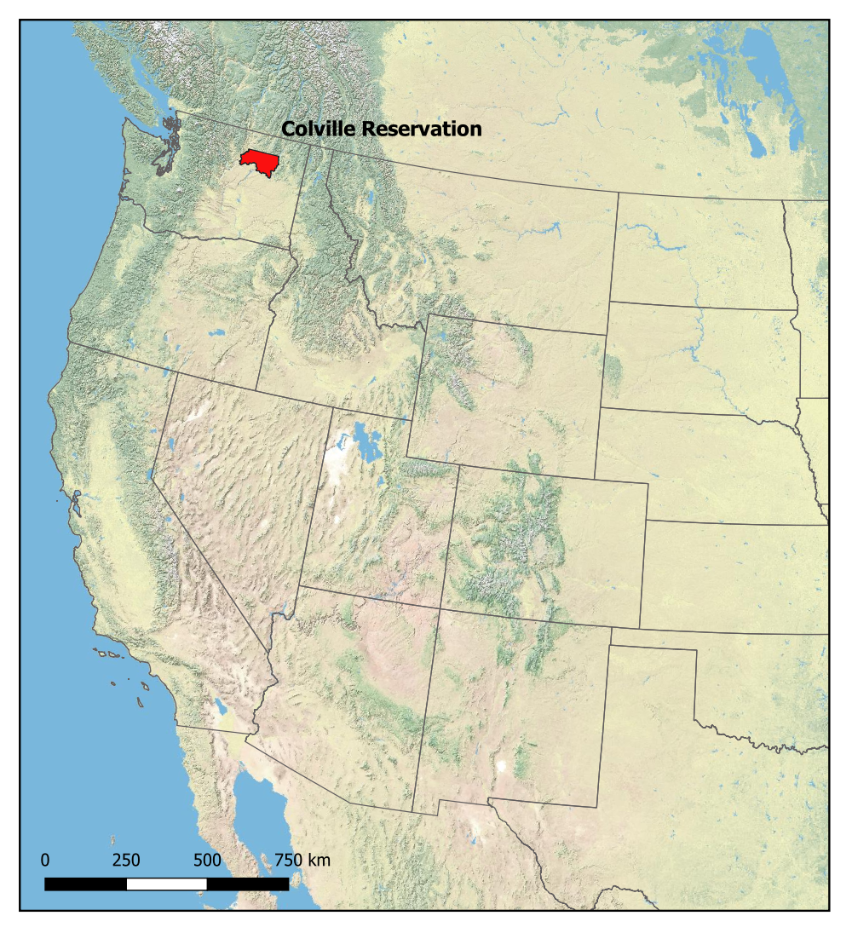
CASE STUDY Forestry, Fire and Air Quality: Confederated Tribes of the Colville Reservation

Slide 20
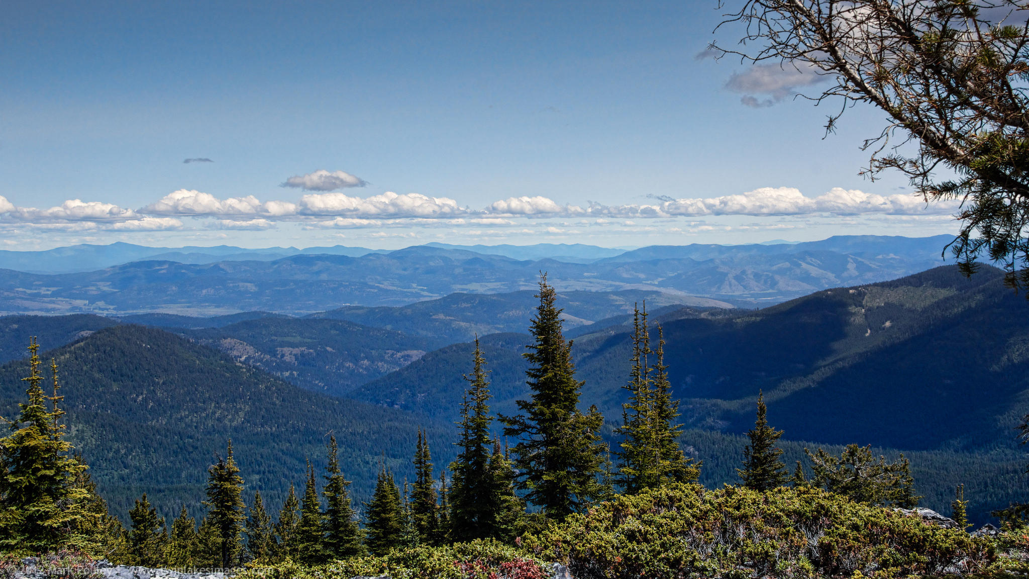
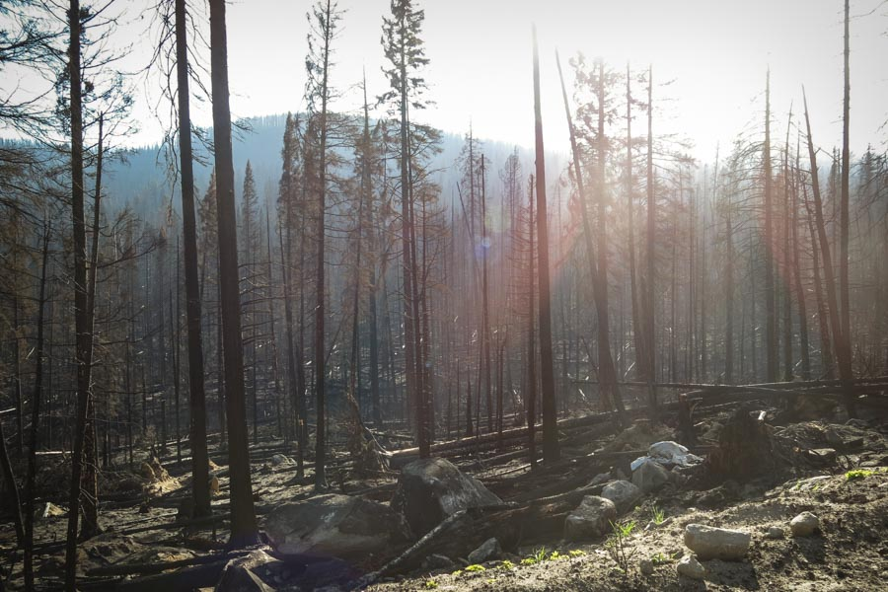
CASE STUDY: Confederated Tribes of Colville Reservation
Forestry = significant revenue for Tribal government and economic benefits for Tribal members
Devastating 2015 wildfires burned 20% of Tribal land
Timber valued at $100 Million
Increased fire season and winter inversion = air quality health concerns
Notes:
Forestry, Fire and Air Quality: Confederated Tribes of the Colville Reservation
For the Confederated Tribes of the Colville Reservation ("Colville Tribes"), who have been long-time active participants in the WRAP, forest management and timber sales are an important source of revenue. These revenues have historically funded Tribal government operations, providing services and supporting government employment. About two thirds of the reservation is forested; the wildfires in the 2015 season burned nearly 20 percent of the Tribe’s total land, including timber valued at $100 million. Increasingly severe fire seasons and a tendency for winter weather inversions also cause serious air quality health concerns. Consequently, managing fires for forest health and public health is important to the Tribes. The Colville Tribes’ Forestry division collaborates with the Air Quality program in the Office of Environmental Trust and other Tribal agencies to plan for and manage fire as part of its strategies in implementing its role in the Integrated Resources Master Plan and the Forest Management Plan.
In Fall 2015, the Confederated Tribes of the Colville Indian Reservation signed an agreement with USEPA Region 10 to allow the Tribes to manage the Federal Air Rules for Reservations provisions for air pollution episodes, open burning and burn bans. This partial delegation of authority under FARR enabled much greater outreach regarding these provisions, as they are now managed by the Colville Reservation Office of Environmental Trust. Enforcement remains the responsibility of EPA Region 10.
The Air Quality Program of the Office of Environmental Trust monitors air quality on the Reservation, makes determinations about appropriate burning times and burn bans, and issues permits for agricultural and other field or open burning. As part of this work, the Air Quality Program is involved with other Tribal programs, such as Emergency Services, Colville Indian Housing Authority, and Tribal Health, and collaborates with regional agencies on smoke and other air pollution issues and monitoring.
The Colville Tribes at this point have been long-time active members of the WRAP. Many years ago, Kris Ray, the Tribes’ Air Quality Program manager, noticed a high haze over the Reservation that could not be attributed to local or regional emissions sources. He looked into WRAP for guidance, and became an active member by joining the Technical Steering Committee and becoming co-chair of the Tribal Data Workgroup. This involvement has helped him understand the complexities of Regional Haze and other Western and national U.S. air quality issues.

Slide 21
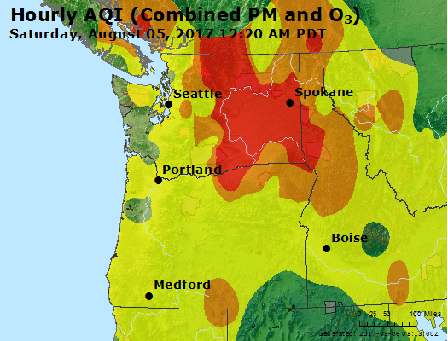
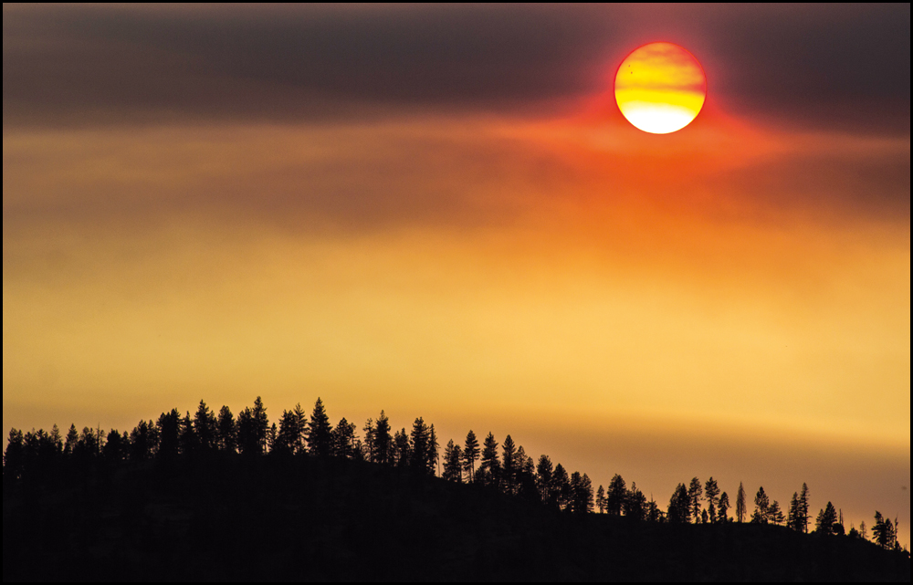
Colville Air Quality Program
Colville Reservation Office of Environmental Trust
Manages air quality monitoring and outreach
Collaborates with Tribal and regional agencies
Works closely with Forestry division
Colville Air Quality Program significant WRAP participant and contributor through committee leadership

Slide 22
For more information on WRAP membership:
www.wrapair2.org

