Slide 1
State-Specific Source Group Visibility Contributions
Methodology for 2028OTBa2 State-Specific Source Group Visibility Source Apportionment Modeling
Ramboll
WRAP Regional Haze Results Meeting #8
April 1, 2021

Slide 2
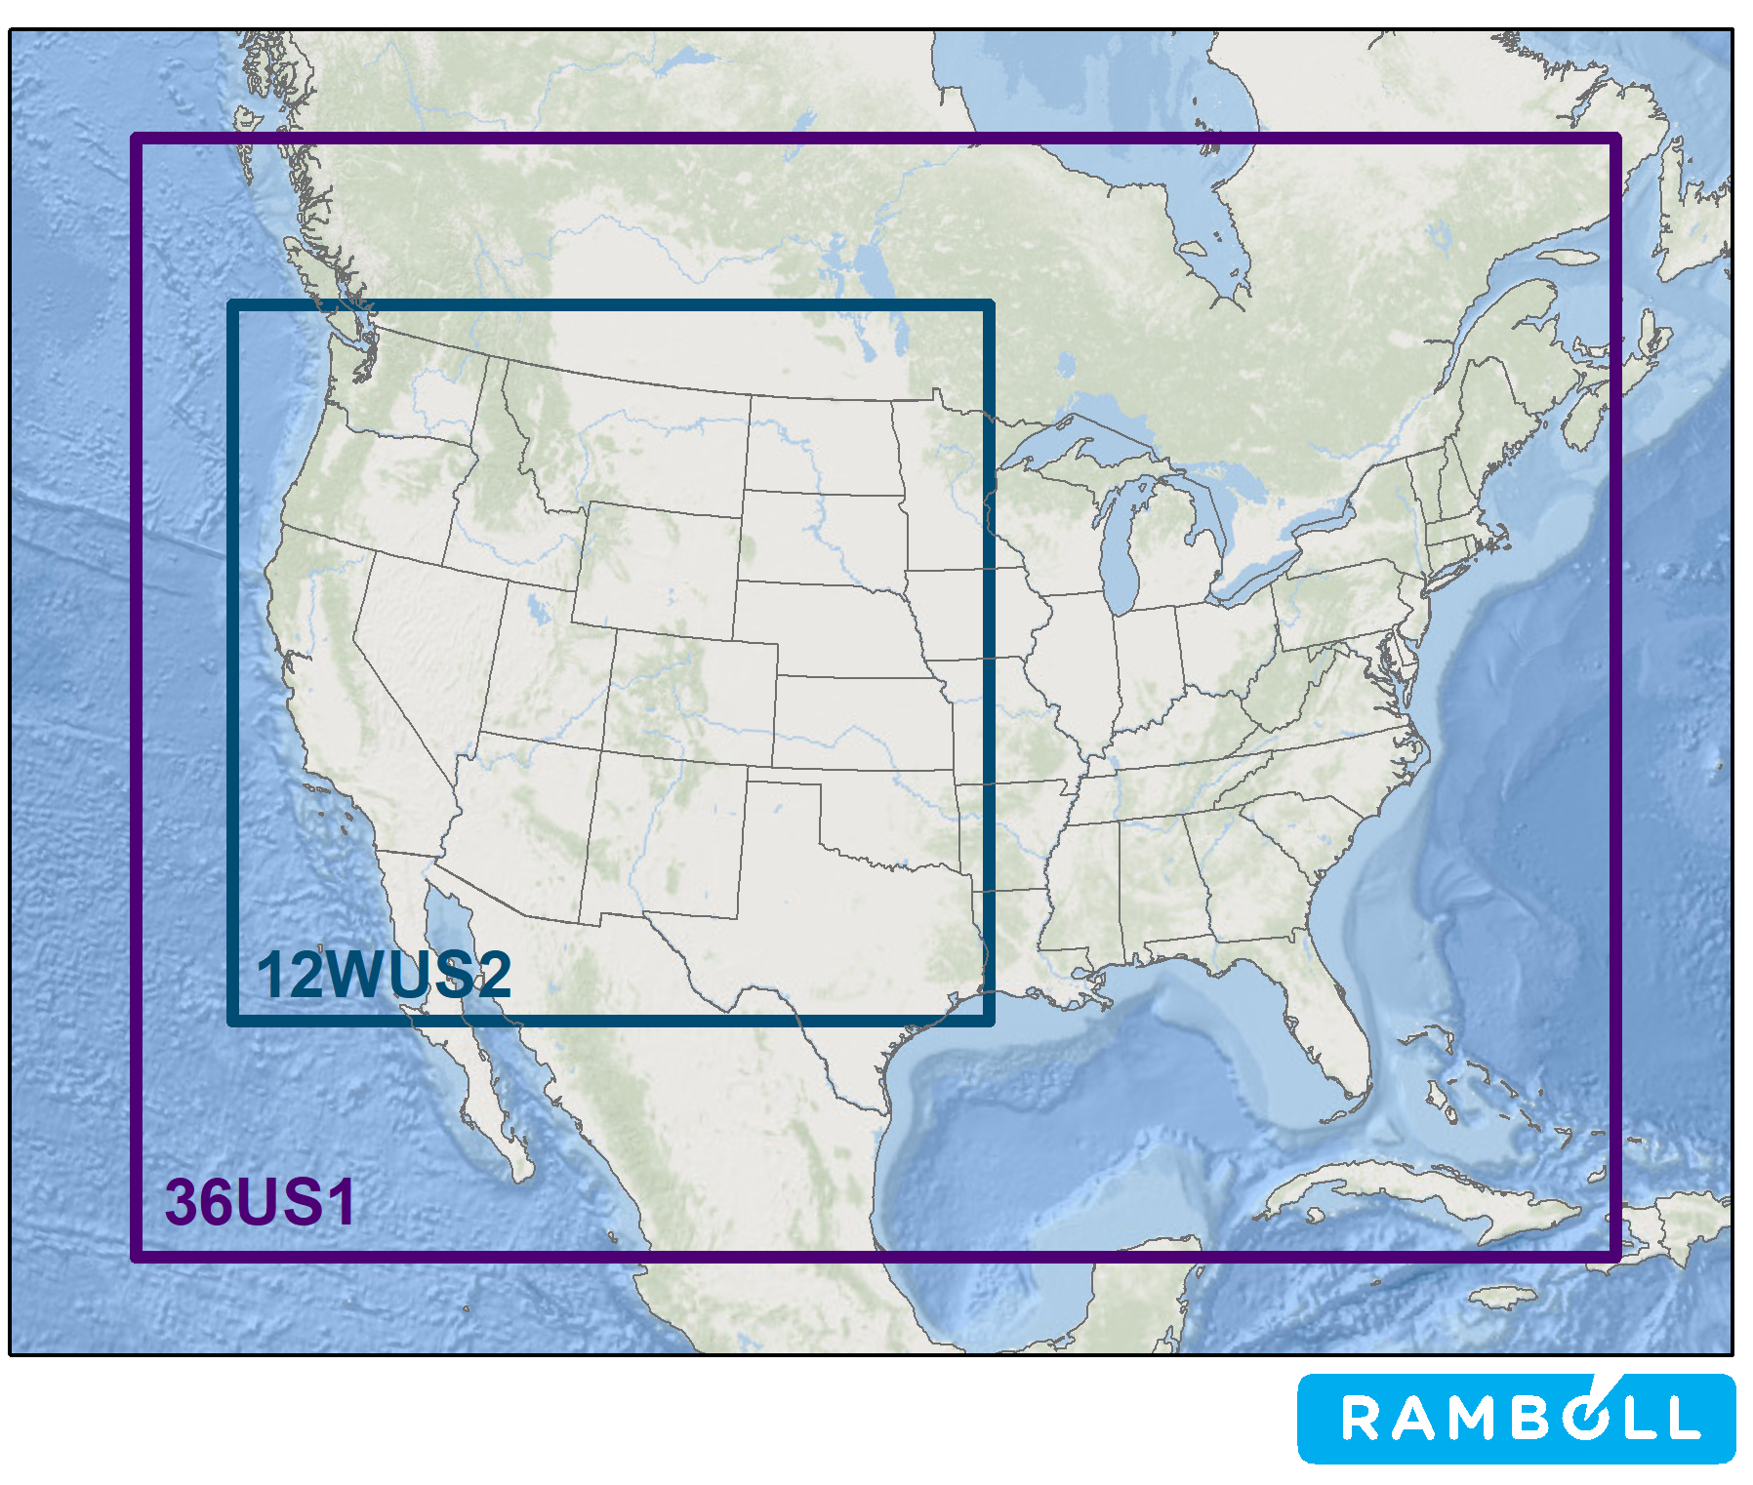
WRAP Regional Haze CAMx 2014 Modeling Platform
2014 Calendar Year
  Run in 4 Quarters with 10 days of spin-up
  Multiprocessing using 24 CPUs per quarter
    8/3 MPI/OpenMP
WAQS WRF 2014 36/12-km Meteorology
2014v2 Actual Emissions
  2014NEIv2 w/ Western State updates
  CAMx 2014v2 used in Model Performance Evaluation
Representative Baseline (RepBase2) Emissions
  Representative of 2014-2018
  RepBase Fires
2028 On-the-Books (2028OTBa2)
  RepBase Fires
2028 PAC2, FFS1, FFS2
2002 Hindcast Scenario
36-km and 12-km Two-Way Nested Domains

Slide 3
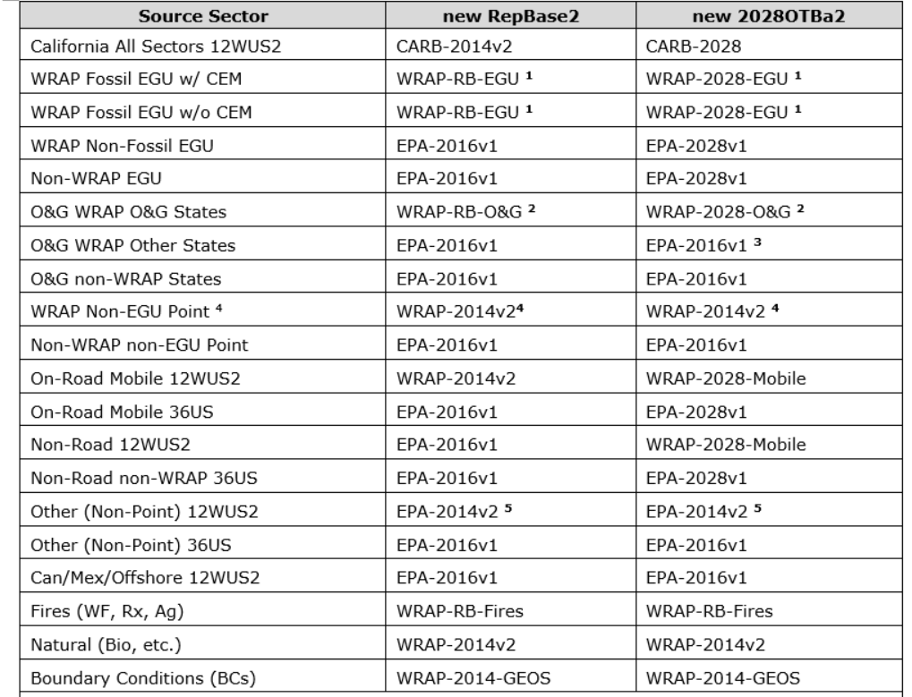
RepBase2 and 2028OTBa2 Emissions Used
RepBase2 Emissions:
  WRAP RepBase EGU, O&G, Fires
  WRAP 2014v2 Non-EGU Point, On-Road
  EPA 2016v1 Many Source Sectors
  CARB 2014v2
2028OTBa2 Emissions:
  WRAP 2028 EGU, On-Road, Non-Road
  WRAP 2023 O&G
  WRAP 2014v2 Non-Point
  EPA 2028 EGU, On-Road, Non-Road
  EPA 2016v1 Non-Point
  CARB 2028

Slide 4
Visibility Source Apportionment Modeling
Visibility Source Apportionment Modeling used for Multiple Purposes:
  Identification of contributions of fires [U.S. WF, Rx & Ag and Other (Mex/Can)]
    Used in some 2028 visibility projections (EPAwoF, ModMID)
  Contributions of International Anthropogenic Emissions and Wildland Prescribed Burns (Rx)
    Used to adjust the Uniform Rate of Progress Glidepaths
  Comparison of model vs. ambient data derived Natural Emissions
  Isolate contributions of U.S. anthropogenic emissions to modeled impairment
    Modeled U.S. Anthropogenic Emissions Rate of Progress Analysis using 2002Hindcast, RepBase2 (2014-2018) and 2028OTBa2 source apportionment and remaining modeled natural/international/fire visibility held constant to 2064 (i.e., no U.S. anthropogenic impairment in 2064)
  Understanding sources of visibility degradation and insight into modeling results
  Contributions of individual WRAP state Source Groups to visibility impairment at Class I Areas
    Quantify own states and nearby states contributions to impairment at state’s Class I Areas

Slide 5
CAMx Source Apportionment Tools
Uses tagged species/reactive tracers that run in parallel to the host model and extracts source contribution information to modeled concentrations for user-defined Source Groups
User-defined Source Groups can be Source Categories (e.g., Wildfire emissions) and/or emissions from geographic areas (Source Regions)
  A typical CAMx source apportionment application will divide the modeling domain into geographic regions (e.g., grid cell definitions of States) using a Source Region map and then provide separate emission input files for each Source Category
    Source contributions are obtained for each Source Group that is defined as the intersection of the Source Regions with the Source Categories (e.g., on-road mobile sources from Colorado)
    Source Groups must include all sources, sum of contributions from all Source Groups adds up to total host model concentrations
There are two ozone source apportionment tools in CAMx:
  Ozone Source Apportionment Technology (OSAT)
  Anthropogenic Precursor Culpability Assessment (APCA)
    APCA only allocates ozone to Natural Sources when it is due to Natural Source VOC reacting with Natural Source NOx
Particulate Source Apportionment Technology (PSAT)
  PSAT used in WRAP regional haze modeling to obtain Source Group contributions to PM species from which extinction is calculated

Slide 6
Families of PSAT Particulate Matter Tracers (# tracers)
Sulfur (3)
  SO2_{i} Primary SO₂ emissions
  DMS_{i} Dimethyl sulfide
  PS4_{i} Particulate sulfate from primary emissions plus secondarily formed sulfate
Nitrogen (8)
  NIT_{i} Nitric oxide (NO) and nitrous acid (HONO)
  RGN_{i} Nitrogen dioxide (NO₂), nitrate radical (NO₃), and dinitrogen pentoxide (N₂O₅)
  TPNi Peroxyl acetyl nitrate (PAN), analogues of PAN and peroxy nitric acid (PNA)
  NTRi Organic nitrates (RNO₃)
  HN3i Nitric acid (HNO₃)
  PN3i Particulate nitrate from primary emissions plus secondarily formed nitrate
  NH3i Ammonia (NH₃)
  PN4i Particulate ammonium (NH₄)
Primary Particulates (14)
  PEC_{i} Primary Elemental Carbon
  POA_{i} Primary Organic Aerosol
  PFC_{i} Fine Crustal PM
  PFN_{i} Other Fine Particulate
  PCC_{i} Coarse Crustal PM
  PCS_{i} Other Coarse Particulate
  PFEi Iron
Secondary Organics (14)
  ARO_{i} Aromatic (benzene, toluene, xylene, IVOA) secondary organic aerosol precursors
  ISP_{i} Isoprene secondary organic aerosol precursor
  TRP_{i} Terpene secondary organic aerosol precursors
  SQT Sesquiterpene secondary organic aerosol precursors
  CG1_{i} Condensable gases from aromatic precursors (high volatility products)
  CG2_{i} Condensable gases from aromatic precursors (low volatility products)
  CG3_{i} Condensable gases from biogenic precursors (high volatility products)
  CG4_{i} Condensable gases from biogenic precursors (low volatility products)
  PO1_{i} Particulate organic aerosol from aromatics (associated with CG1)
  PO2_{i} Particulate organic aerosol from aromatics (associated with CG2)
  PO3_{i} Particulate organic aerosol from biogenics (associated with CG3)
  PO4_{i} Particulate organic aerosol from biogenics (associated with CG4)
  PPA_{i} Anthropogenic organic aerosol polymers (SOPA)
  PPB_{i} Biogenic organic aerosol polymers (SOPB)
Mercury (3)
  HG0_{i} Elemental Mercury vapor
  HG2_{i} Reactive gaseous Mercury vapor
  PHG_{i} Particulate Mercury
  PMNi Manganese
  PMGi Magnesium
  PKi Potassium
  PCAi Calcium
  PALi Aluminum
  PSIi Silicon
  PTIi Titanium
WRAP regional haze source apportionment modeling used the Sulfur, Nitrogen and Primary Particulates families of PSAT Tracers (25 tracers per Source Group)

Slide 7
WRAP Regional Haze Source Apportionment Modeling
Regional Source Apportionment
  Provides visibility source apportionment for major Source Categories with limited geographic region breakdown (i.e., U.S. vs. International)
    U.S. Anthropogenic
    International Anthropogenic
    Natural
    Four types of Fires (U.S. WF, Rx & Ag and Other)
    Stratified Boundary Conditions (BC_{Nat}, BC_{Intl}, BC_{US})
  Used for RepBase2, 2028OTBa2 and 2002Hindcast
Source Group Source Apportionment
  Use Source Region map to divide domain into 13 WRAP States, Remainder U.S. and International
  Obtain several contributions for 5 major U.S. anthropogenic emission Source Categories:
    EGU Point
    Non-EGU Point
    Oil and Gas (Point and Non-Point)
    Mobile (On-Road and Non-Road, Rail, CMV)
    Remainder Anthropogenic (Fugitive dust, agricultural, agfire, residential wood combustion, remaining nonpoint)
Although PSAT SOA family of tracers was not used, the standard model output was used to operationally separate SOA into anthropogenic (SOAA) and biogenic (SOAB) categories based on VOC species precursor:
    SOAA (Aromatics, Xylene, Toluene, Benzene)
    SOAB (Isoprene, Terpene, Sesquiterpene)

Slide 8
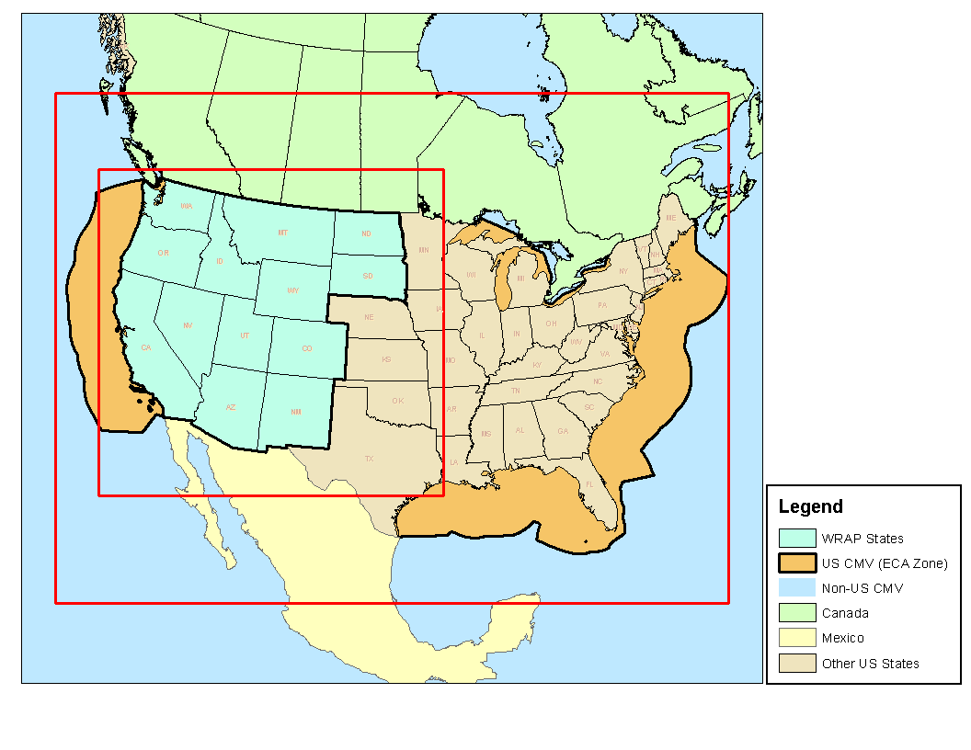
RepBase2 & 2028OTBa2 Regional Source Apportionment
No Source Region map used
Feed CAMx model-ready emission for each Source Group
Boundary Conditions (BCs) stratified:
  International Anthropogenic
  U.S. Anthropogenic
  Natural
U.S. Anthropogenic Differences between RepBase2 (1) and 2028OTBa2 (2)
16 Source Groups x 25 = 400 Reactive Tracers
Takes 21-28 calendar days to run (4 quarters, 24 CPUs each)

Slide 9
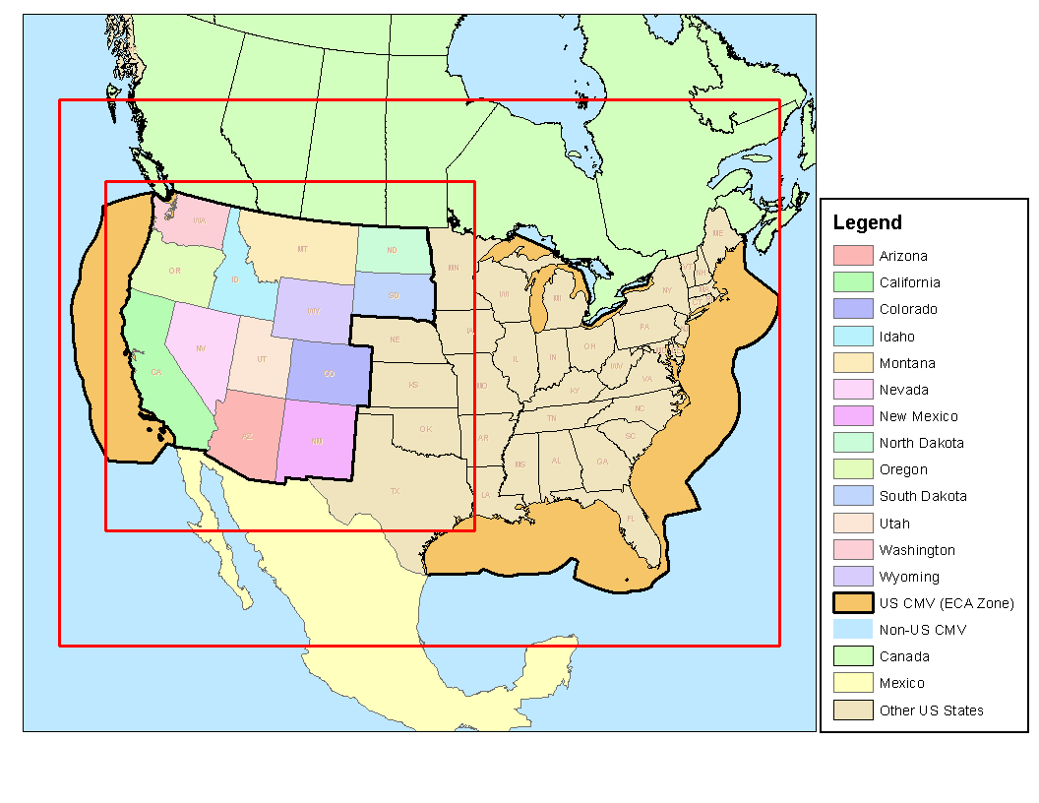
2028OTBa2 Source Group Source Apportionment
Source Region Map (15)
  13 WRAP States
  Remainder U.S.
  International
Source Categories (6)
  EGU Point
  Non-EGU Point
  Oil and Gas (Point and Non-Point)
  Mobile (On-Road, Non-Road, Rail, CMV)
  Remainder Anthropogenic
  Everything Else (Natural and Fires)
92 Source Groups (=15 x 6 +2)
Just Sulfur (AmmSO4) and Nitrogen (AmmNO3) families of PSAT Tracers
  11 tracers per Source Group
92 Source Groups x 11 = 1,012 Reactive Tracers
Takes ~55 calendar days to run (if included PSAT Primary PM family of tracers would take ~120 days)

Slide 10
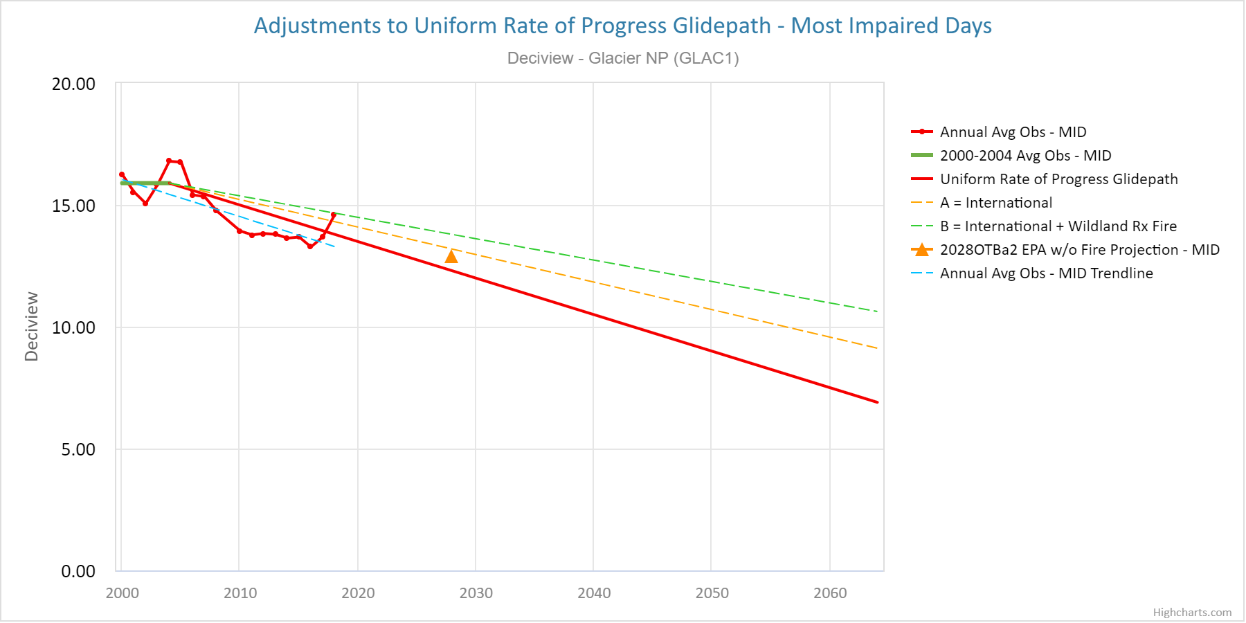
2028OTBa Source Group Source Apportionment Displays
Focus on state-specific U.S. anthropogenic emissions contributions to visibility impairment at Class I Areas (CIAs)
  Which states have anthropogenic emissions that contribute to visibility impairment at downwind CIAs
  For natural contributions to visibility degradation (e.g., wildfires, biogenic, WBD), it doesn’t matter which state it comes from
  Consistent with 1977 Clean Air Act to remedy any impairment at Class I Areas due to man-made air pollution
  U.S. Anthropogenic emissions are probably the most accurate component of the regional haze analysis
Uncertainties/limitations in Regional Haze URP Glidepath approach:
  Most Impaired Days (MID) metric relies on imperfect method for determining anthropogenic impairment
    Fires and WBD highly uncertain
    Species ≠ Sources
  2064 Natural Conditions unknowable
  Glidepath adjustments due to highly uncertain international and wildland prescribed fire emissions

Slide 11
Post-Processing of the 2028OTBa2 Source Group SA
Combine the 2028OTBa2 Source Group state-specific AmmSO4 and AmmNO3 U.S. anthropogenic emission results for 13 WRAP states and remainder U.S. with 2028OTBa2 Regional (H-L) SA U.S. Boundary Condition (BC_{US}) contributions:
  Obtain contributions of all U.S. anthropogenic emissions to AmmSO4 and AmmNO3 extinction at western IMPROVE sites
  Quality Assure in Excel Dashboard visualization tool for 17 Class I areas across WESTAR=WRAP region
  Transfer 2028OTBa2 Source Group AmmSO4 and AmmNO3 extinction source apportionment results to CSU/CIRA for implementation on WRAP TSS Modeling Express Tools

Slide 12
2028OTBa2 Source Group – Most Impaired Days (MID) Mesa Verde (MEVE)
AmmNO3
AmmSO4

Slide 13
2028OTBa2 Source Group – Most Impaired Days (MID) Yellowstone (YELL)
AmmNO3
AmmSO4

Slide 14
QuestionS?

