Slide 1
EPA 2016 TSD RPG vs adjusted URP and
WRAP 2014v2 and RepBase vs unadjusted URP
4/29/2020

Slide 2
Comparison of EPA TSD and preliminary WRAP RPGs
WRAP URP has not yet been adjusted for international impairment and wildland prescribed fires, so this does not include comparison of WRAP RPGs to adjusted URP.
  WRAP model estimates of adjusted URP will be available soon.
WRAP results are shown for two estimates of RPGs:
  2014v2 and 2028 OTB model relative response factors (RRF) applied to 2012 to 2016 IMPROVE data.
  Representative Base and 2028 OTB model RRF applied to 2014 to 2018 IMPROVE data.
  Differences in RPG are largely due to differences in baseline IMROVE data (2012-2016 vs 2014-2018) and also lower RRF in the RepBase compared to 2014v2.
  Note that EPA TSD RPGs were based on 2014 to 2017 IMPROVE data.
  EPA CAMx does not include wind blown dust or lightning NOx emissions.

Slide 3
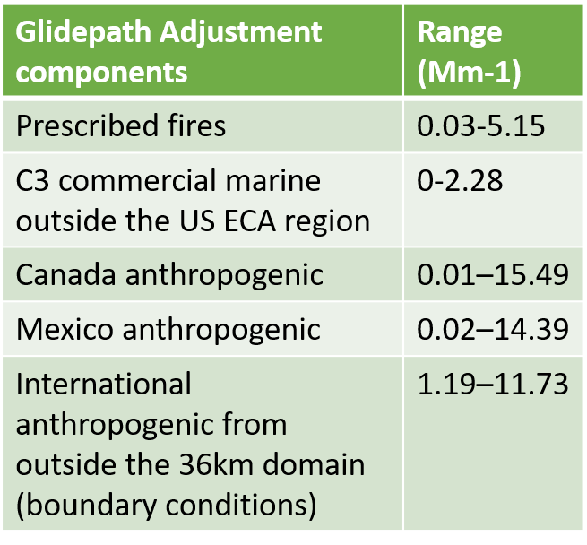
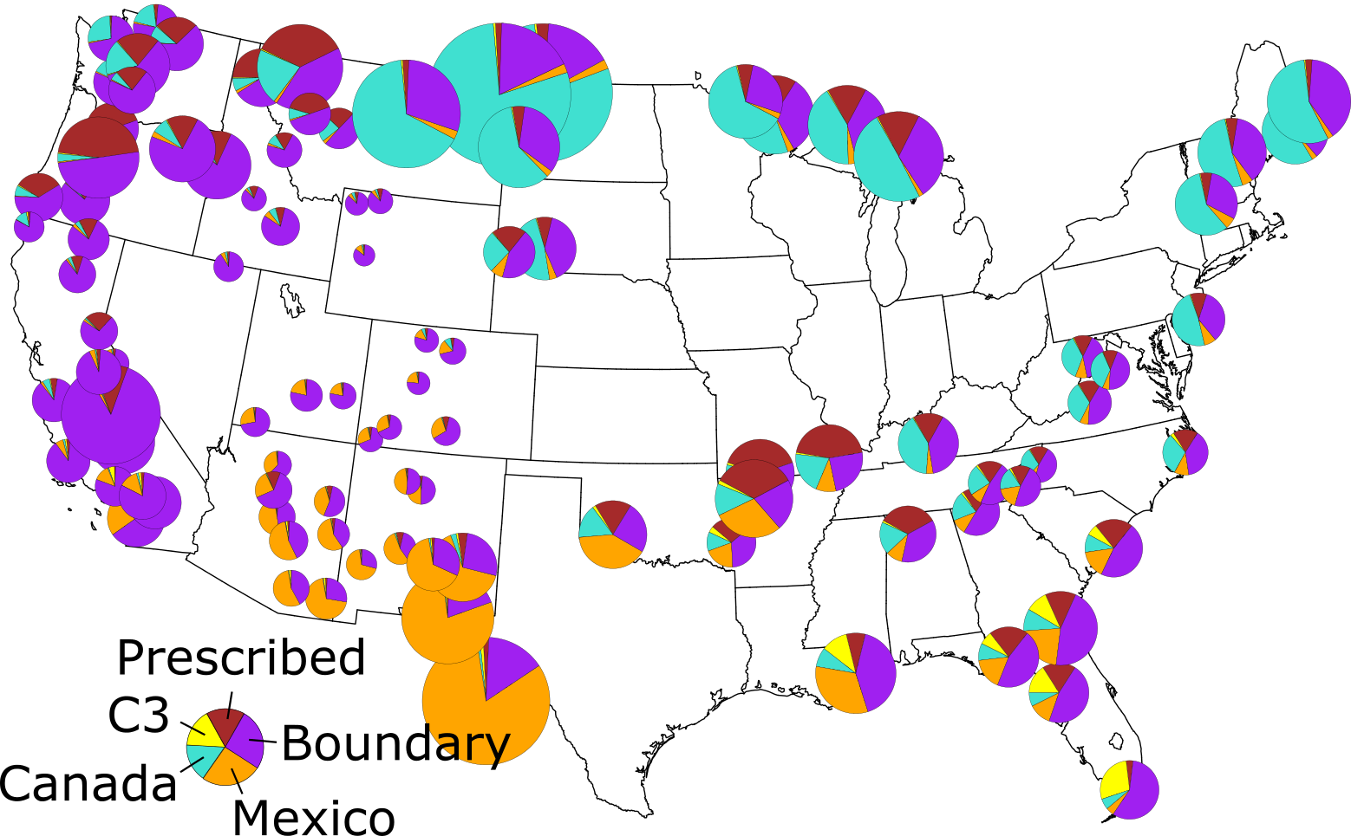
EPA TSD International Anthropogenic and Prescribed Fire Contributions (20% most impaired days)

Slide 4
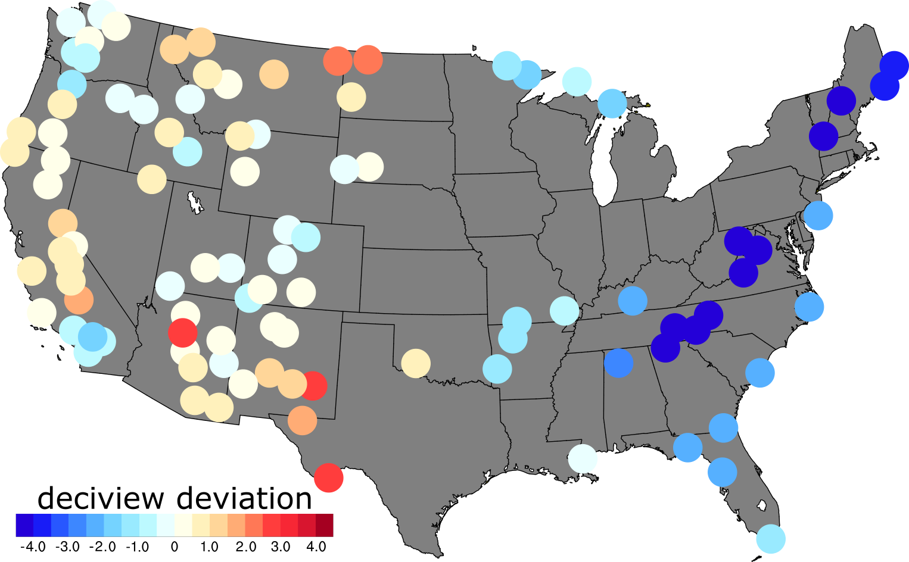
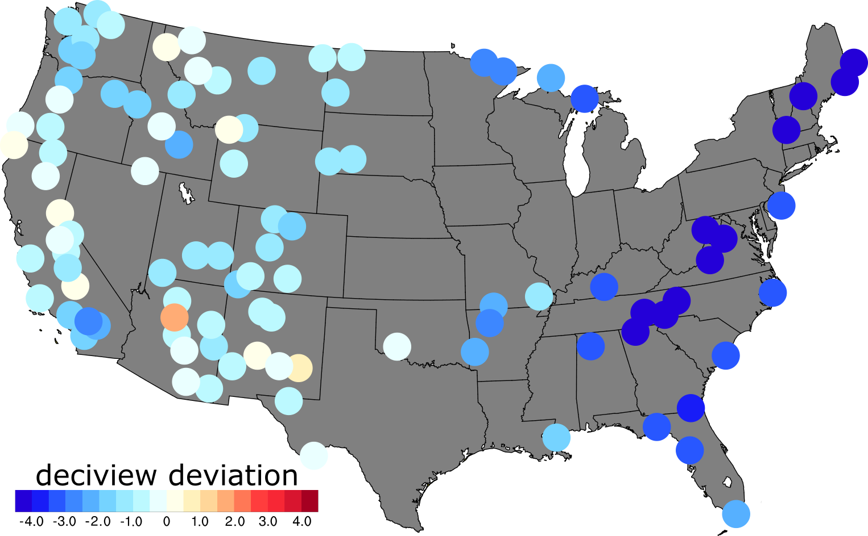
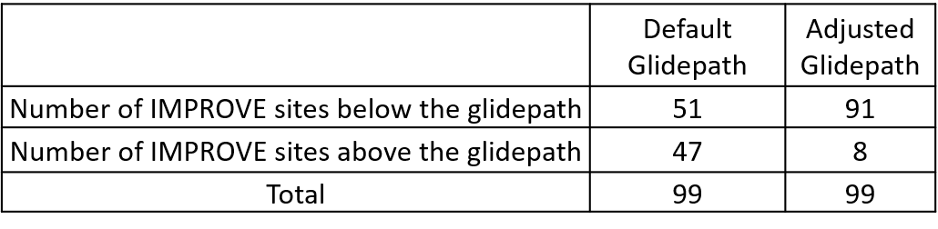
Updated EPA TSD Regional Haze Modeling (2028fg) Deviation from 2028 Glidepath (20% most impaired days)
Deviation from Unadjusted Glidepath
Deviation from Default Adjusted Glidepath
Note that the 99 IMPROVE sites represent 142 Class I areas

Slide 5
EPA TSD: Eight Class I areas have 2028 RPG above adjusted URP
Yellowstone, WY: 7.38 vs 7.31 dv URP, fires counted as anthropogenic?
Cabinet Wilderness, MT: 9.69 vs 9.52 dv URP, large prescribed fire contribution
Salt Creek, NM: 14.5 vs 13.8 dv URP, high 4 year ave baseline, large dust component
Bosque del Apache, NM: 10.16 vs 9.97 dv URP, large wind blown dust component
Sycamore Canyon, AZ: 11.8 vs 10.15, large wind blown dust component
Dome Land, CA: 14.47 vs 14.3 dv URP, poor performance for NO3, SO4, fire and dust
Desolation, CA: 9.15 vs 8.83 dv URP, model overestimates fires?
Redwood, CA: 12.5 vs 12.24 dv URP, model overestimates sulfate

Slide 6
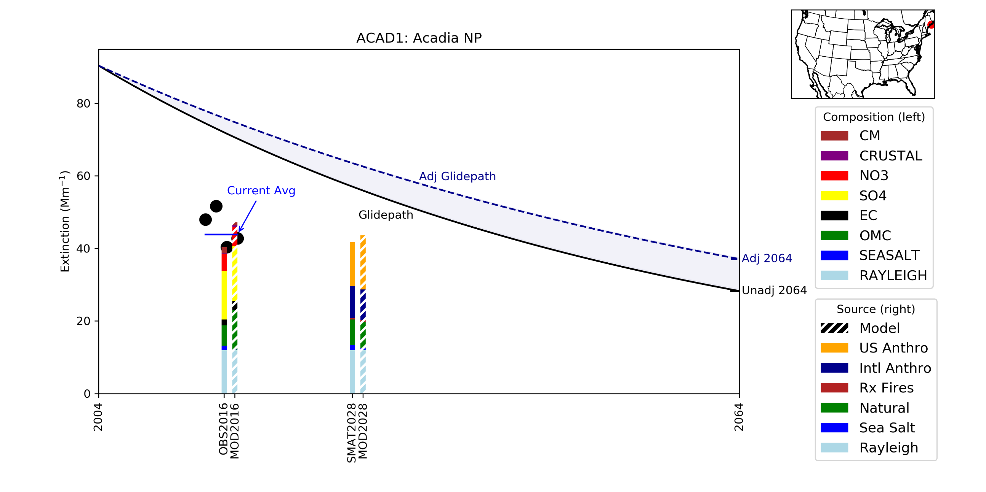
Sample plot showing EPA RPG and URP estimates for the full 64 year period

Slide 7
Yellowstone, WY
fires counted as anthropogenic?
2000-2004 baseline: 8.30 dv
2014-2017: 7.51 dv
2028: 7.38 dv
Natural haze: 3.98 dv
International: 1.85 dv
U.S. 2028: 1.55 dv

Slide 8
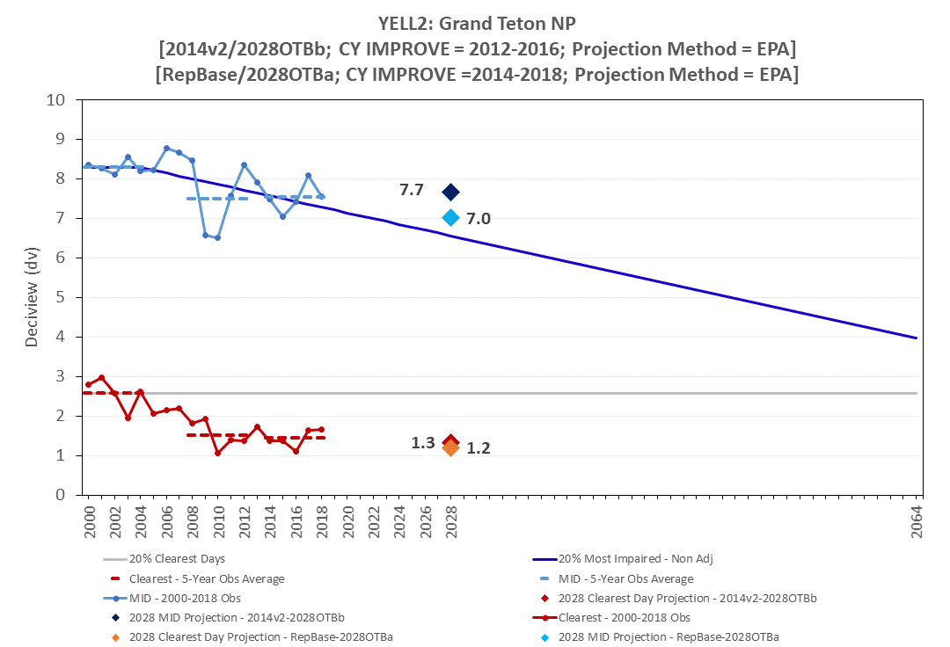
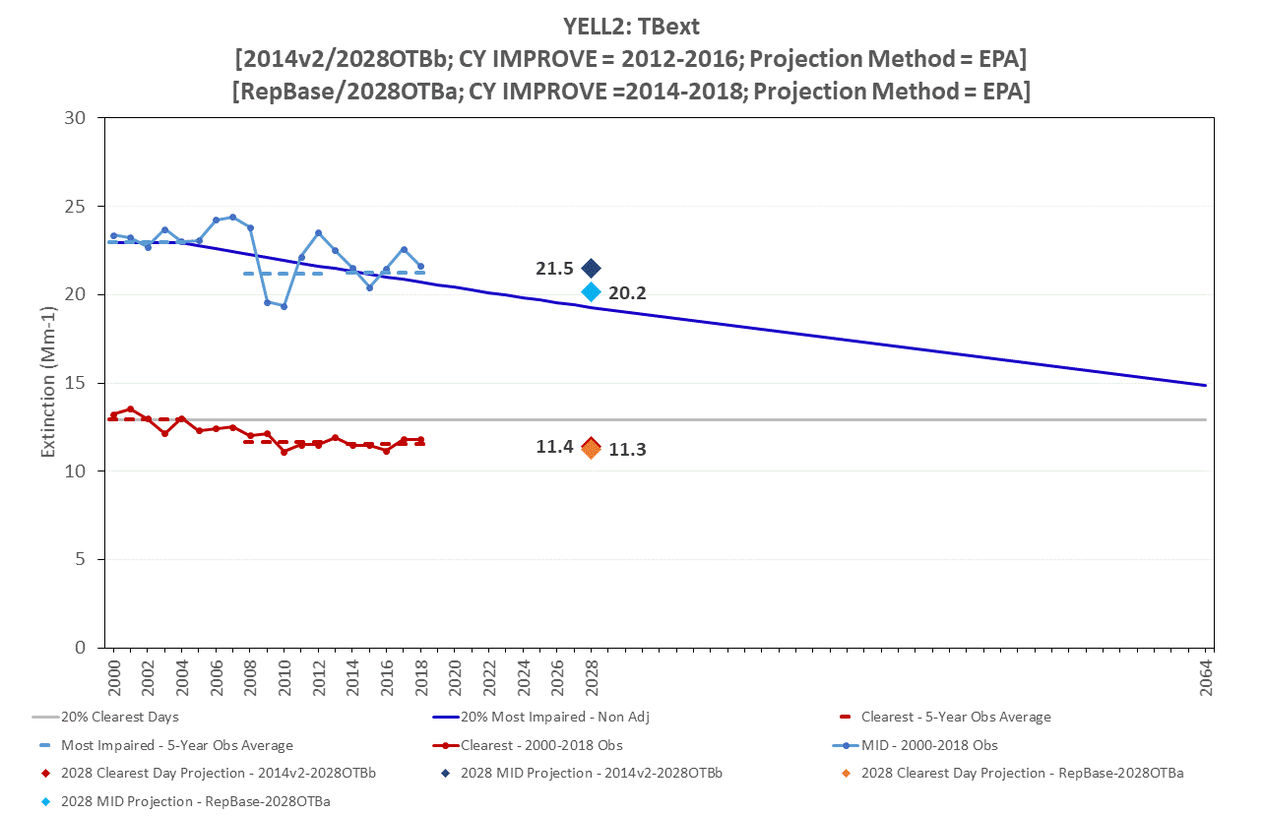
Yellowstone, WY
WRAP RepBase and 2014v2
2000-2004 baseline: 8.30 dv
2014-2018 IMPROVE: 7.52 dv
2028 RPG: 7.0 dv, 7.7 dv
Natural haze: 3.98 dv
International: TBD
U.S. 2028: TBD
2028 clearest: 1.3 dv, 1.2 dv
EPA TSD
2000-2004 baseline: 8.30 dv
2014-2017 IMPROVE: 7.51 dv
2028 RPG: 7.38 dv
Natural haze: 3.98 dv
International: 1.85 dv (2026: 5.83 vs 3.98 dv)
U.S. 2028: 1.55 dv
2028 clearest: 1.24 dv

Slide 9
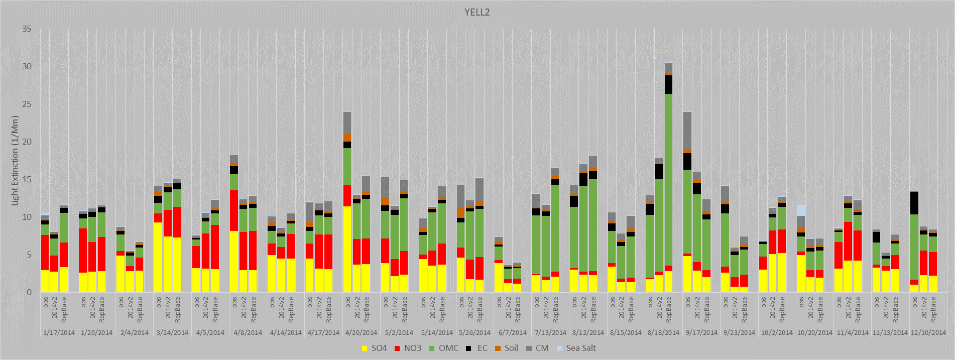
WRAP MPE vs IMPROVE 2014, EPA Most Impaired Days (MID), Yellowstone

Slide 10
Cabinet Mt WA, MT
large prescribed fire contribution?
EPA TSD
2000-2004 baseline: 10.73 dv
2014-2017: 9.81 dv
2028: 9.69 dv
Natural haze: 5.65 dv
International: 2.06 dv (2064: 7.71 vs 5.65 dv)
U.S. impairment 2028: 2.84 dv
2028 clearest: 2.41

Slide 11
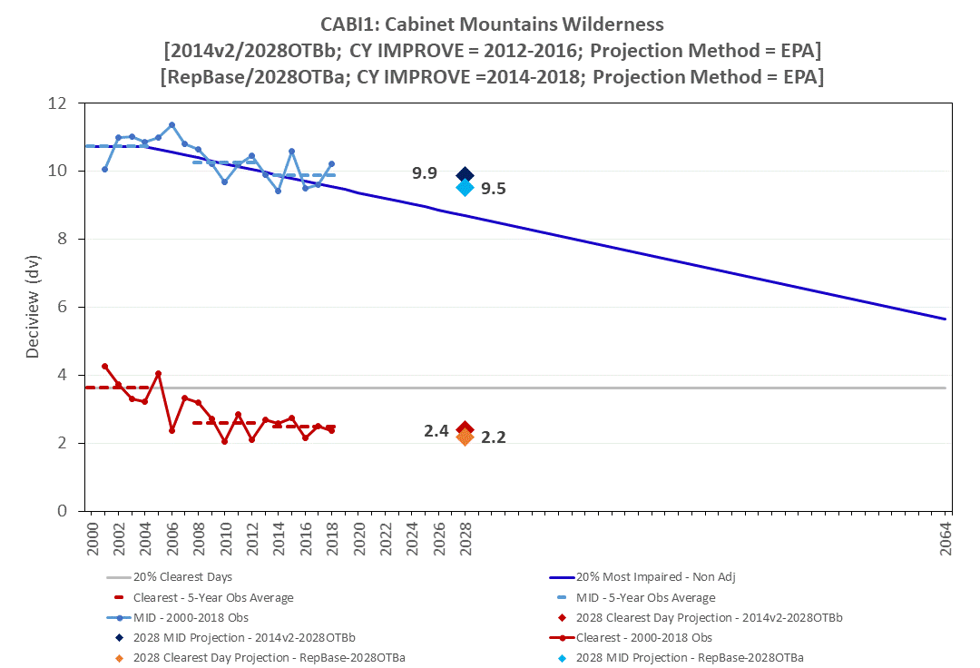
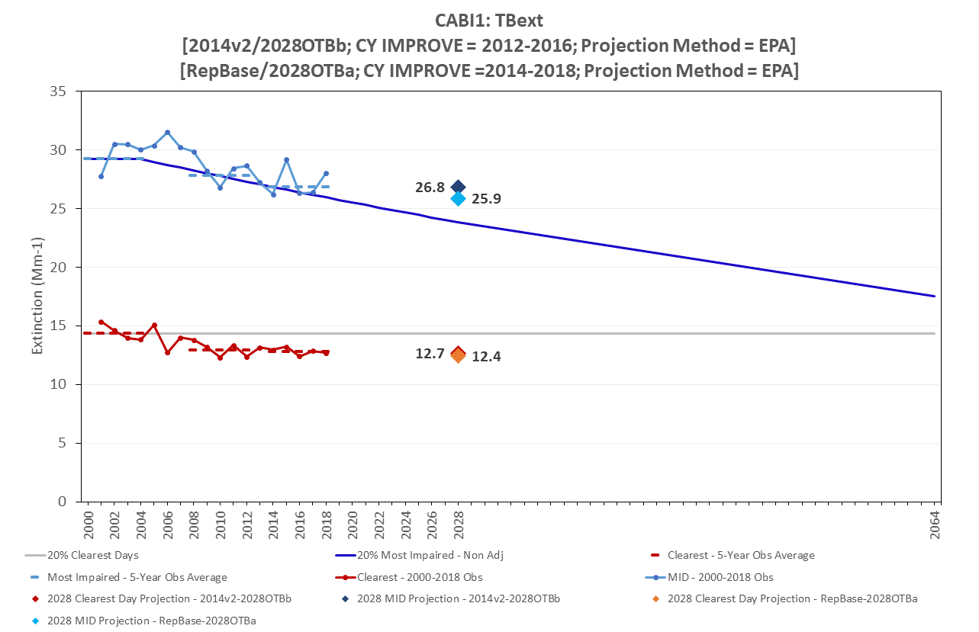
Cabinet Mt WA, MT
WRAP RepBase and 2014v2
2000-2004 baseline: 10.73 dv
2014-2018 IMPROVE: 9.87 dv
2028 RPG: 9.5 dv, 9.9 dv
Natural haze: 5.65 dv
International: TBD
U.S. impairment 2028: TBD
2028 clearest: 2.4 dv, 2.2 dv
EPA TSD
2000-2004 baseline: 10.73 dv
2014-2017 IMPROVE: 9.81 dv
2028 RPG: 9.69 dv
Natural haze: 5.65 dv
International: 2.06 dv (2064: 7.71 vs 5.65 dv)
U.S. impairment 2028: 2.84 dv
2028 clearest: 2.4 dv

Slide 12
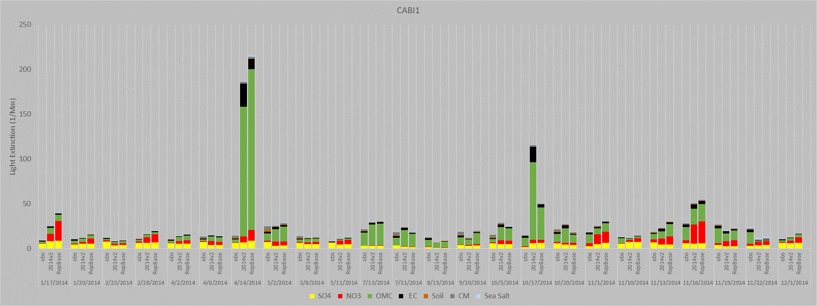
WRAP MPE vs IMPROVE 2014 EPA Most Impaired Days (MID), Cabinet

Slide 13
Salt Creek, NM
high 4 year ave baseline, large wind blown dust component
nearby oil and gas development?
EPA TSD
2000-2004 baseline: 16.54 dv
2014-2017: 15.04 dv
2028: 14.49 dv
Natural haze: 5.5 dv
International: 4.19 dv (2064: 9.69 vs 5.50 dv)
U.S. 2028: 4.8 dv
2028 clearest: 6.52 dv

Slide 14
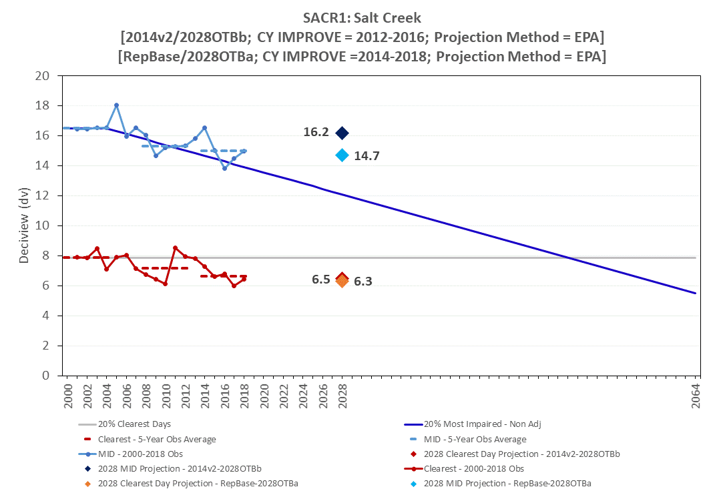
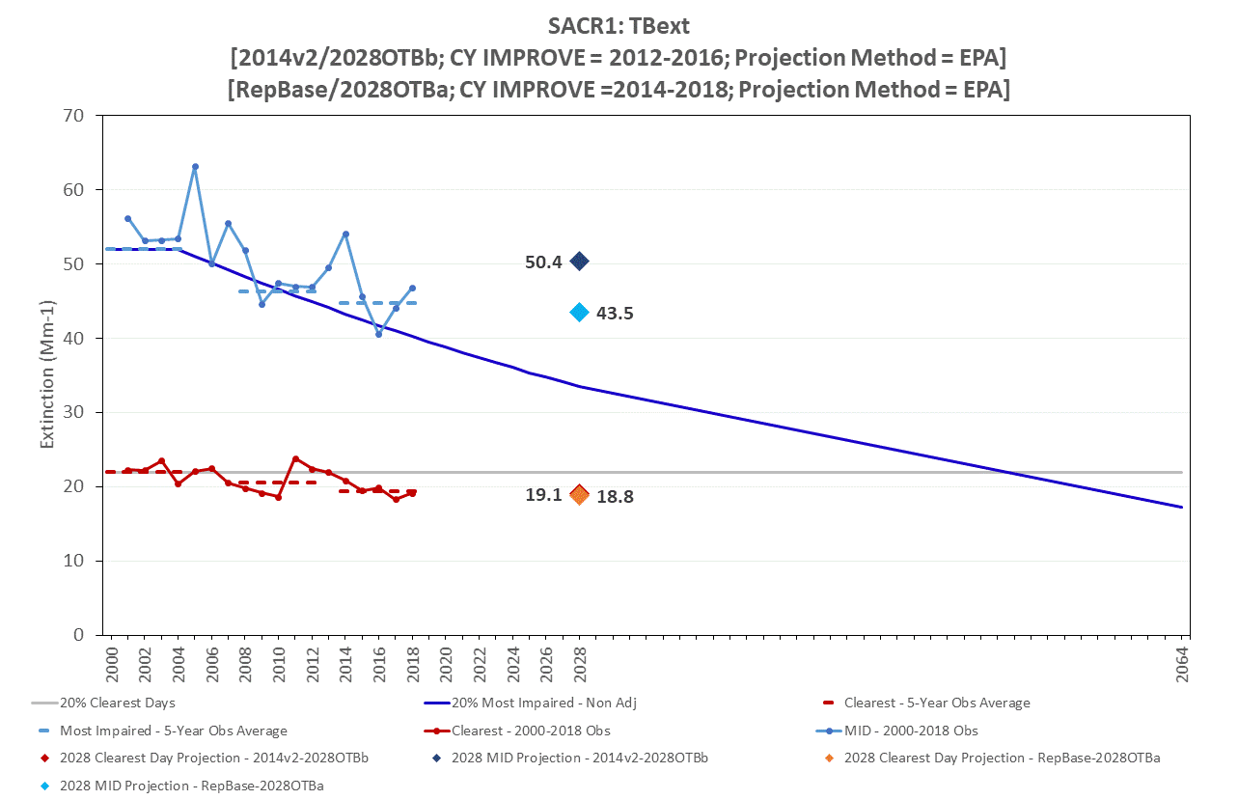
Salt Creek, NM
WRAP RepBase, 2014v2
2000-2004 baseline: 16.54 dv
2014-2018: 15.0 dv
2028 RPG: 14.7 dv, 16.2 dv
Natural haze: 5.5 dv
International: TBD
U.S. 2028: TBD
2028 clearest: 6.3 dv, 6.5 dv
EPA TSD
2000-2004 baseline: 16.54 dv
2014-2017: 15.04 dv
2028 RPG: 14.49 dv
Natural haze: 5.5 dv
International: 4.19 dv (2064: 9.69 vs 5.50 dv)
U.S. 2028: 4.8 dv
2028 clearest: 6.52 dv

Slide 15
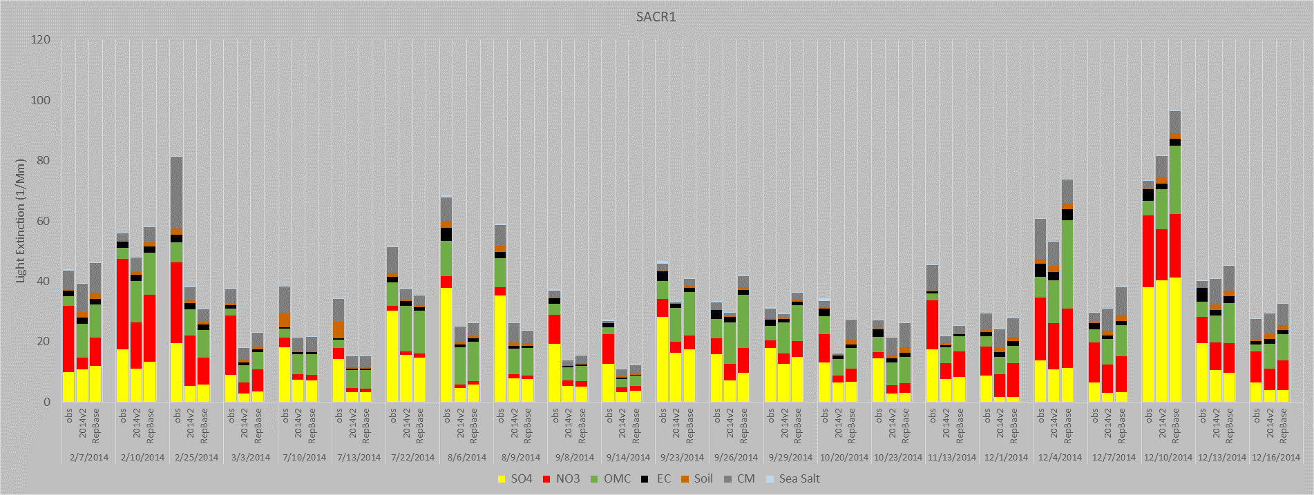
WRAP MPE vs 2014 IMPROVE EPA MID, Salt Creek

Slide 16
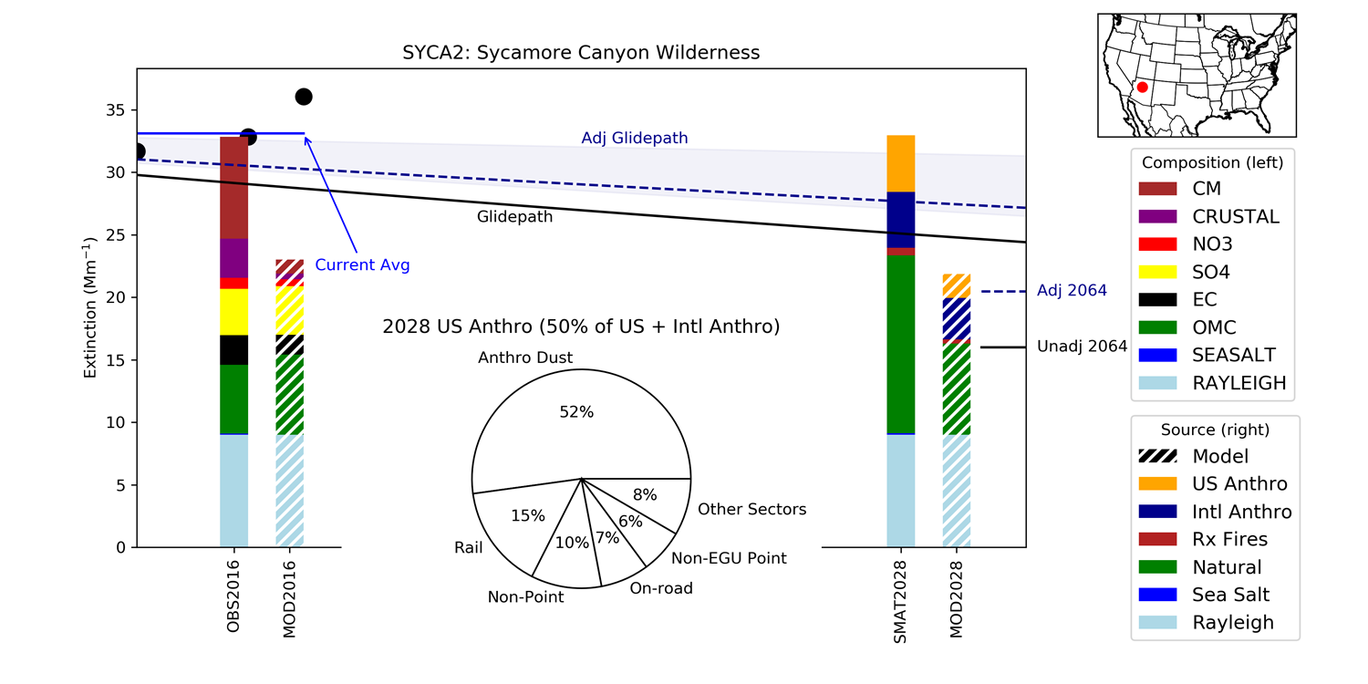
Sycamore Canyon, AZ
high 4 year ave baseline, large wind blown dust component
EPA TSD
2000-2004 baseline: 12.16 dv
2014-2017: 11.97 dv
2028: 11.8 dv
Natural haze: 4.68 dv
International: 2.47 dv (2064: 7.15 vs 4.68 dv)
U.S. 2028: 4.82 dv
2028 clearest: 4.05 dv

Slide 17
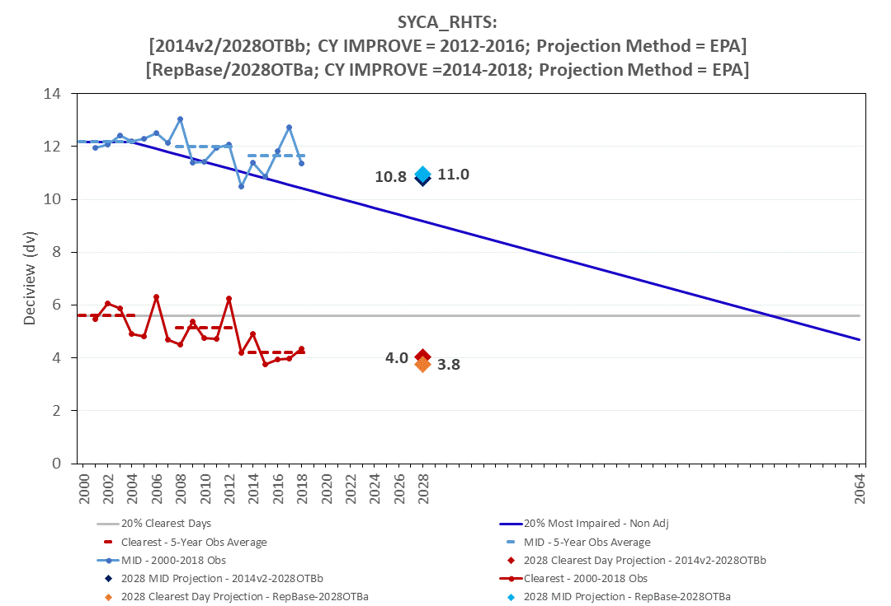
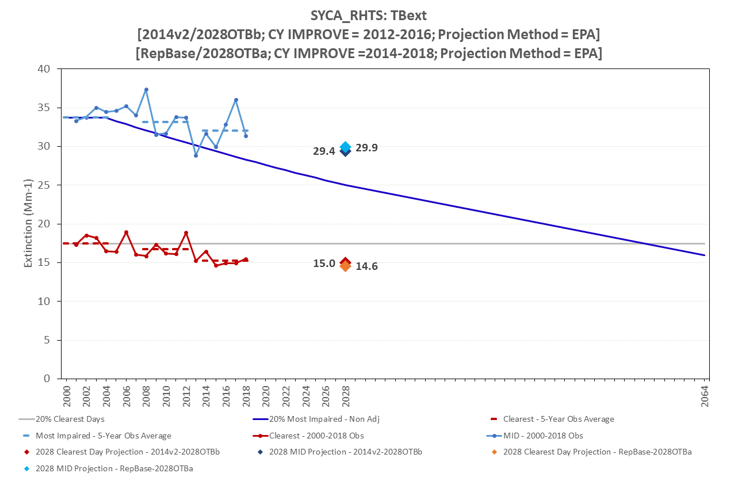
Sycamore Canyon, AZ
WRAP RepBase and 2014v2
2000-2004 baseline: 12.16 dv
2014-2018 IMPROVE: 11.6 dv
2028 RPG: 11.0 dv, 10.8
Natural haze: 4.68 dv
International: TBD
U.S. 2028: TBD
2028 clearest: 4.0 dv, 3.8 dv
EPA TSD
2000-2004 baseline: 12.16 dv
2014-2017 IMPROVE: 11.97 dv
2028 RPG: 11.8 dv
Natural haze: 4.68 dv
International: 2.47 dv (2064: 7.15 vs 4.68 dv)
U.S. 2028: 4.65 dv
2028 clearest: 4.05 dv

Slide 18
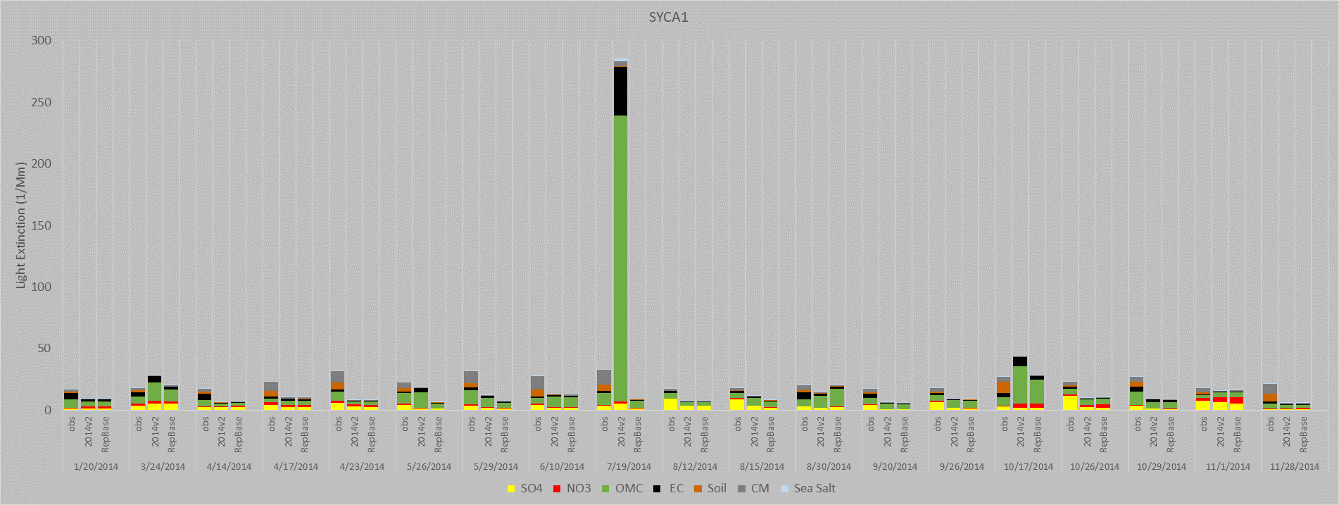
WRAP MPE vs 2014 IMPROVE EPA MID, Sycamore Canyon
Note model negative bias for CM and Soil
Also, 3 IMPROVE days with large OMC and EC

Slide 19
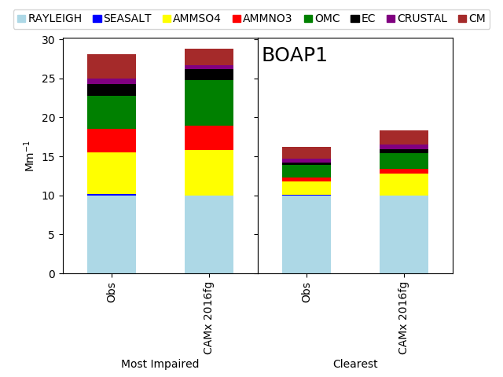
Bosque del Apache, NM
large wind blown dust component?
2000-2004 baseline: 11.61 dv
2014-2017: 10.36 dv
2028: 10.16 dv
Natural haze: 5.36 dv
International: 2.16 dv (2064: 7.52 vs 5.36)
U.S. 2028: dv
2028 clearest: 4.62

Slide 20
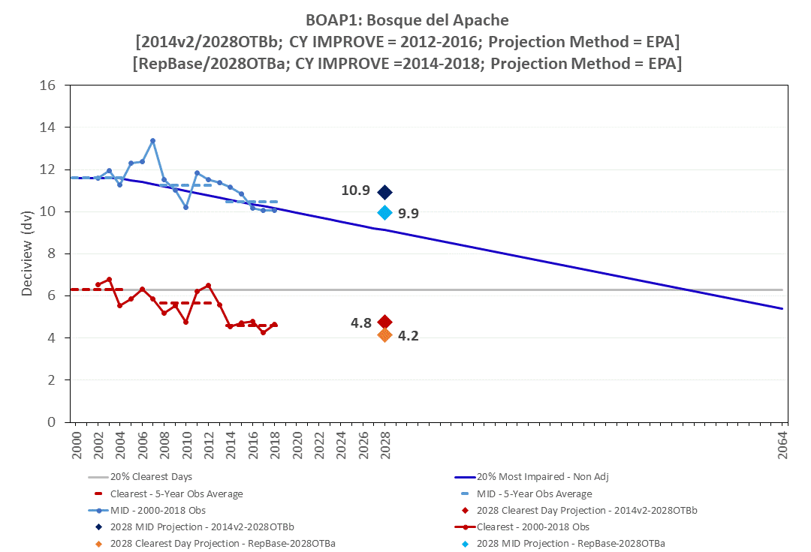
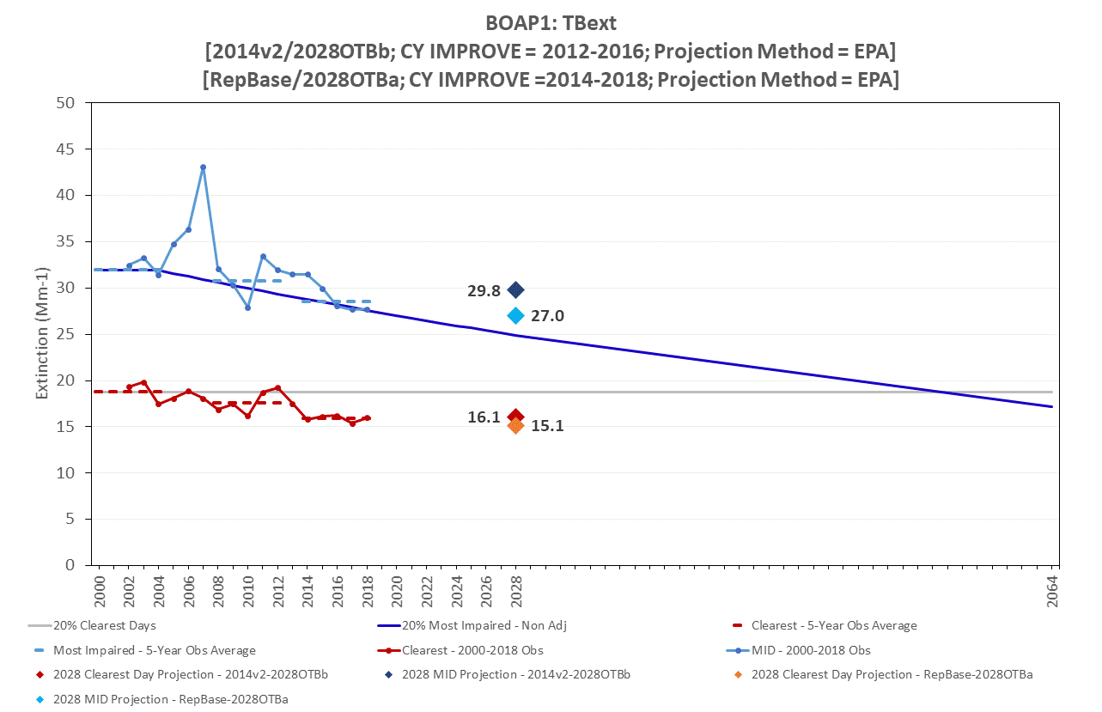
Bosque del Apache, NM
WRAP RepBase and 2014v2
2000-2004 baseline: 11.61 dv
2014-2018 IMPROVE: 10.47 dv
2028 RPG: 9.9 dv, 10.9 dv
Natural haze: 5.36 dv
International: TBD
U.S. 2028: TBD
2028 clearest: 4.8 dv, 4.2 dv
EPA TSD
2000-2004 baseline: 11.61 dv
2014-2017 IMPROVE: 10.36 dv
2028 RPG: 10.16 dv
Natural haze: 5.36 dv
International: 2.16 dv (2064: 7.52 vs 5.36)
U.S. 2028: 2.64 dv
2028 clearest: 4.62 dv

Slide 21
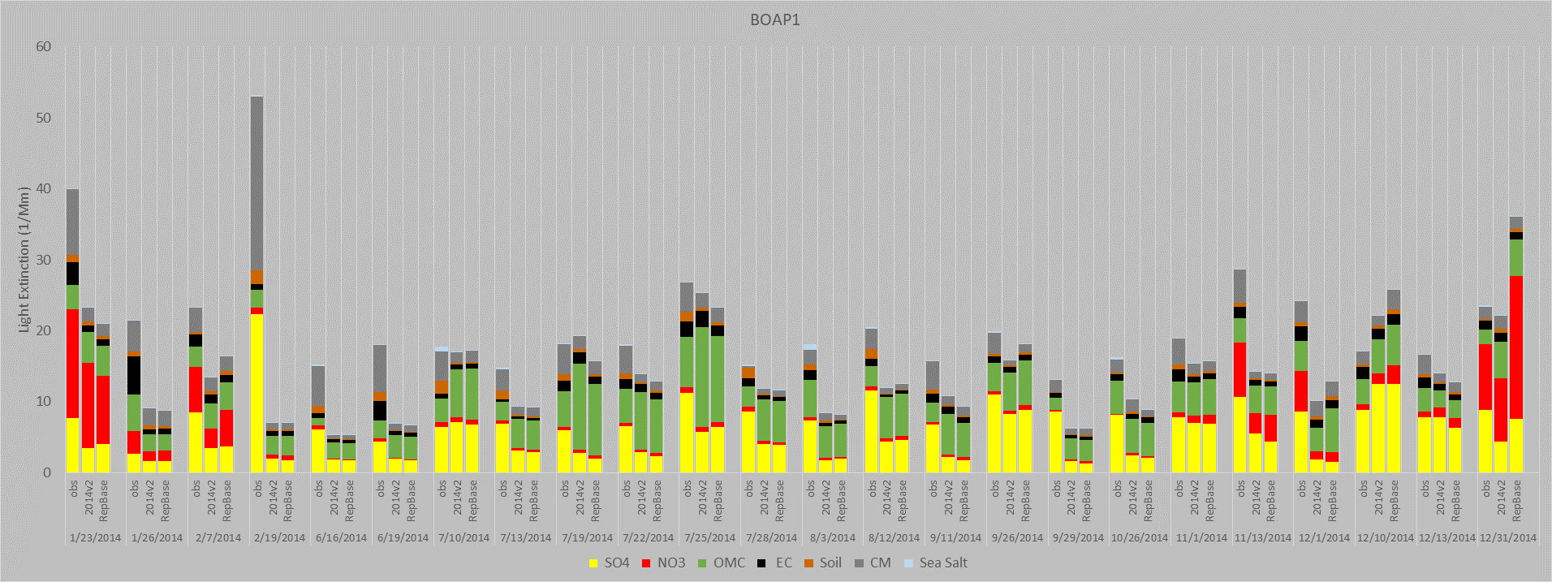
WRAP MPE vs 2014 IMPROVE EPA MID, Bosque del Apache

Slide 22
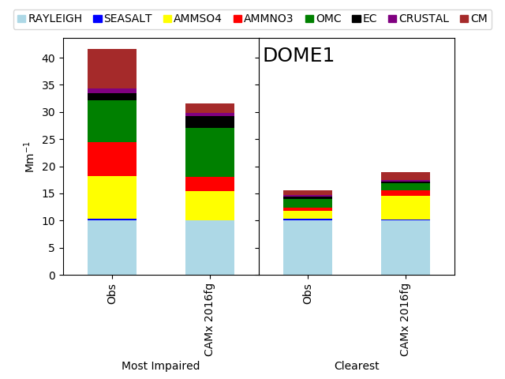
Domeland, NM
Poor performance for nitrate and sulfate.
Fire impacts and wind blown dust component?
2000-2004 baseline: 17.20 dv
2014-2017: 15.07 dv
2028: 14.47 dv
Natural haze: 6.18 dv
International: 3.77 dv (2064: 9.95 vs 6.18 dv)
U.S. 2028: 4.52 dv
2028 clearest: 4.21 dv

Slide 23
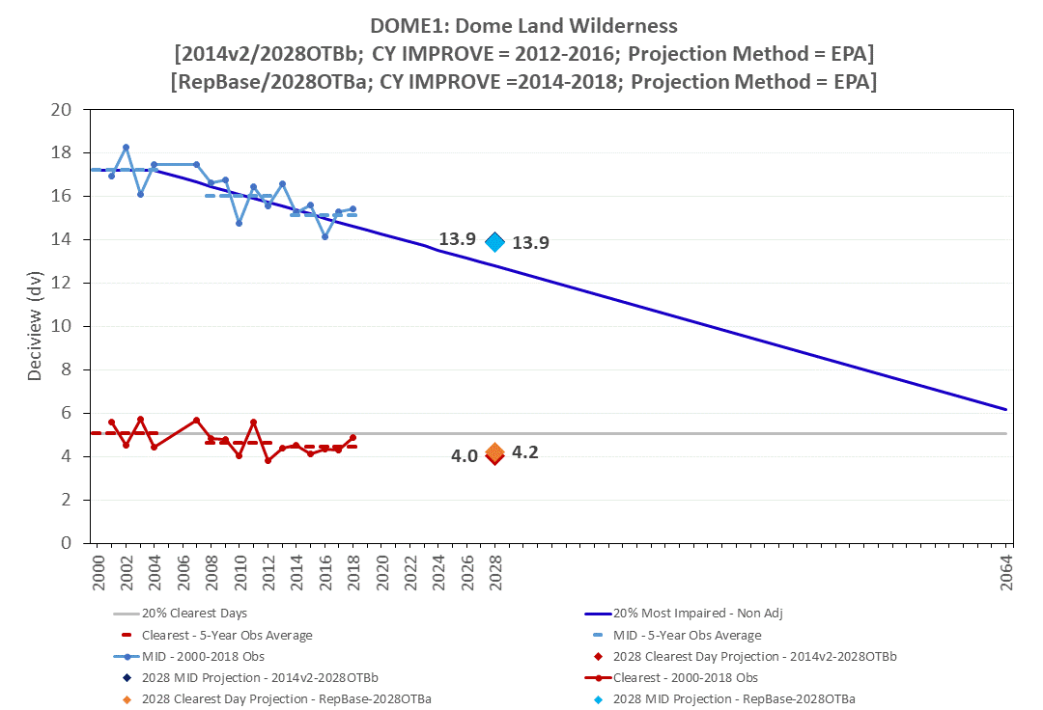
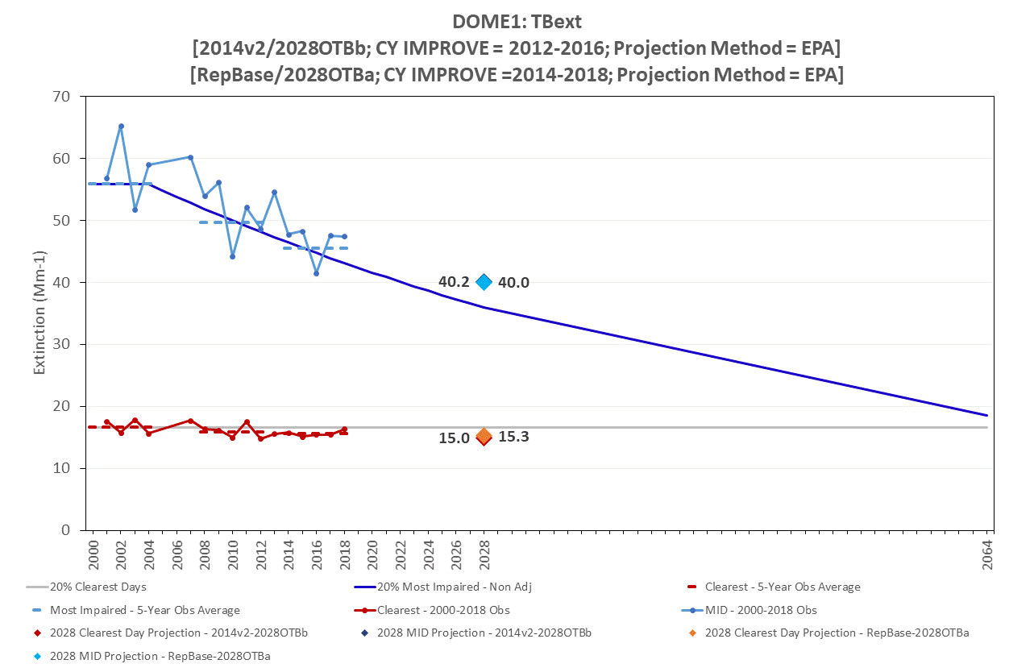
Dome Land, NM
WRAP RepBase, 2014v2
2000-2004 baseline: 17.20 dv
2014-2018 IMPROVE: 15.14 dv
2028 RPG: 13.9 dv, 13.9
Natural haze: 6.18 dv
International: TBD
U.S. 2028: TBD
2028 clearest: 4.0 dv, 4.2 dv
EPA TSD
2000-2004 baseline: 17.20 dv
2014-2017 IMPROVE: 15.07 dv
2028 RPG: 14.47 dv
Natural haze: 6.18 dv
International: 3.77 dv (2064: 9.95 vs 6.18 dv)
U.S. 2028: 4.52 dv
2028 clearest: 4.21 dv

Slide 24
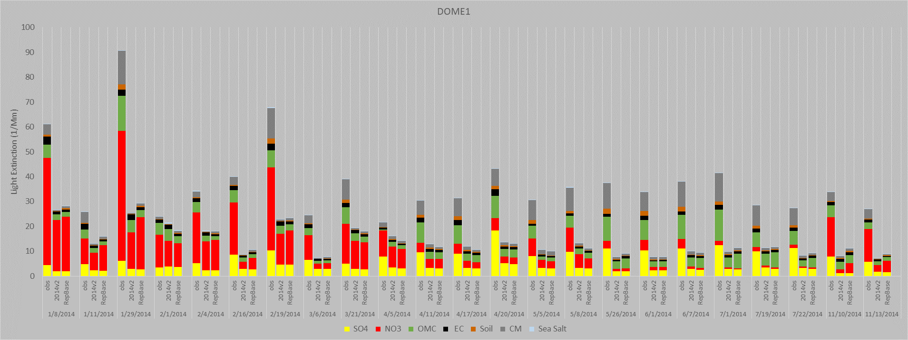
WRAP MPE vs 2014 IMPROVE EPA MID, Dome Land
Model has large negative bias for nitrate and sulfate in winter
Model underestimates large observed carbon and windblown dust in summer

Slide 25
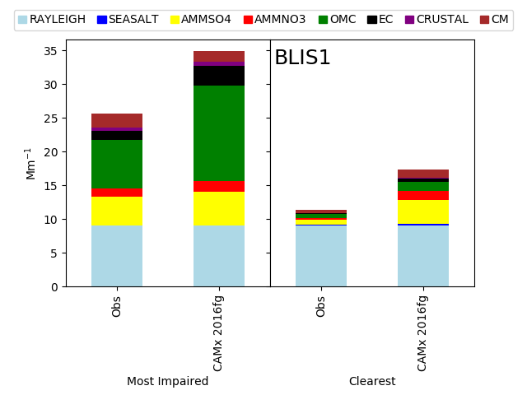
Desolation WA, CA
model overestimates fires?
2000-2004 baseline: dv
2014-2017: 9.35 dv
2028: 9.15 dv
Natural haze: 4.91 dv
International: 2.14 dv (2064: 7.05 vs 4.91)
U.S. 2028: 2.1 dv
2028 clearest: 1.71 dv

Slide 26
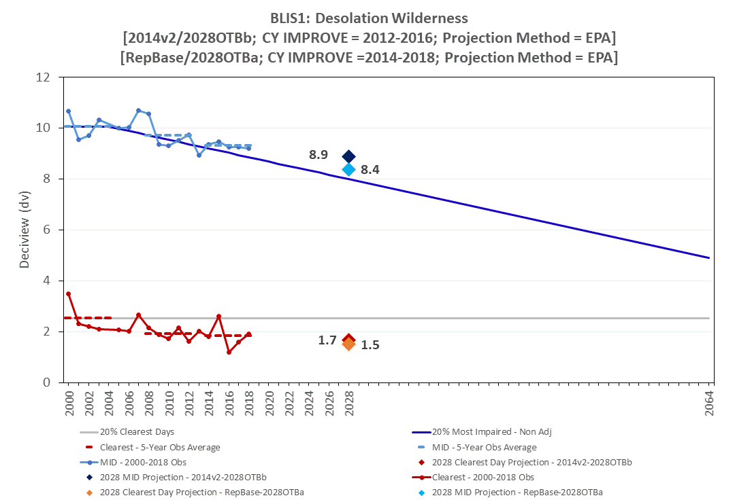
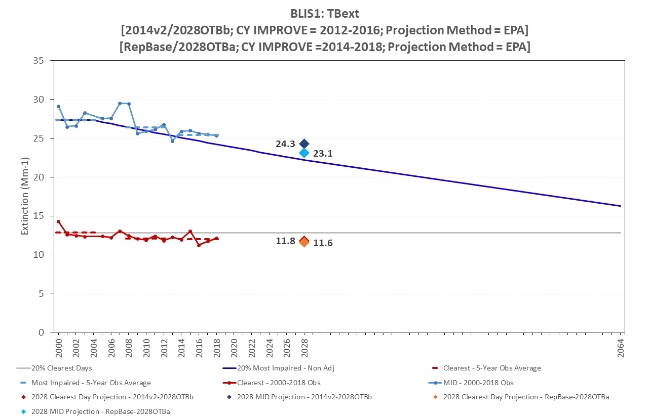
Desolation WA, CA
WRAP RepBase, 2014v2
2000-2004 baseline: 10.06 dv
2014-2018 IMPROVE: 9.31 dv
2028 RPG: 8.4 dv, 8.9 dv
Natural haze: 4.91 dv
International: TBD
U.S. 2028: TBD
2028 clearest: 1.7 dv, 1.5 dv
EPA TSD
2000-2004 baseline: 10.06 dv
2014-2017 IMPROVE: 9.35 dv
2028 RPG: 9.15 dv
Natural haze: 4.91 dv
International: 2.14 dv (2064: 7.05 vs 4.91)
U.S. 2028: 2.1 dv
2028 clearest: 1.71 dv

Slide 27
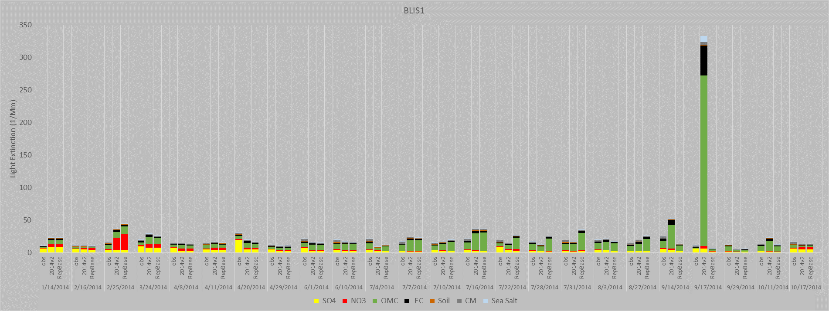
WRAP MPE vs 2014 IMPROVE EPA MID, Desolation
Large contributions from carbon in summer in IMPROVE data and in the model

Slide 28
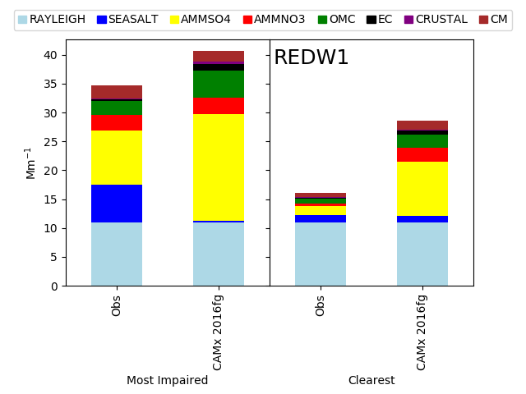
Redwood Wilderness, CA
model overestimates sulfate
2000-2004 baseline: 13.64 dv
2014-2017: 12.69 dv
2028: 12.50 dv
Natural haze: 8.54 dv
International: 1.59 dv (2064: 10.13 vs 8.54 dv)
U.S. 2028: 2.37 dv
2028 clearest: 5.11 dv

Slide 29
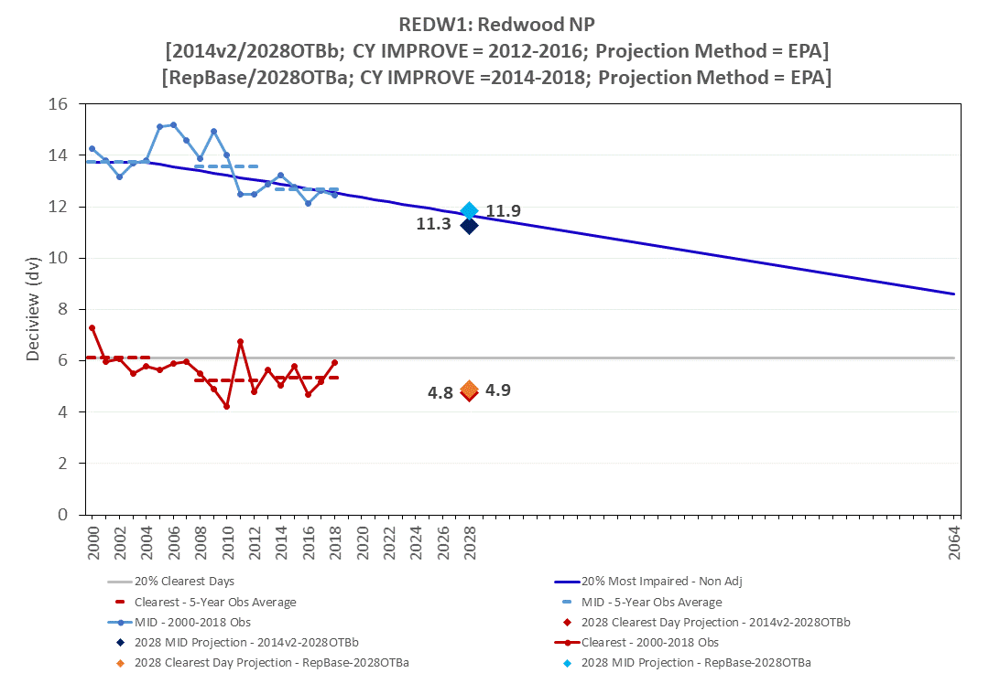
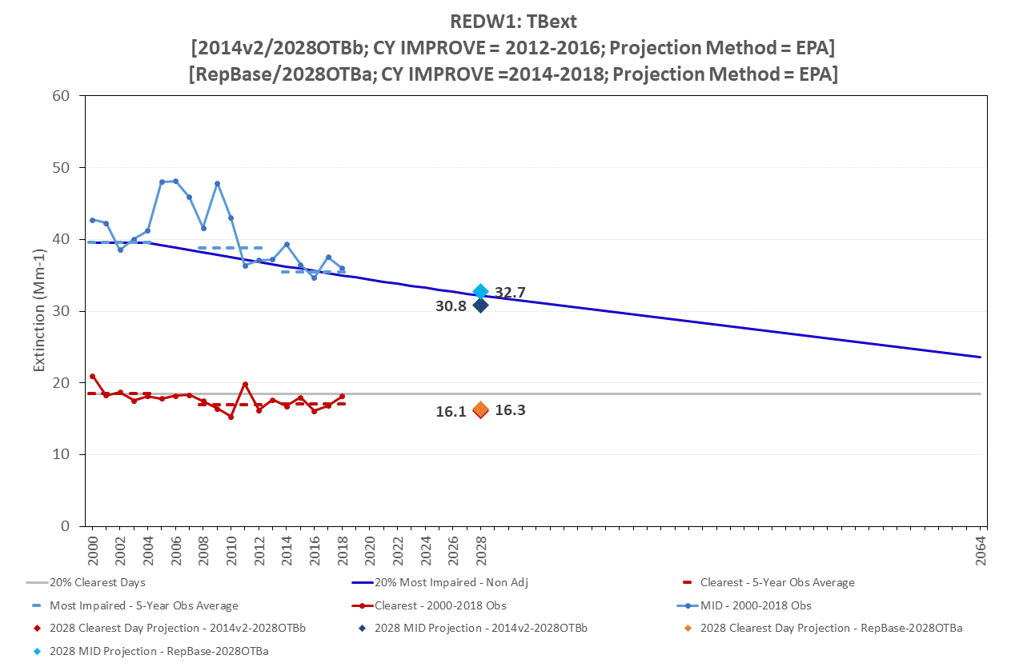
Redwood Wilderness, CA
WRAP RepBase, 2014v2
2000-2004 baseline: 13.74 dv
2014-2018 IMPROVE: 12.65 dv
2028 RPG: 11.9 dv, 11.3 dv
Natural haze: 8.54 dv
International: TBD
U.S. 2028: TBD
2028 clearest: 4.8 dv, 4.9 dv
EPA TSD
2000-2004 baseline: 13.64 dv
2014-2017 IMPROVE: 12.69 dv
2028 RPG: 12.50 dv
Natural haze: 8.54 dv
International: 1.59 dv (2064: 10.13 vs 8.54 dv)
U.S. 2028: 2.37 dv
2028 clearest: 5.11 dv

Slide 30
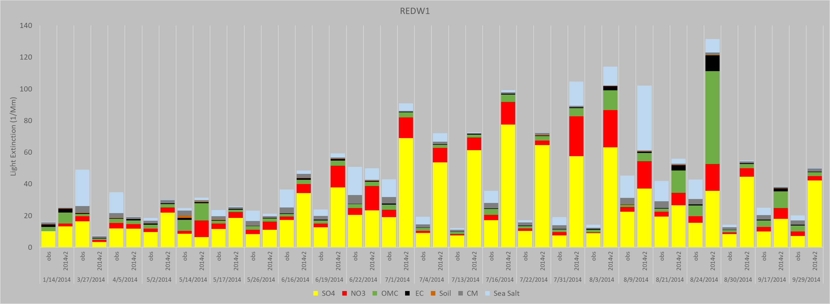
WRAP MPE vs 2014 IMPROVE EPA MID, Redwood
Model has large positive bias for SO4 and NO3 in summer

