Slide 1

2021 Western Fire, Smoke, and Air Quality Assessment
Fire and Smoke Work Group Exceptional Events support team meeting
November 17, 2021
Tom Moore & Jay Baker
WESTAR-WRAP

Slide 2



Background
Wildfire activity caused numerous western monitoring sites to exceed PM and Ozone air quality standards in Summer-Fall 2021
Exceptional Events “Demonstration” analyses have been used by WESTAR-WRAP member agencies

Slide 3
Jaffe, D., September 15, 2021 WESTAR-WRAP Fire and Smoke Exceptional Events Team meeting

Slide 4
Exceptional Events
Demonstrations analyze which air quality data are affected, identify sites and days impacted
  Due to scope and scale of 2021 impacts, western state-local-tribal members met with EPA Office of Air Quality Planning & Standards, also included EPA Regional Offices, Federal Land Managers
  90-minute virtual meeting held Wednesday, September 29th
Discuss western wildfire impacts and exceptional events
Purpose is share information about how 2021 western air quality was impacted by wildfire smoke

Slide 5
Exceptional Events effort for 2021 wildfire impacts
Each member agency participating in the virtual meeting addressed the following in a short summary:
likely number of exceedance days due to fires and for which pollutants
likelihood that the state will submit EE demonstrations and number of days for EE demonstrations
staffing/resources available to states to conduct the demonstrations
additional tools needed for exceptional events demonstrations related to wildfire

Slide 6
Exceptional Events efforts for 2021 wildfire impacts
15 WESTAR-WRAP region states, many local agencies, and a few tribes participated on Sept. 29th
widespread number of exceedance days due to fires across the Summer and into Fall
  necessary to explain impacts, manage workload for Clean Air Act planning requirements, and discuss 2021 air pollution exposures
  both ozone and PM, dominated by PM
variation in response by agency that EE demonstrations will be submitted
  regulatory significance
  flagging requirements
  staffing/resources limitations
  upcoming reviews of PM and Ozone National Ambient Air Quality Standards - significance of 2021 data in a year or 2

Slide 7


Next Steps on 2021 Wildfire Impacts
Collecting data tables from WESTAR-WRAP member agencies, of:
sites and days affected by smoke
both PM and ozone
define regional geographic and temporal scope
Await feedback from OAQPS
Scope out any needed technical analysis support

Slide 8
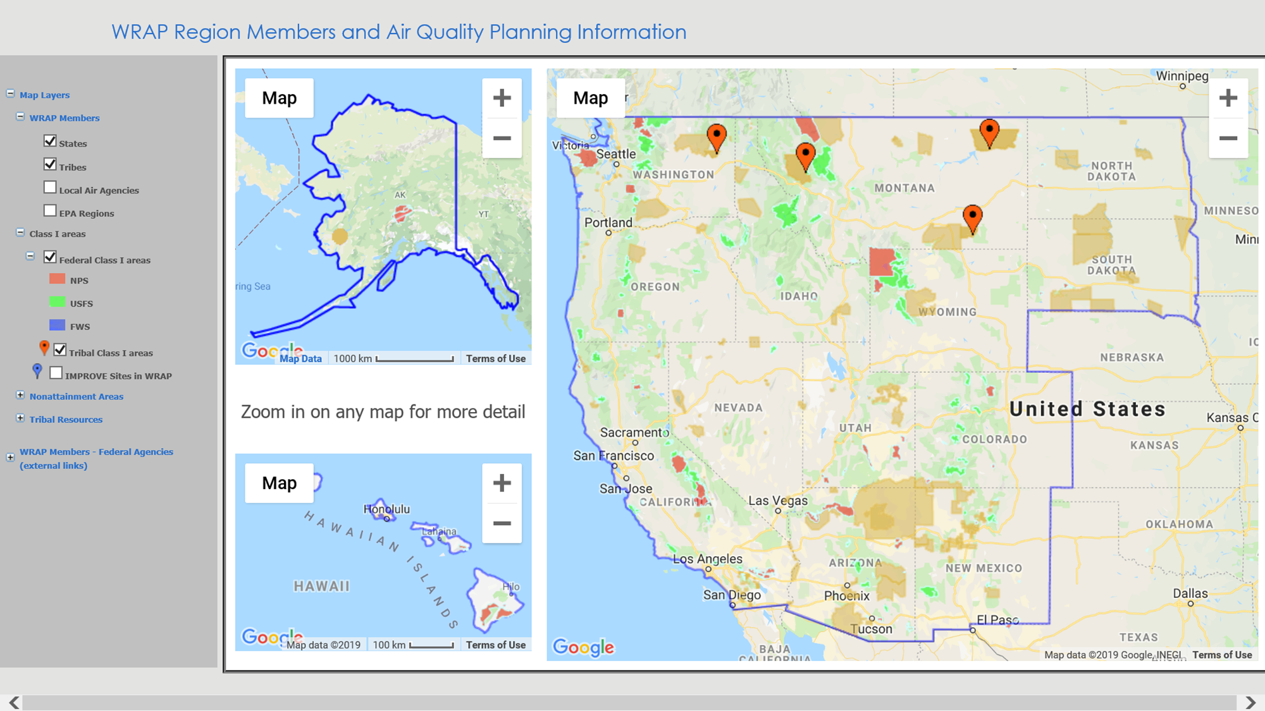
- 2021 Wildfire Impact Reports received as of Nov. 2021
Report from State of WA
Report from State of SD
Report from State of ID
Report from State of WY
Report from State of NV, Clark and Washoe Counties
Report from State of UT
Reports from State of CA, plus 8 air quality mgmt. districts

Slide 9
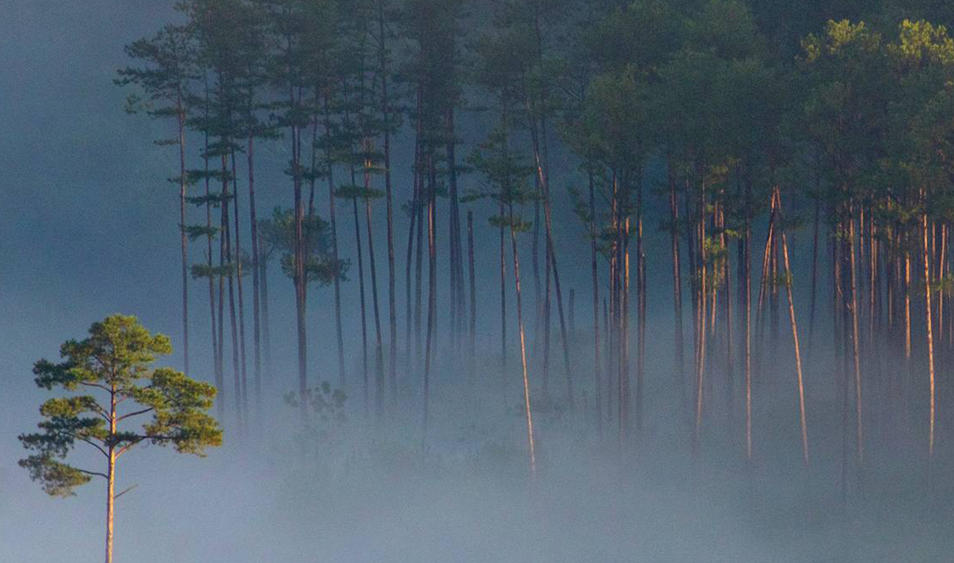
Thank you
Tom Moore
tmoore@westar.org
(970) 988-4055
Jay Baker
jbaker@westar.org
(435) 757-9868

